Slide 1
Microbiology
Chapter 1
History of Microbiology

Slide 2
The Early Years of Microbiology
What Does Life Really Look Like?
Antoni van Leeuwenhoek
Began making and using simple microscopes
Often made a new microscope for each specimen
Examined water and visualized tiny animals, fungi, algae, and single-celled protozoa; “animalcules”
By end of 19th century, these organisms were called microorganisms.

Slide 3
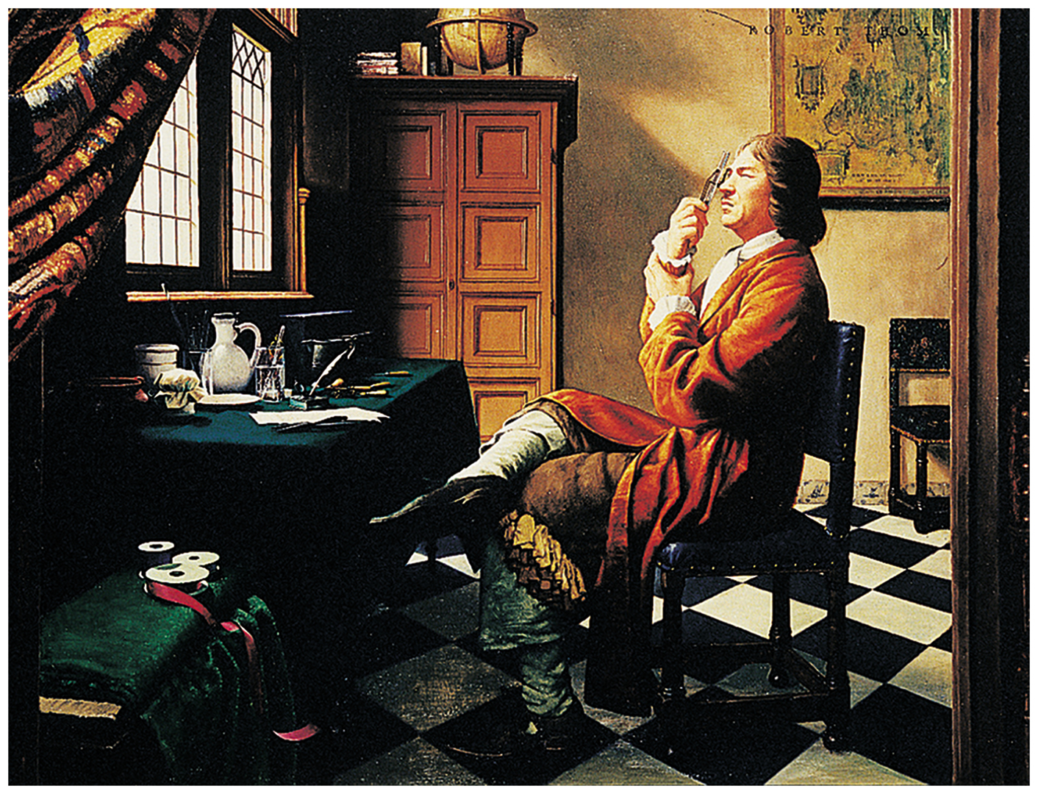
Figure 1.1 Antoni van Leeuwenhoek.
Notes:
3

Slide 4
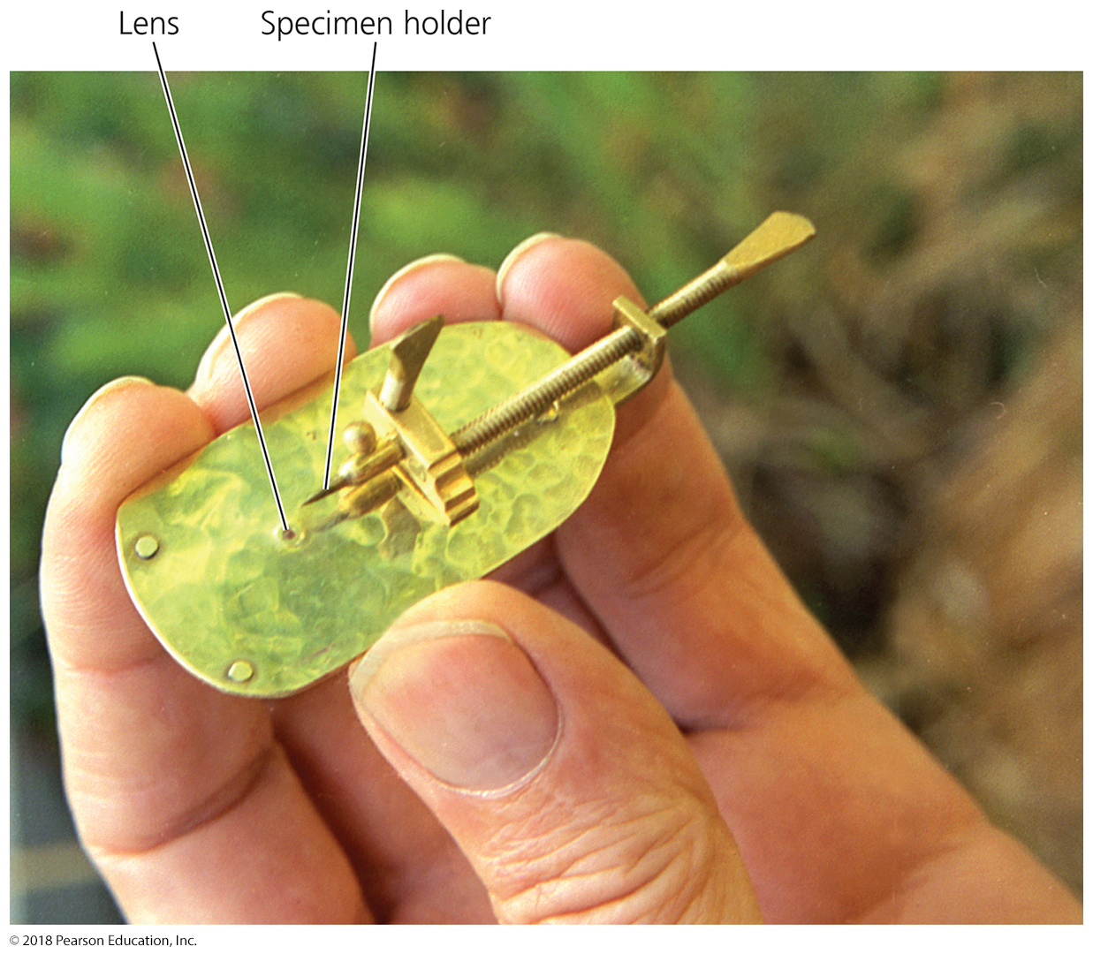
Figure 1.2 Reproduction of Leeuwenhoek’s microscope.
Notes:
4

Slide 5
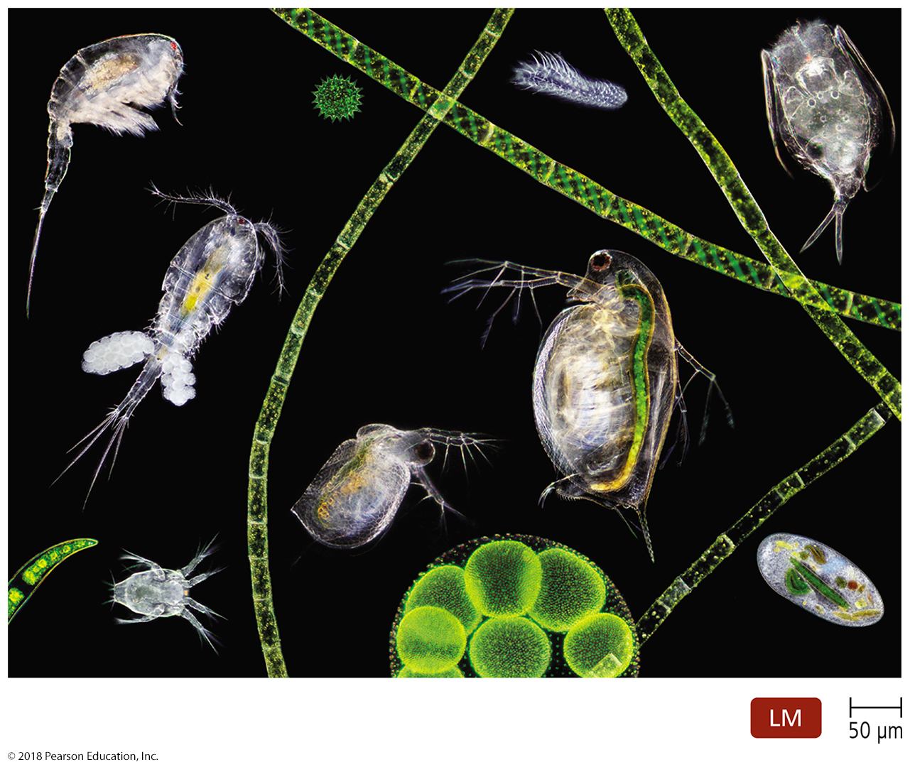
Figure 1.3 The microbial world.
Notes:
5

Slide 6
The Early Years of Microbiology
How Can Microbes Be Classified?
Carolus Linnaeus developed a taxonomic system for naming plants and animals and grouping similar organisms together.
Leeuwenhoek’s microorganisms can be grouped into six categories:
Bacteria
Archaea
Fungi
Protozoa
Algae
Small multicellular animals

Slide 7
The Early Years of Microbiology
How Can Microbes Be Classified?
Bacteria and Archaea
Unicellular and lack nuclei
Much smaller than eukaryotes
Found everywhere there is sufficient moisture; some isolated in extreme environments
Reproduce asexually
Bacterial cell walls contain peptidoglycan, though some lack cell walls.
Archaeal cell walls are composed of polymers rather than peptidoglycan.

Slide 8
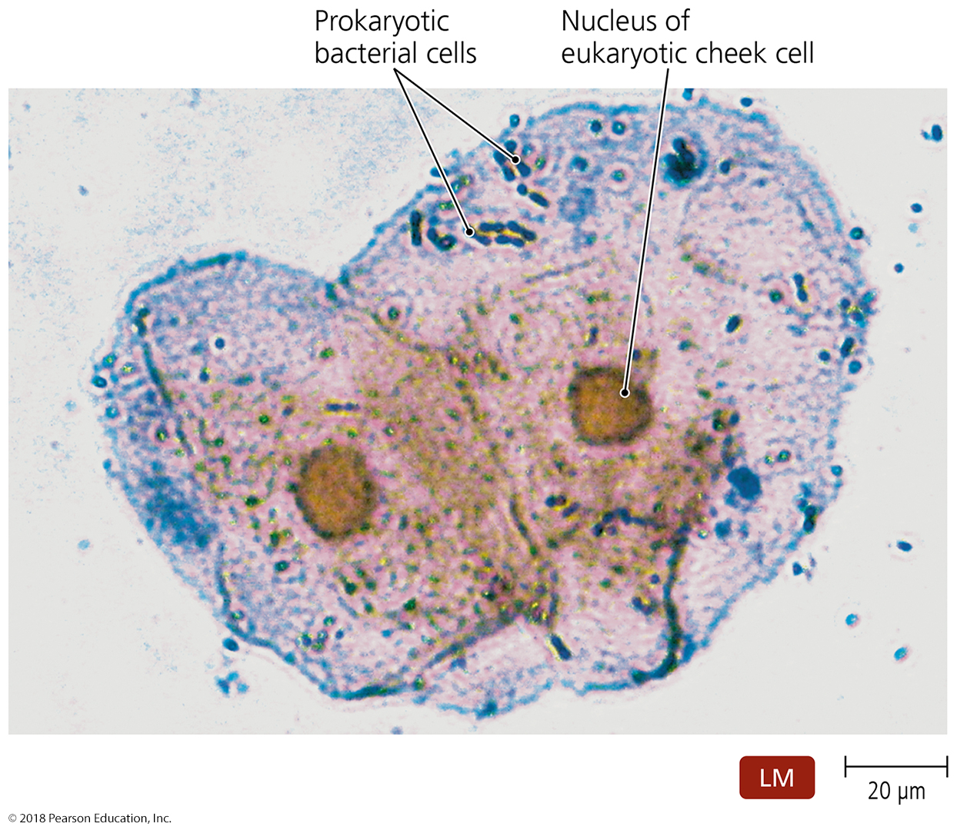
Figure 1.4 Cells of the bacterium Streptococcus (dark blue) and two human cheek cells.
Notes:
8

Slide 9
The Early Years of Microbiology
How Can Microbes Be Classified?
Fungi
Eukaryotic (have membrane-bound nucleus)
Obtain food from other organisms
Possess cell walls
Include:
Molds—multicellular; grow as long filaments; reproduce by sexual and asexual spores
Yeasts—unicellular; reproduce asexually by budding; some produce sexual spores

Slide 10
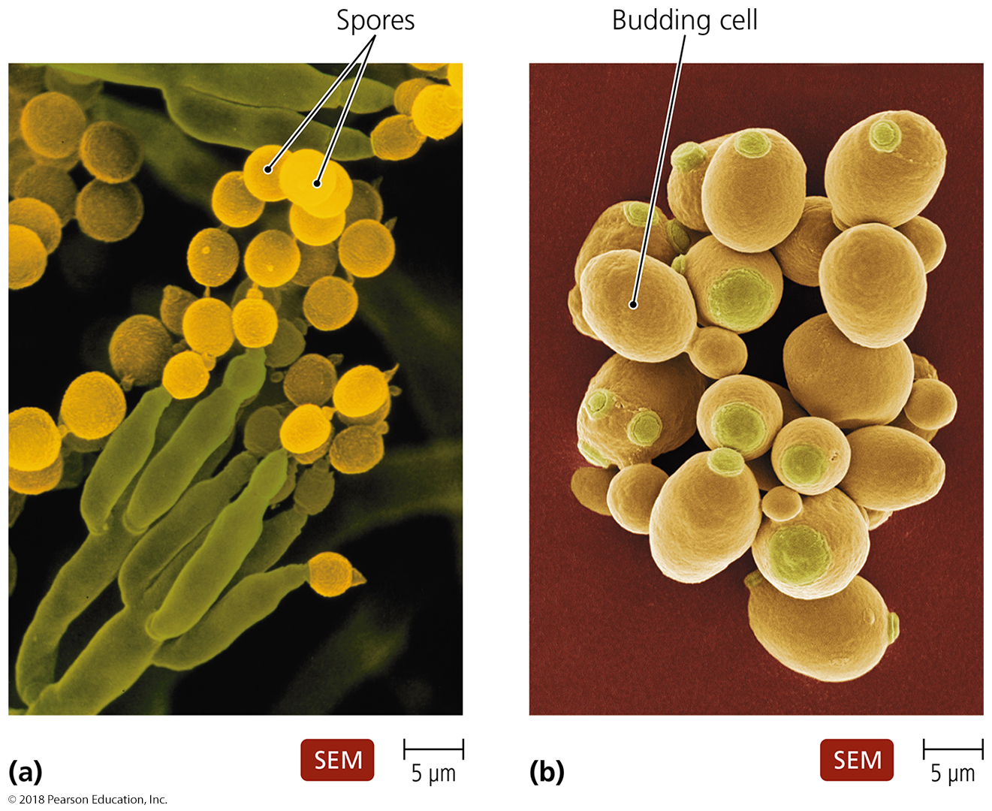
Figure 1.5 Fungi.
Notes:
10

Slide 11
The Early Years of Microbiology
How Can Microbes Be Classified?
Protozoa
Single-celled eukaryotes
Similar to animals in nutrient needs and cellular structure
Live freely in water; some live in animal hosts
Asexual (mostly) and sexual reproduction
Most are capable of locomotion by:
Pseudopods—cell extensions that flow in direction of travel
Cilia—numerous short protrusions that propel organisms through its environment
Flagella—extensions of a cell that are fewer, longer, and more whiplike than cilia

Slide 12
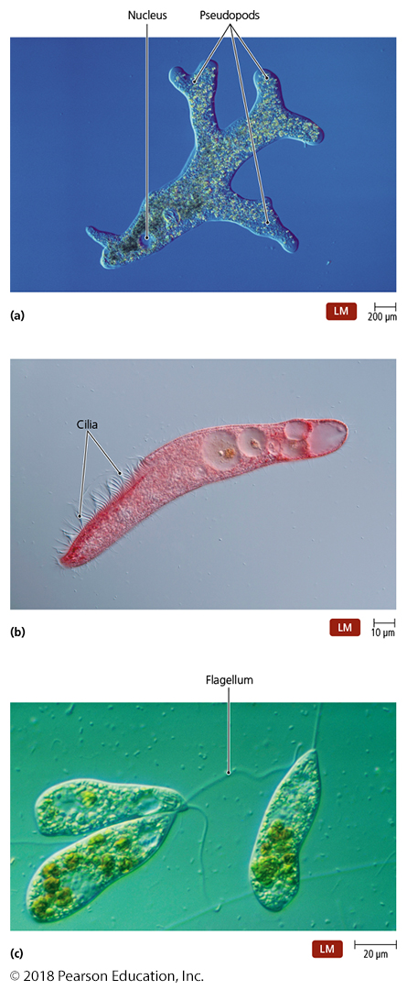
Figure 1.6 Locomotive structures of protozoa.
Notes:
12

Slide 13
The Early Years of Microbiology
How Can Microbes Be Classified?
Algae
Unicellular or multicellular
Photosynthetic
Simple reproductive structures
Categorized on the basis of pigmentation and composition of cell wall

Slide 14
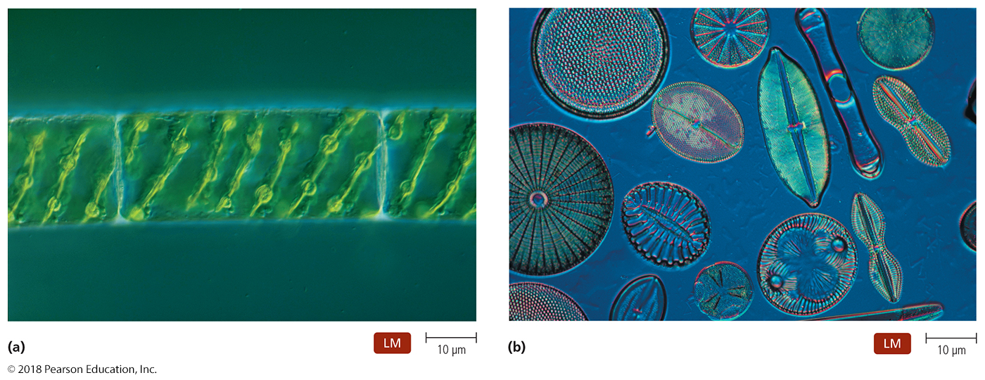
Figure 1.7 Algae.
Notes:
14

Slide 15
The Early Years of Microbiology
How Can Microbes Be Classified?
Other organisms of importance to microbiologists
Parasites
Viruses

Slide 16
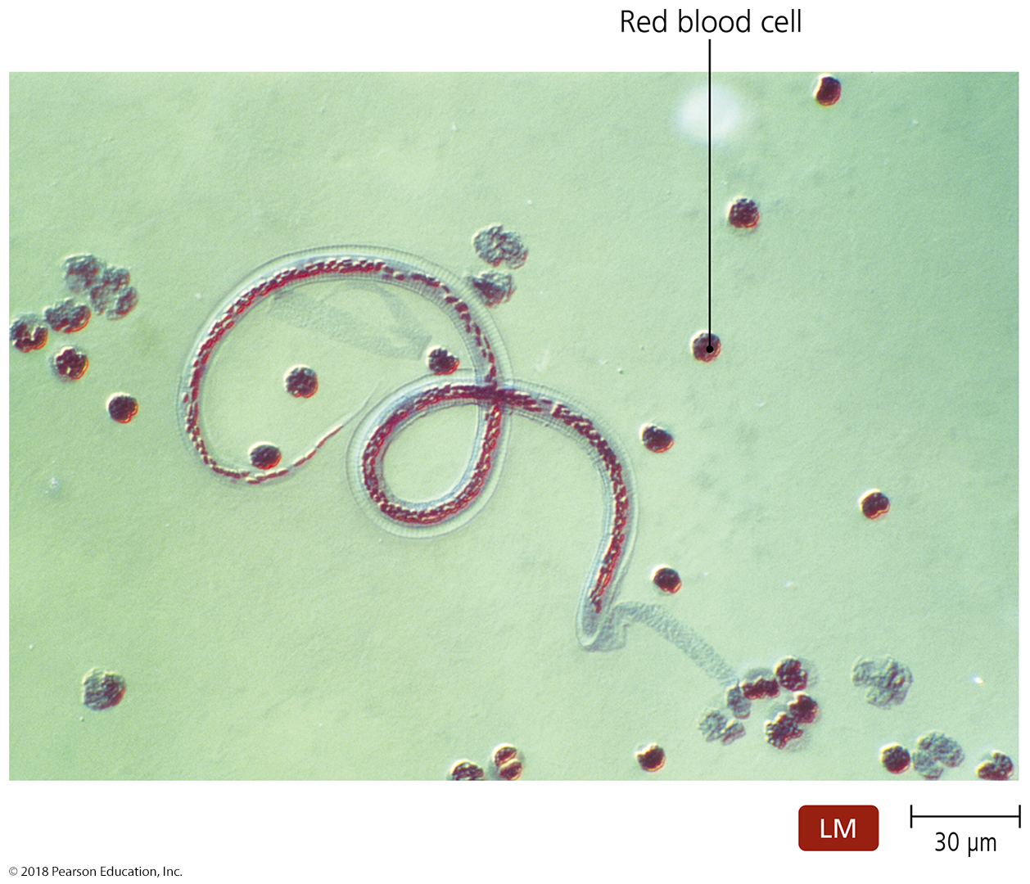
Figure 1.8 An immature stage of a parasitic worm in blood.
Notes:
16

Slide 17
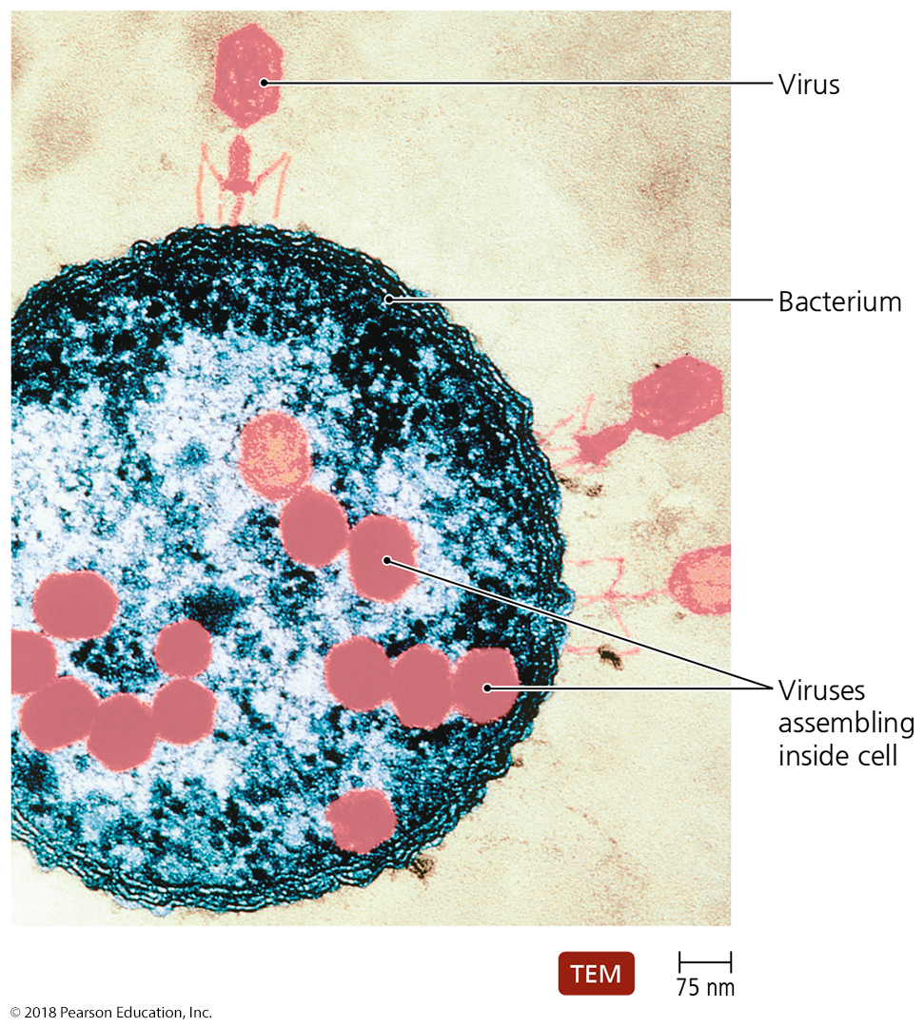
Figure 1.9 A colorized electron microscope image of viruses infecting a bacterium.
Notes:
17

Slide 18
The Golden Age of Microbiology
Scientists searched for answers to four questions:
Is spontaneous generation of microbial life possible?
What causes fermentation?
What causes disease?
How can we prevent infection and disease?

Slide 19
The Golden Age of Microbiology
Does Microbial Life Spontaneously Generate?
Some philosophers and scientists of the past thought living things arose from three processes:
Asexual reproduction
Sexual reproduction
Nonliving matter
Aristotle proposed spontaneous generation.
Living things can arise from nonliving matter.

Slide 20
The Golden Age of Microbiology
Does Microbial Life Spontaneously Generate?
Redi’s experiments
When decaying meat was kept isolated from flies, maggots never developed.
Meat exposed to flies was soon infested.
As a result, scientists began to doubt Aristotle’s theory.

Slide 21
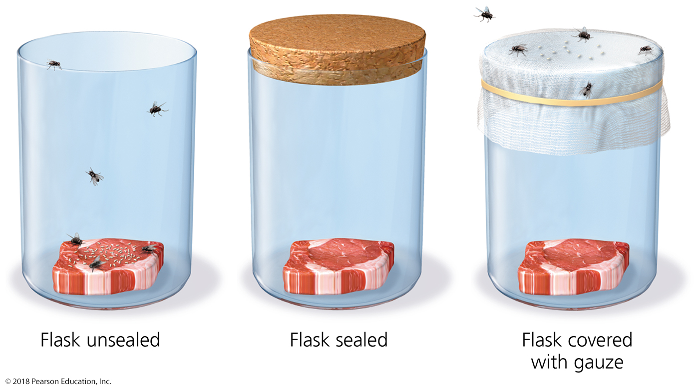
Figure 1.10 Redi’s experiments.
Notes:
21

Slide 22
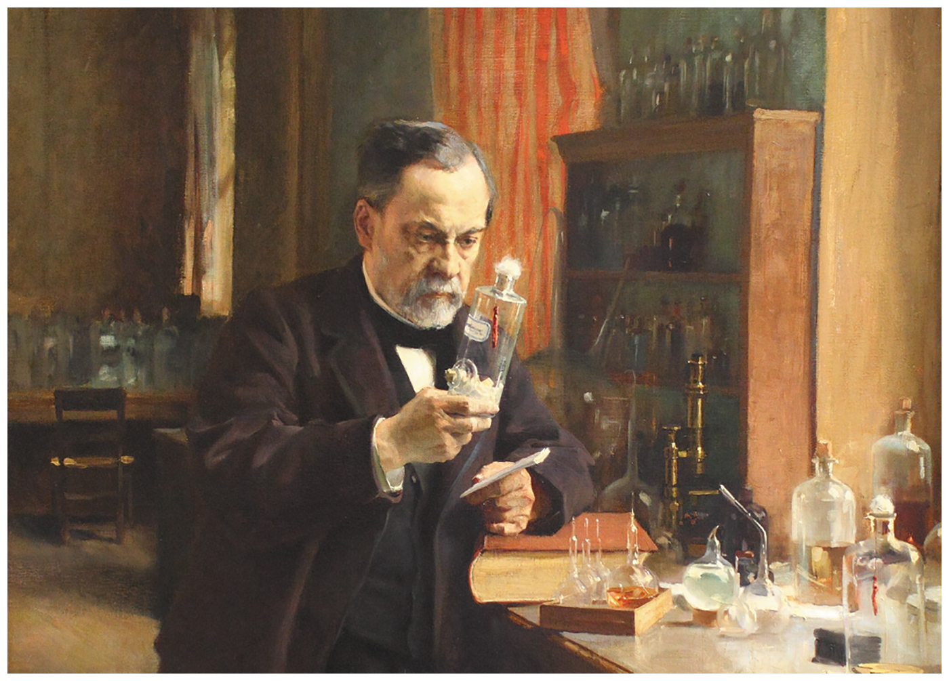
Figure 1.11 Louis Pasteur.
Notes:
22

Slide 23
The Golden Age of Microbiology
Does Microbial Life Spontaneously Generate?
Pasteur’s experiments
Performed experiments with “swan-necked” flasks
When the flasks remained upright, no microbial growth appeared.
When the flask was tilted, dust from the bend in the neck seeped back into the flask and made the infusion cloudy with microbes within a day.

Slide 24
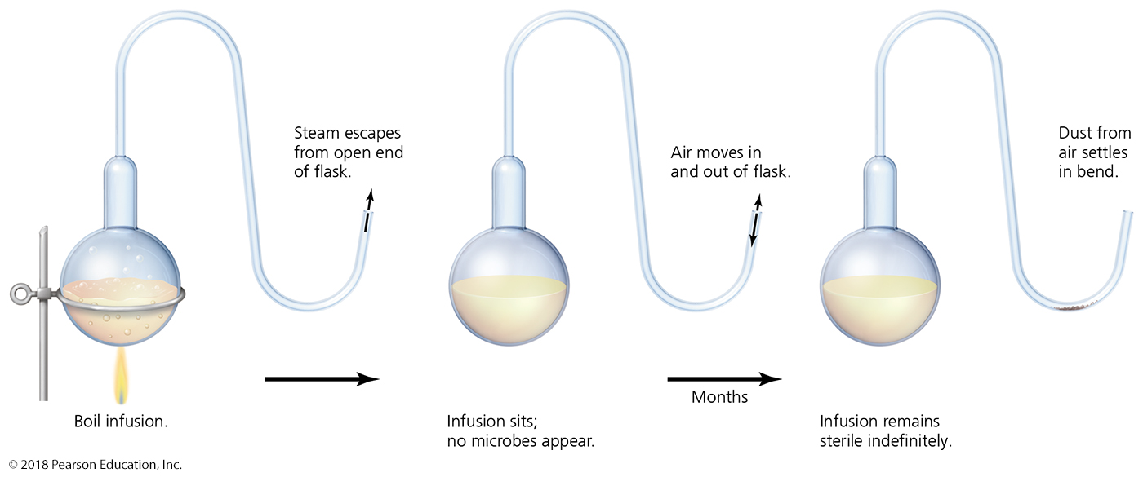
Figure 1.12 Pasteur’s experiments with “swan-necked flasks.”
Notes:
24

Slide 25
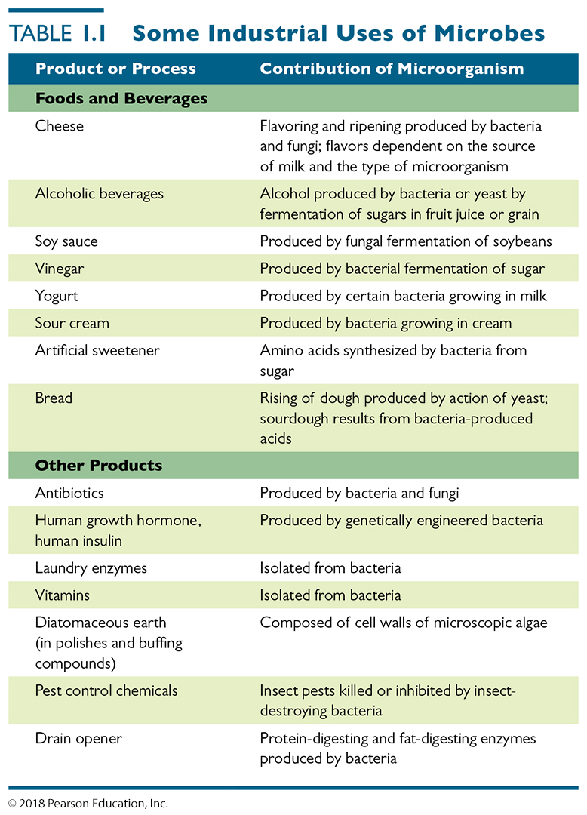
Table 1.1 Some Industrial Uses of Microbes
Notes:
25

Slide 26
The Golden Age of Microbiology
What Causes Disease?
Pasteur developed the germ theory of disease.
Some diseases caused by specific germs called pathogens

Slide 27
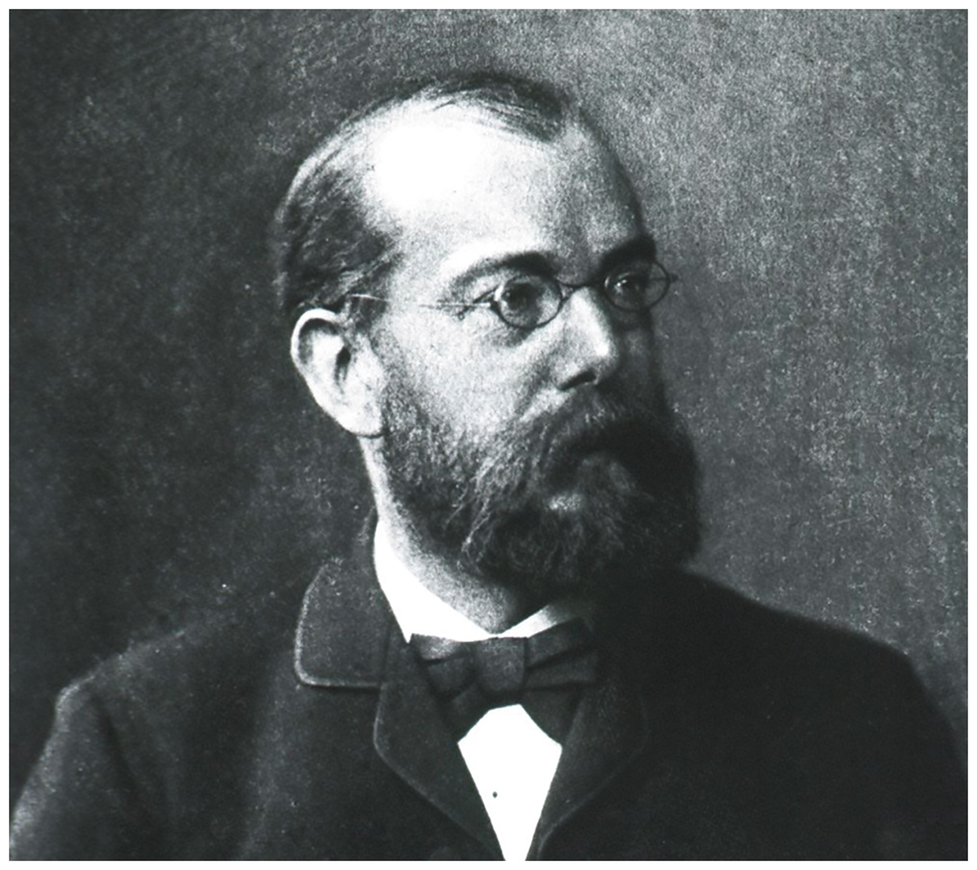
Figure 1.15 Robert Koch.
Notes:
27

Slide 28
The Golden Age of Microbiology
What Causes Disease?
Koch’s experiments
Robert Koch studied causative agents of disease (etiology).
Demonstrated a bacterium causes anthrax
Examined colonies of microorganisms

Slide 29
The Golden Age of Microbiology
What Causes Disease?
Koch’s experiments
Simple staining techniques
First photomicrograph of bacteria
First photograph of bacteria in diseased tissue
Techniques for estimating bacterial number in a solution
Use of steam to sterilize growth media
Use of Petri dishes
Laboratory techniques to transfer bacteria
Bacteria as distinct species

Slide 30
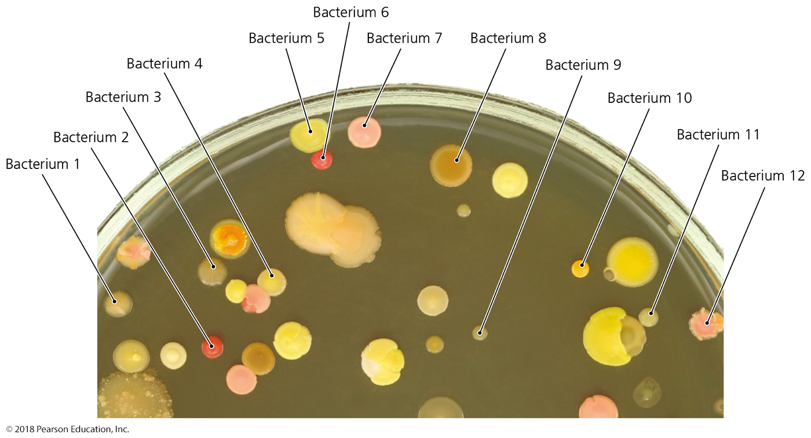
Figure 1.16 Bacterial colonies on a solid surface (agar).
Notes:
30

Slide 31
The Golden Age of Microbiology
What Causes Disease?
Koch’s postulates
Suspected causative agent must be found in every case of the disease and be absent from healthy hosts.
Agent must be isolated and grown outside the host.
When agent is introduced to a healthy, susceptible host, the host must get the disease.
Same agent must be found in the diseased experimental host.

Slide 32
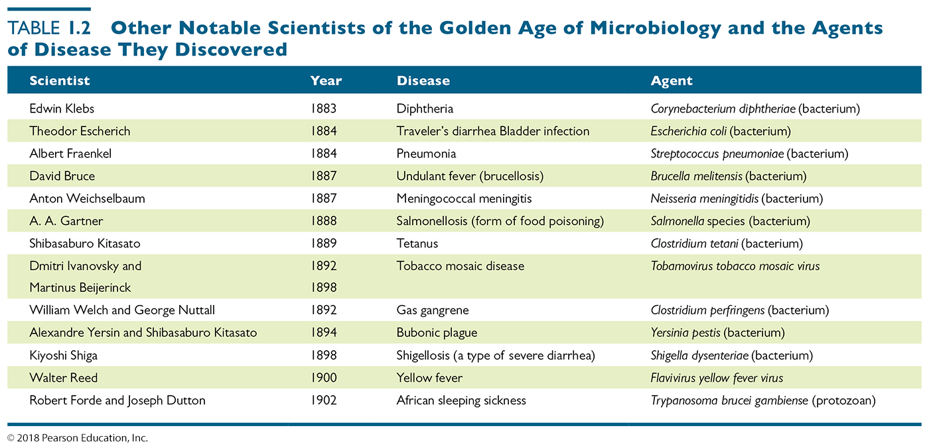
Table 1.2 Other Notable Scientists of the “Golden Age of Microbiology” and the Agents of Disease They Discovered
Notes:
32

Slide 33
The Golden Age of Microbiology
What Causes Disease?
Gram’s stain
The most widely used staining technique
One of the first steps to identify a bacterium

Slide 34
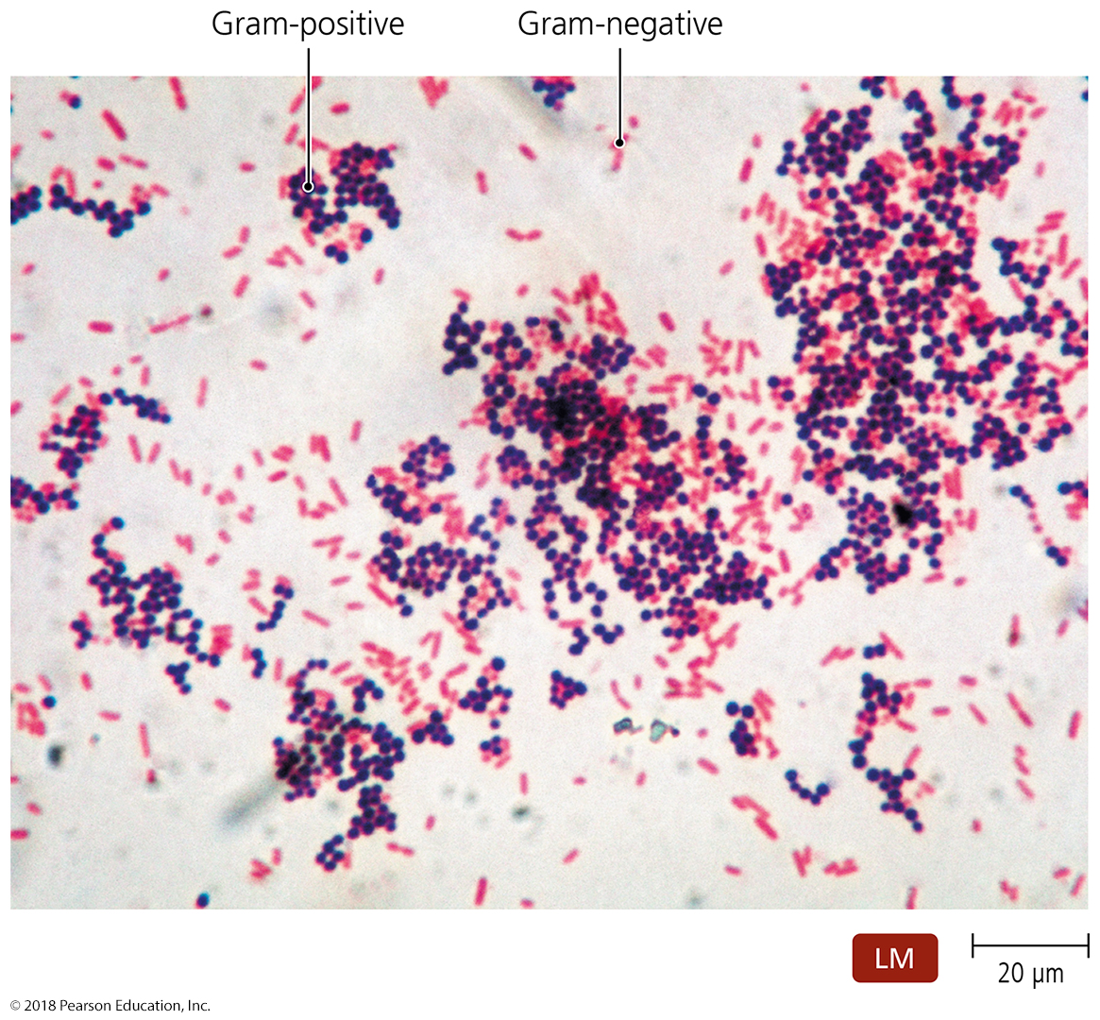
Figure 1.17 Results of Gram staining.
Notes:
34

Slide 35
The Golden Age of Microbiology
How Can We Prevent Infection and Disease?
Semmelweis and handwashing
Lister’s antiseptic technique
Nightingale and nursing
Snow—infection control and epidemiology
Jenner’s vaccine—field of immunology
Ehrlich’s “magic bullets”—field of chemotherapy

Slide 36
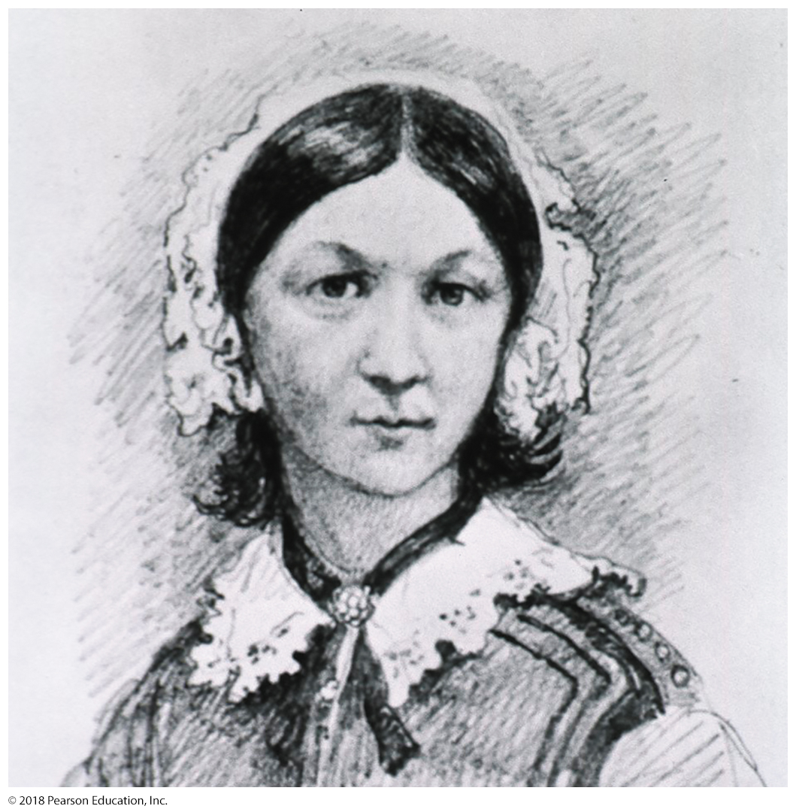
Figure 1.18 Florence Nightingale.
Notes:
36

Slide 37
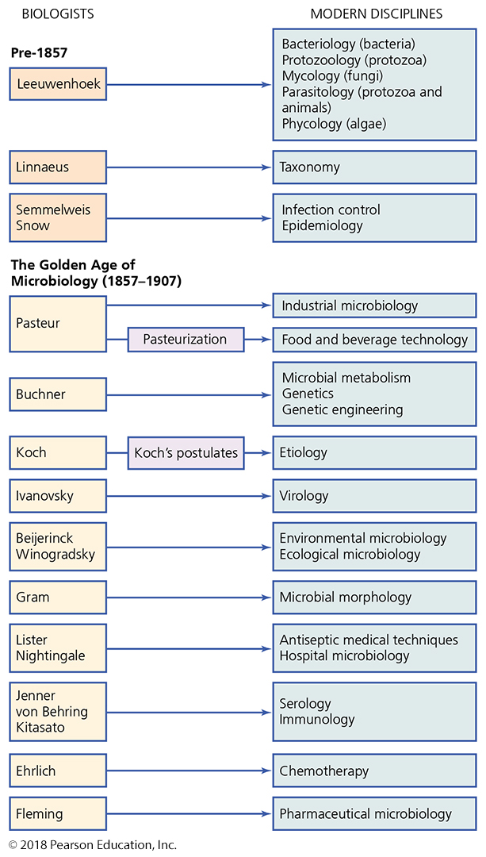
Figure 1.19 Some of the many scientific disciplines and applications that arose from the pioneering work of scientists just before and around the time of the Golden Age of Microbiology.
Notes:
37

Slide 38
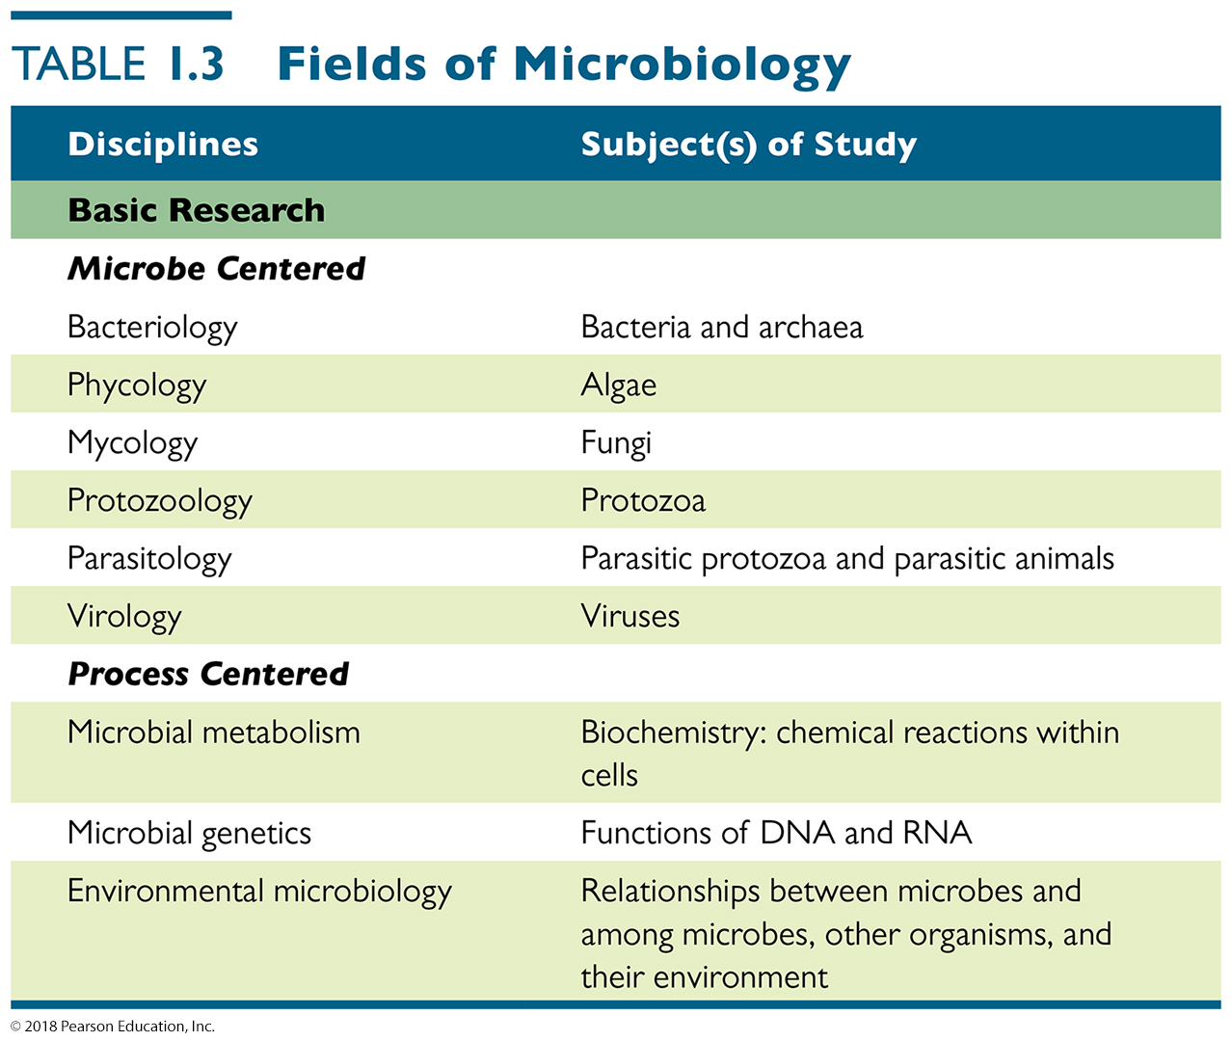
Table 1.3 Fields of Microbiology (1 of 2)
Notes:
38

Slide 39
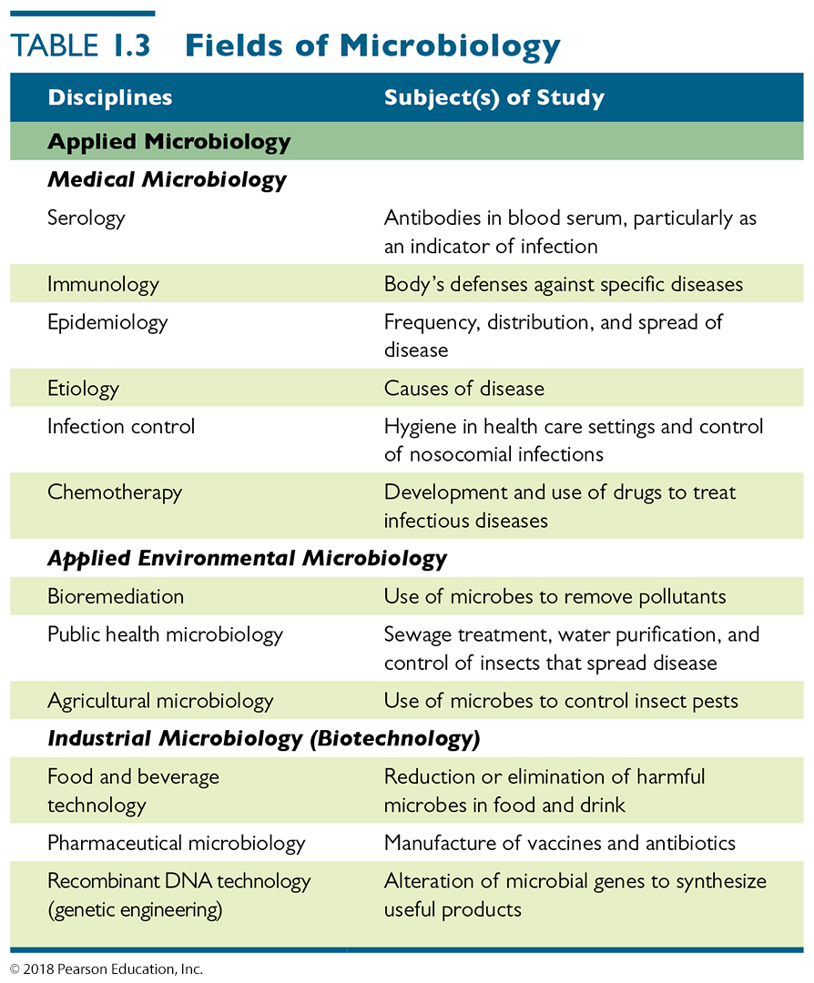
Table 1.3 Fields of Microbiology (2 of 2)
Notes:
39

Slide 40
The Modern Age of Microbiology
What Are the Basic Chemical Reactions of Life?
Biochemistry
Practical applications:
Design of herbicides and pesticides
Diagnosis of illnesses and monitoring of patients’ responses to treatment
Treatment of metabolic diseases
Drug design

Slide 41
The Modern Age of Microbiology
How Do Genes Work?
Microbial genetics
Molecular biology
Recombinant DNA technology
Gene therapy

Slide 42
The Modern Age of Microbiology
How Do Genes Work?
Microbial genetics
Avery, MacLeod, and McCarty determined genes are contained in molecules of DNA.
Beadle and Tatum established that a gene’s activity is related to protein function.
Translation of genetic information into protein explained
Rates and mechanisms of genetic mutation investigated
Identify methods cells use to control genetic expression

Slide 43
The Modern Age of Microbiology
How Do Genes Work?
Recombinant DNA technology
Genes in microbes, plants, and animals manipulated for practical applications
Production of human blood-clotting factor by E. coli to aid hemophiliacs
Gene therapy
Inserting a missing gene or repairing a defective one in humans by inserting desired gene into host cells

Slide 44
The Modern Age of Microbiology
What Role Do Microorganisms Play in the Environment?
Bioremediation uses living bacteria, fungi, and algae to detoxify polluted environments.
Recycling of chemicals such as carbon, nitrogen, and sulfur
Causation of disease

Slide 45
The Modern Age of Microbiology
How Do We Defend Against Disease?
Serology
The study of blood serum
Von Behring and Kitasato—existence in the blood of chemicals and cells that fight infection
Immunology
The study of the body’s defenses against specific pathogens
Chemotherapy
Fleming discovered penicillin.
Domagk discovered sulfa drugs.

Slide 46
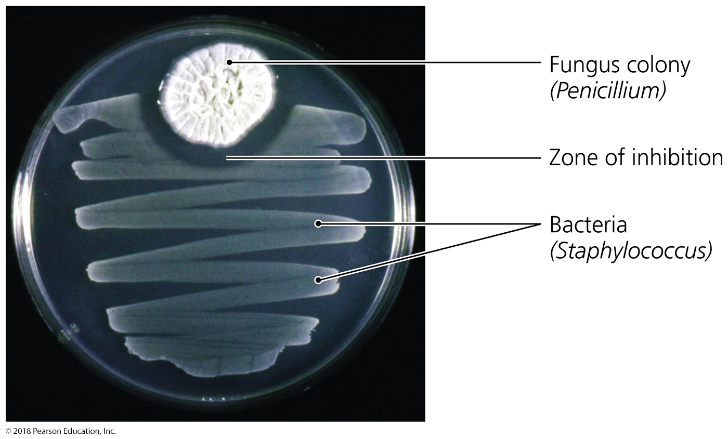
Figure 1.20 The effects of penicillin on a bacterial “lawn” in a Petri dish.
Notes:
46

