Slide 1
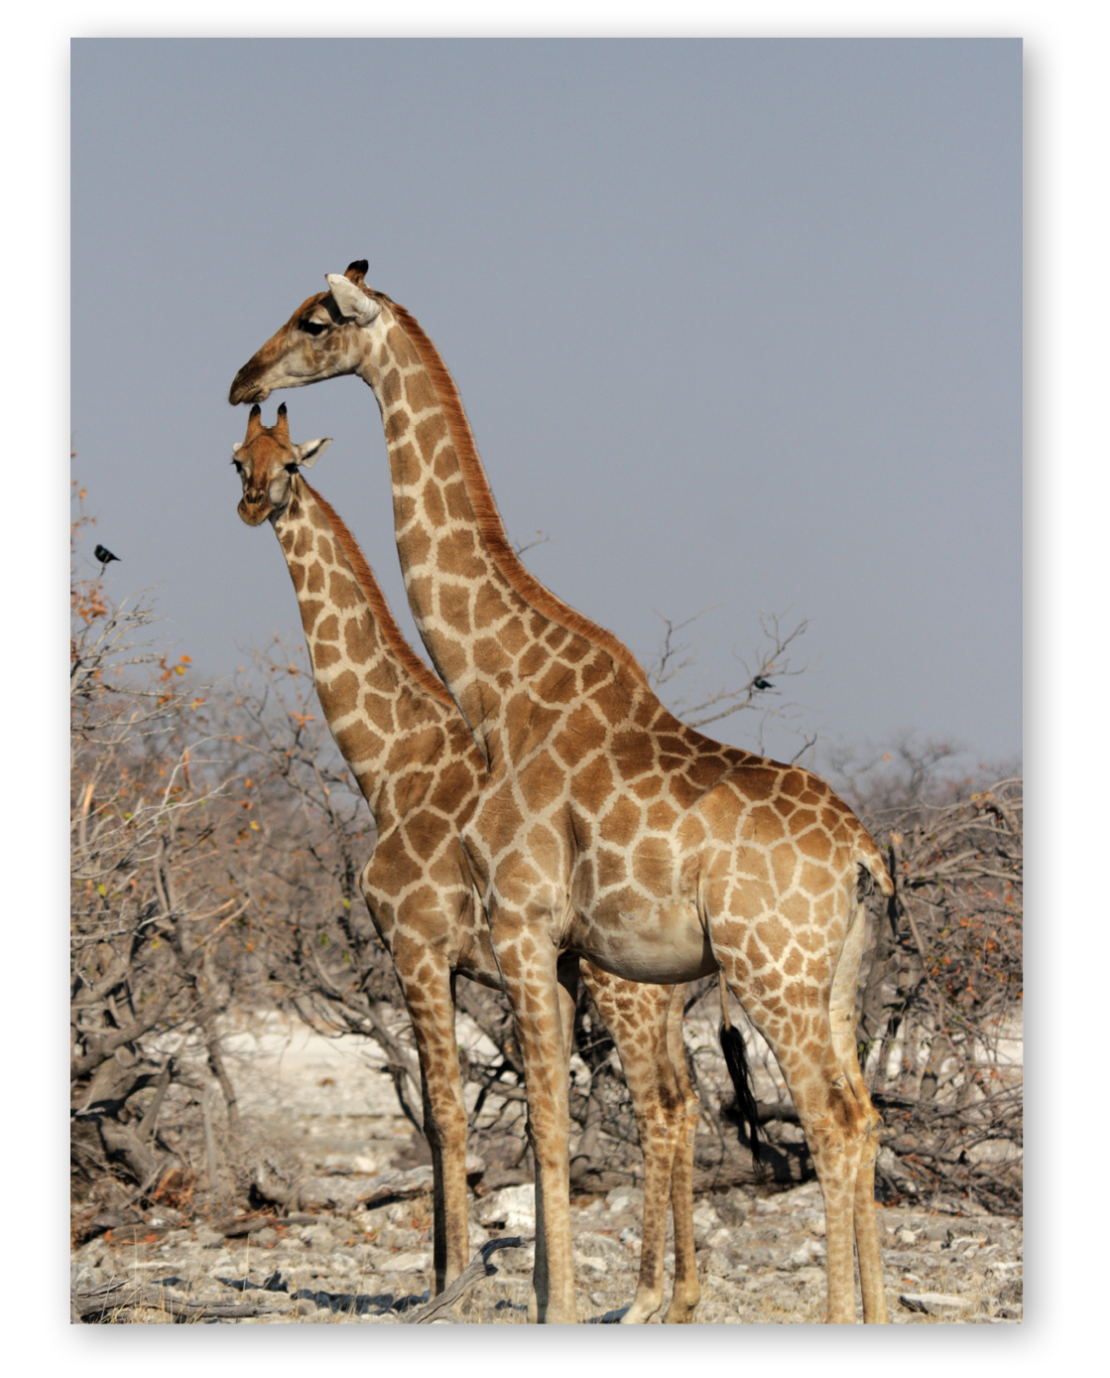
Chapter 13 The origin of species

Slide 2
Species are independently evolving lineages
General lineage species concept: species are metapopulations that exchange alleles frequently enough to comprise the same gene pool

Slide 3
Phenetic characters
Make sure you can distinguish between defining a species by phenetic characters and recognizing species according to phenetic characters.
The distinction between "definition" and "recognition" is similar to the distinction between the formal description of a species and the diagnosis of a species.

Slide 4
Phenetic characters are all the observable or measureable characters of an organism, including microscopic and physiological. Pretty much interchangeable with “morphological”.

Slide 5
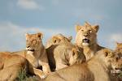
The distinction is between features which are essential, in principle, and those which are useful, in practice. It is a distinction between an explanation of what a species ought to be and a description of what a species happens to be.

Slide 6
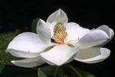
Formal definition is the description of a species, using phenetic characters
i.e. describe the difference between a rose, gardenia and a magnolia

Slide 7
Example
Size, Proportion, Substance The desired height for males at the top of the highest point of the shoulder blade is 24 to 26 inches; and for bitches, 22 to 24 inches.
The Dog is longer than tall, with the most desirable proportion as 10 to 8½.

Slide 8
Head The head is noble, cleanly chiseled, strong without coarseness, but above all not fine, and in proportion to the body. The head of the male is distinctly masculine, and that of the bitch distinctly feminine.
The expression keen, intelligent and composed.

Slide 9
Neck, Topline, Body The neck is strong and muscular, clean-cut and relatively long, proportionate in size to the head and without loose folds of skin. When the dog is at attention or excited, the head is raised and the neck carried high.
Tail bushy, with the last vertebra extended at least to the hock joint.

Slide 10
Ideal??

Slide 11
Some species concepts define species at a point in time; others define species through evolutionary time
Non-temporal species concepts
Phenetic species (definition based on clustering of physical characters)
Typological species (definition based on similarity to a type specimen or ideal type)
Reproductive species (definition based on reproductive isolation)
Ecological species (definition based on niche)

Slide 12
Temporal species concept
Cladistic species (definition based on segment of phylogenetic tree)
Evolutionary species concept (definition based on vague "tendencies")

Slide 13
The phenetic species concept
Phenetic species are defined as as populations distinguished by discrete clusters of phenotypic characters.
The phenetic species concept resembles the practical criteria commonly used to describe species. A population can be defined as a species by a group of phenetic characters sufficient to distinguish it from other populations.

Slide 14
Other ways to identify species
Biological species concept: species are groups of interbreeding populations that are reproductively isolated from other such groups
Phylogenetic species concept: smallest possible group descending from a common ancestor and recognizable by unique, derived traits

Slide 15
"The biological species concept"
Ernst Mayr's Biological Species Concept (BSC) defines species as "groups of interbreeding natural populations that are reproductively isolated from other such groups" is the most widely accepted definition for species.
Most discussion of speciation has been based on this species concept.
That is, most hypotheses concern mechanisms which establish reproductive isolation.
In the BSC, species are unified by gene flow within a common gene pool; gene flow involves migration and interbreeding.

Slide 16
Interbreeding between species is prevented by isolating mechanisms
isolating mechanisms serve to prevent interbreeding and thereby establish reproductive isolation of populations.
Isolating mechanisms can be categorized as either premating (prezygotic) or postmating (postzygotic).

Slide 17
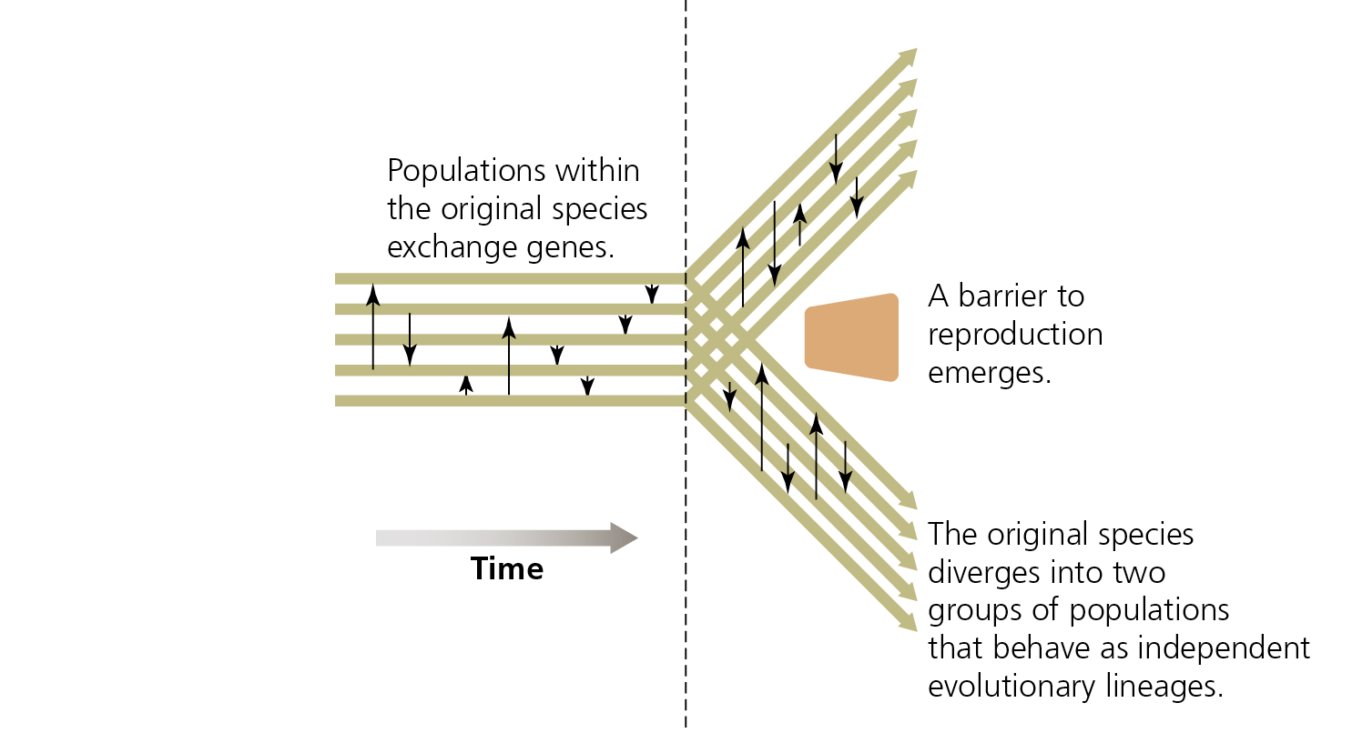
Speciation involves barriers to reproduction

Slide 18
Isolating barriers
Premating isolating mechanisms prevent potential mates from two separate populations from getting together.
The most basic of premechanisms involve one or another variation on allopatry (geographic separation, habitat separation, seasonal or temporal separation).
More complicated premating mechanisms involve behavior, biomechanics, or gamete interaction to prevent gametes from coming together.

Slide 19
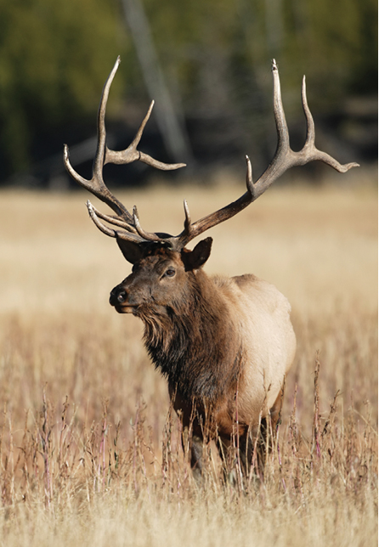
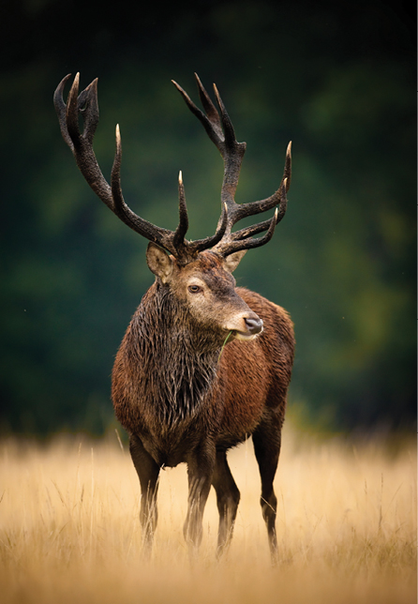
Elk and red deer: two species?

Slide 20
Premating mechanisms
geographic separation
populations are geographically separated
(e.g. islands)
habitat separation
Populations occur in different habitats in the same general region
(e.g. mangroves)
seasonal or temporal separation
Mating or flowering occur in different seasons
Separation of photosynthesis and nitrogen fixing

Slide 21
Geographical variation
A cline is a type of geographical variation
Cline is the gradual change in the species’ phenotype and genotype frequencies through a series of geographically separate populations (ex: ring species)

Slide 22
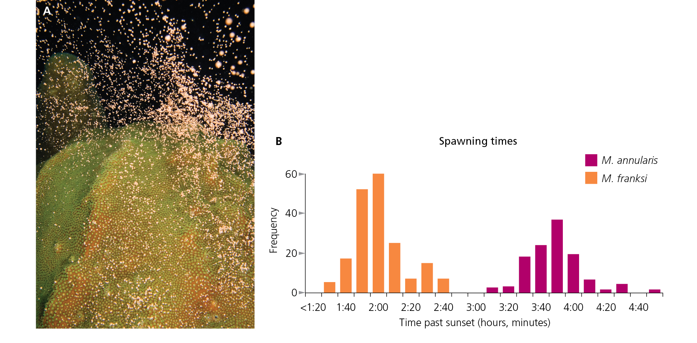
Premating barriers: timing of reproduction

Slide 23
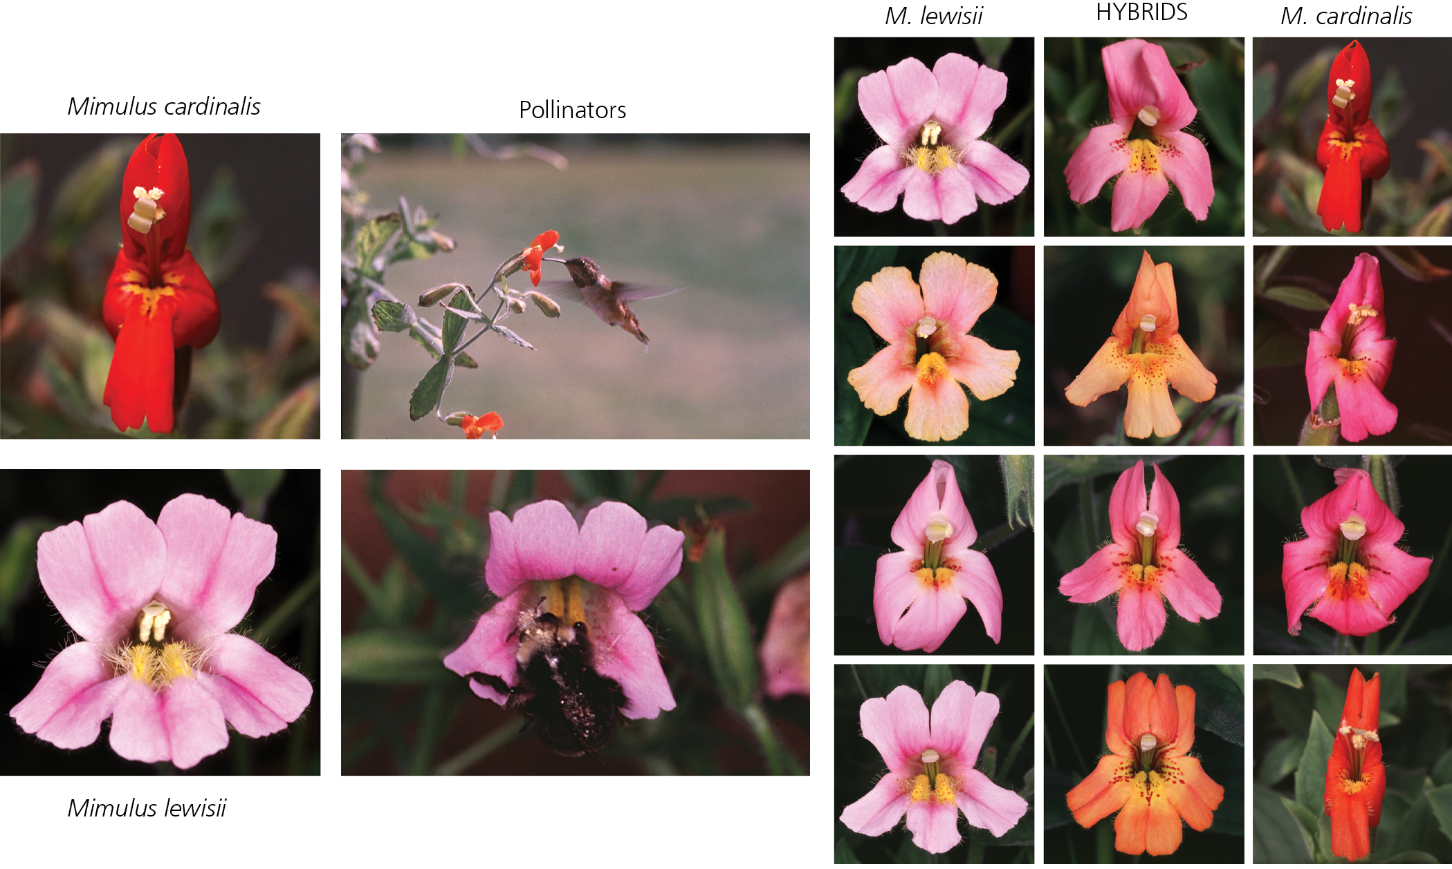
Premating barriers: pollinator isolation

Slide 24
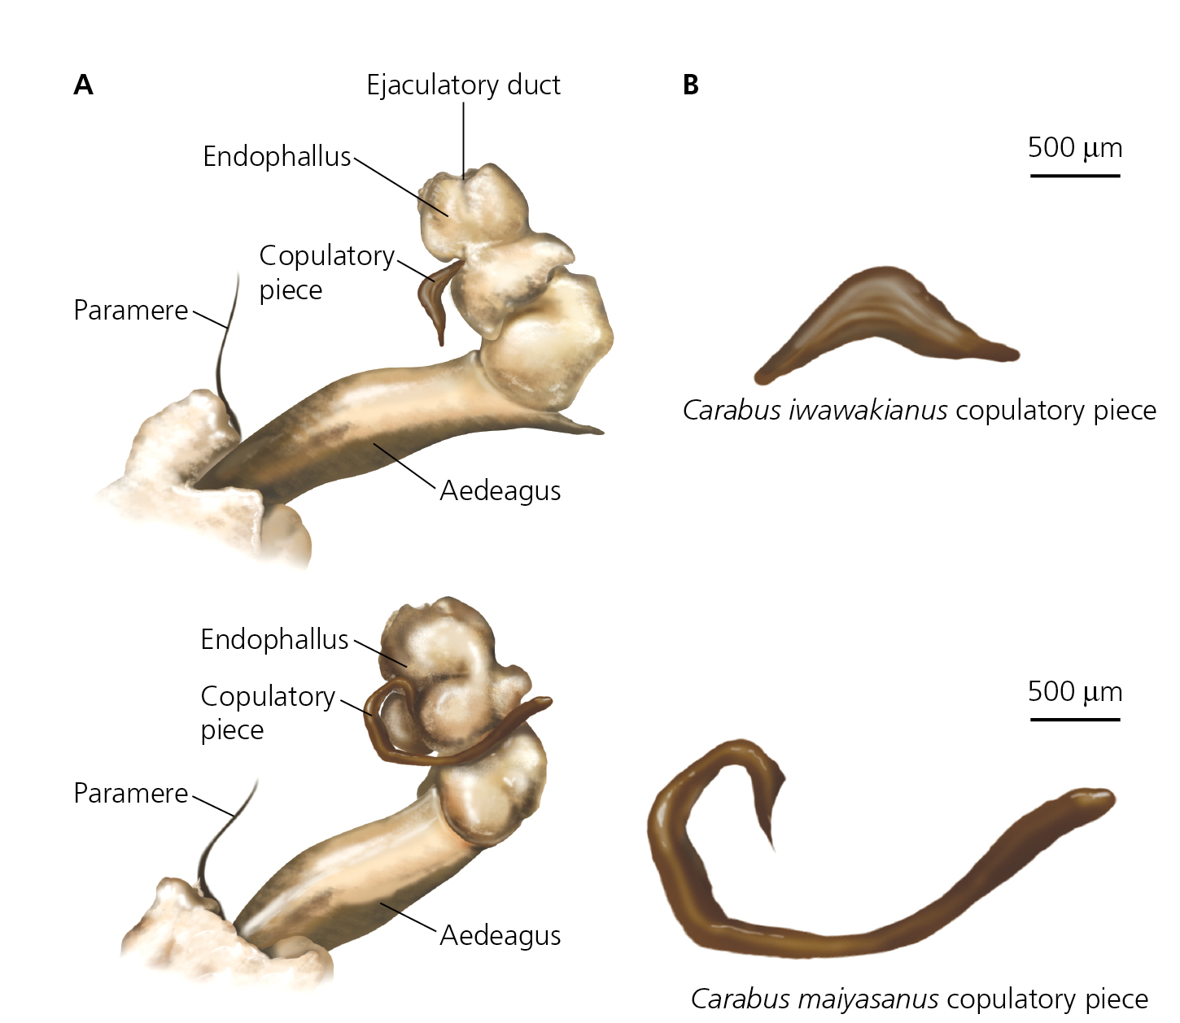
Premating barriers: mismatched morphology

Slide 25
Postmating-prezygotic barriers
Gametic incompatibility: sperm or pollen from one species fails to penetrate and fertilize the egg of another species

Slide 26
Postmating isolating mechanisms involve some form of genetic incompatibility, such as reduced viability or reduced fertility of hybrid individuals.
Haldane's rule notes that in species with genetic sex determination, reduced viability or fertility is much more common in the heterogametic sex (e.g., the sex that produces different gametes, the XY sex; in mammals the heterogametic sex is male, in birds it is females).
Postmating isolating mechanisms comprise a selection pressure that favors premating mechanisms, to minimize the production of less-fit offspring.

Slide 27
Postzygotic barriers
Hybrids are produced but have low fitness
Hybrid inviability
Hybrid sterility
Ecological inviability
Behavioral sterility

Slide 28
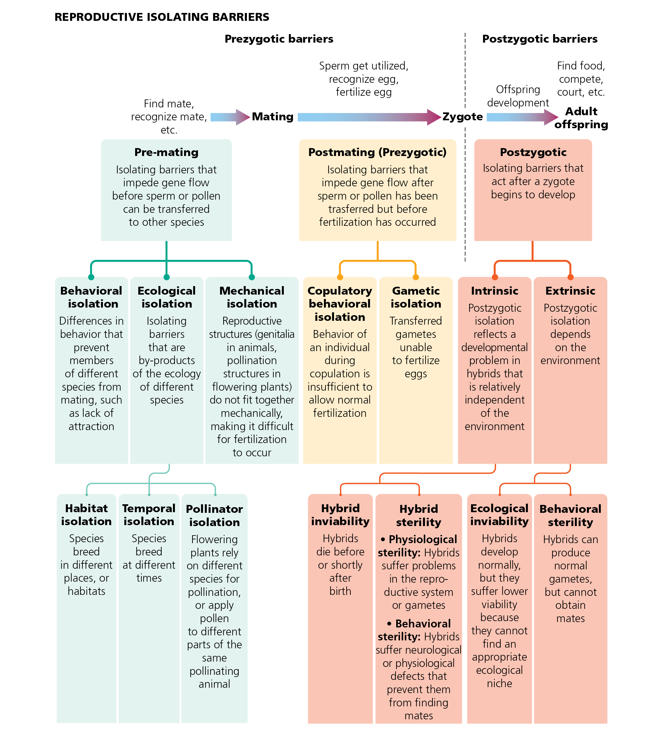

Slide 29
Recognition species concept
The recognition species concept places emphasis not on reproductive isolation per se but on mechanisms for recognizing suitable mates.
In this concept, a species is defined by mutual recognition of suitable mates among the members of a population.
Specific mate recognition system is the term given to a method of recognizing mates that is shared by all the members of a population.
In this concept, mate recognition is causal for the origin of species, while reproductive isolation is a secondary consequence of mate recognition.
The recognition species concept is thus associated with a more specific hypothesis concerning speciation than is the more general biological species concept.

Slide 30
Ecological species concept
The ecological species concept places on emphasis on niche or adaptive zone rather than reproductive isolation.
This concept draws support from two phenomena.
In the phenomenon called competitive exclusion, two or more species cannot occupy the same niche. Either one will be better and beat out the other one in competition, or (in the unlikely event that they are exactly equal) chance drift in relative population size will eventually eliminate one or the other.
In the phenomenon called character displacement, similar species which share a common resource will diverge from one another. This effectively divides the shared niche and reduces competition.

Slide 31
A pluralistic species concept"
Whether or not a pluralistic species concept is the best choice is related to the question of how many different ways there are for speciation to occur.
If species can form by adaptive splitting within a population, and by specific mate recognition systems, and by incidental reproductive isolation (i.e., allopatry), and by reorganization of genomic architecture, then a pluralistic concept might be appropriate.
But a pluralistic concept raises the question, is there anything essentially the same in the various accounts? If so, shouldn't that "essence" define species? And, if not, is the concept of species meaningful?

Slide 32
Causes of Speciation
1. Geographic Isolation
Scientists think that geographic isolation is a common way for the process of speciation to begin: rivers change course, mountains rise, continents drift, organisms migrate, and what was once a continuous population is divided into two or more smaller populations.

Slide 33
It doesn’t even need to be a physical barrier like a river that separates two or more groups of organisms—it might just be unfavorable habitat between the two populations that keeps them from mating with one another.

Slide 34
2. Reduction of Gene Flow
However, speciation might also happen in a population with no specific extrinsic barrier to gene flow. Imagine a situation in which a population extends over a broad geographic range, and mating throughout the population is not random. Individuals in the far west would have zero chance of mating with individuals in the far eastern end of the range. So we have reduced gene flow, but not total isolation.

Slide 36
Modes of Speciation
The key to speciation is the evolution of genetic differences between the incipient species.
For a lineage to split once and for all, the two incipient species must have genetic differences that are expressed in some way that causes matings between them to either not happen or to be unsuccessful.
These need not be huge genetic differences. A small change in the timing, location, or rituals of mating could be enough. But still, some difference is necessary. This change might evolve by natural selection or genetic drift.

Slide 37
Allopatric Speciation: The Great Divide
(allo = other, patric = place)
Allopatric speciation is just a fancy name for speciation by geographic isolation.

Slide 38
Allopatric Speciation
In this mode of speciation, something extrinsic to the organisms prevents two or more groups from mating with each other regularly, eventually causing that lineage to speciate. Isolation might occur because of great distance or a physical barrier, such as a desert or river.

Slide 39
Allopatric speciation can occur even if the barrier is a little “porous,” that is, even if a few individuals can cross the barrier to mate with members of the other group.
In order for a speciation even to be considered “allopatric,” gene flow between the soon-to-be species must be greatly reduced—but it doesn’t have to be reduced completely to zero.

Slide 40
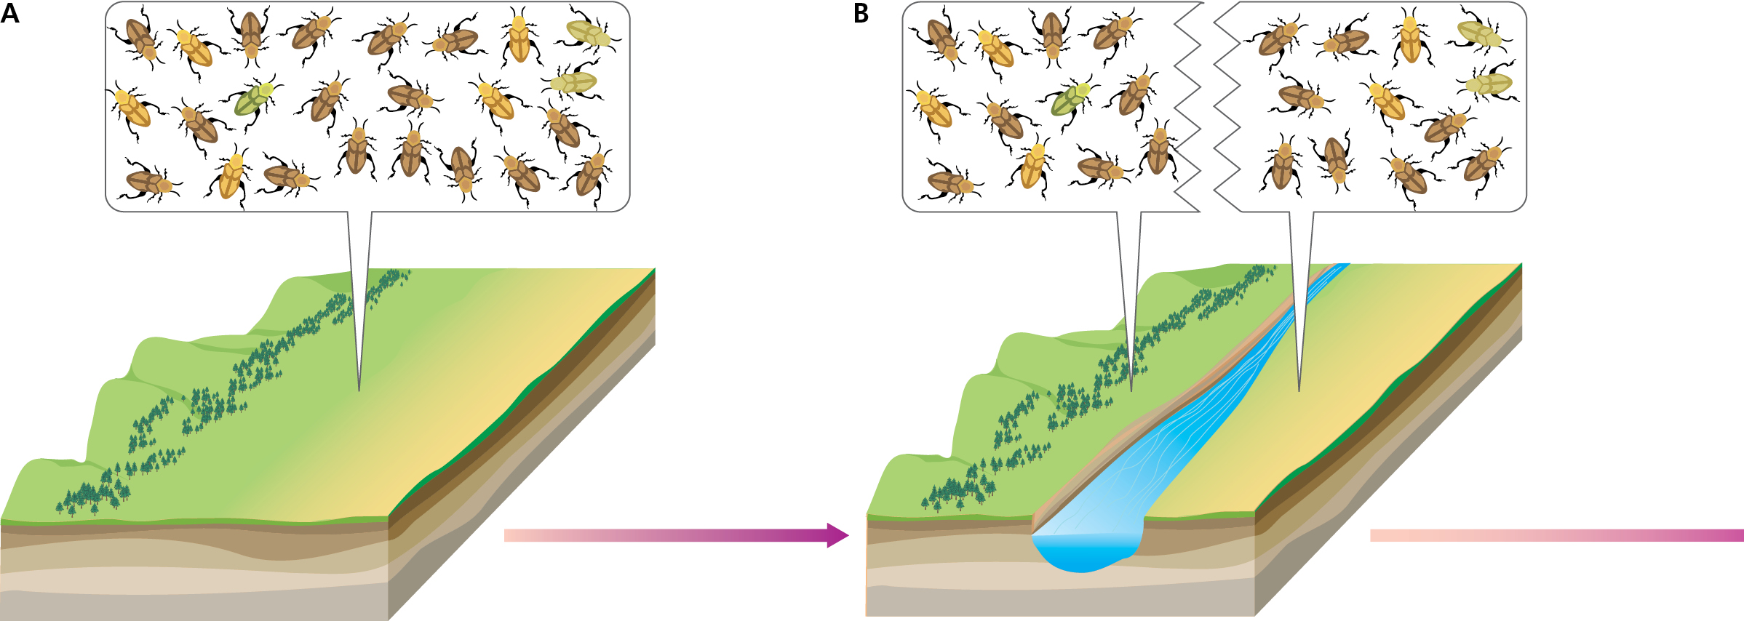
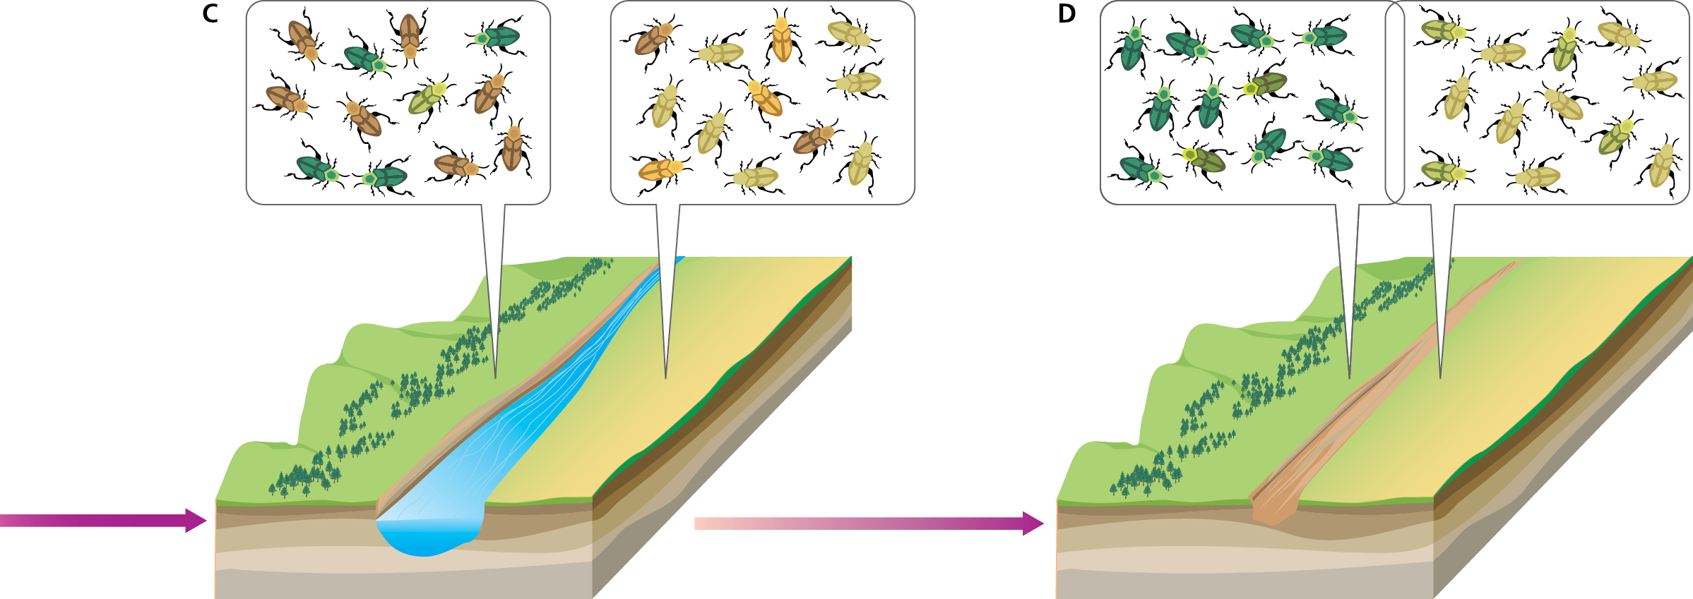
Allopatric speciation

Slide 41
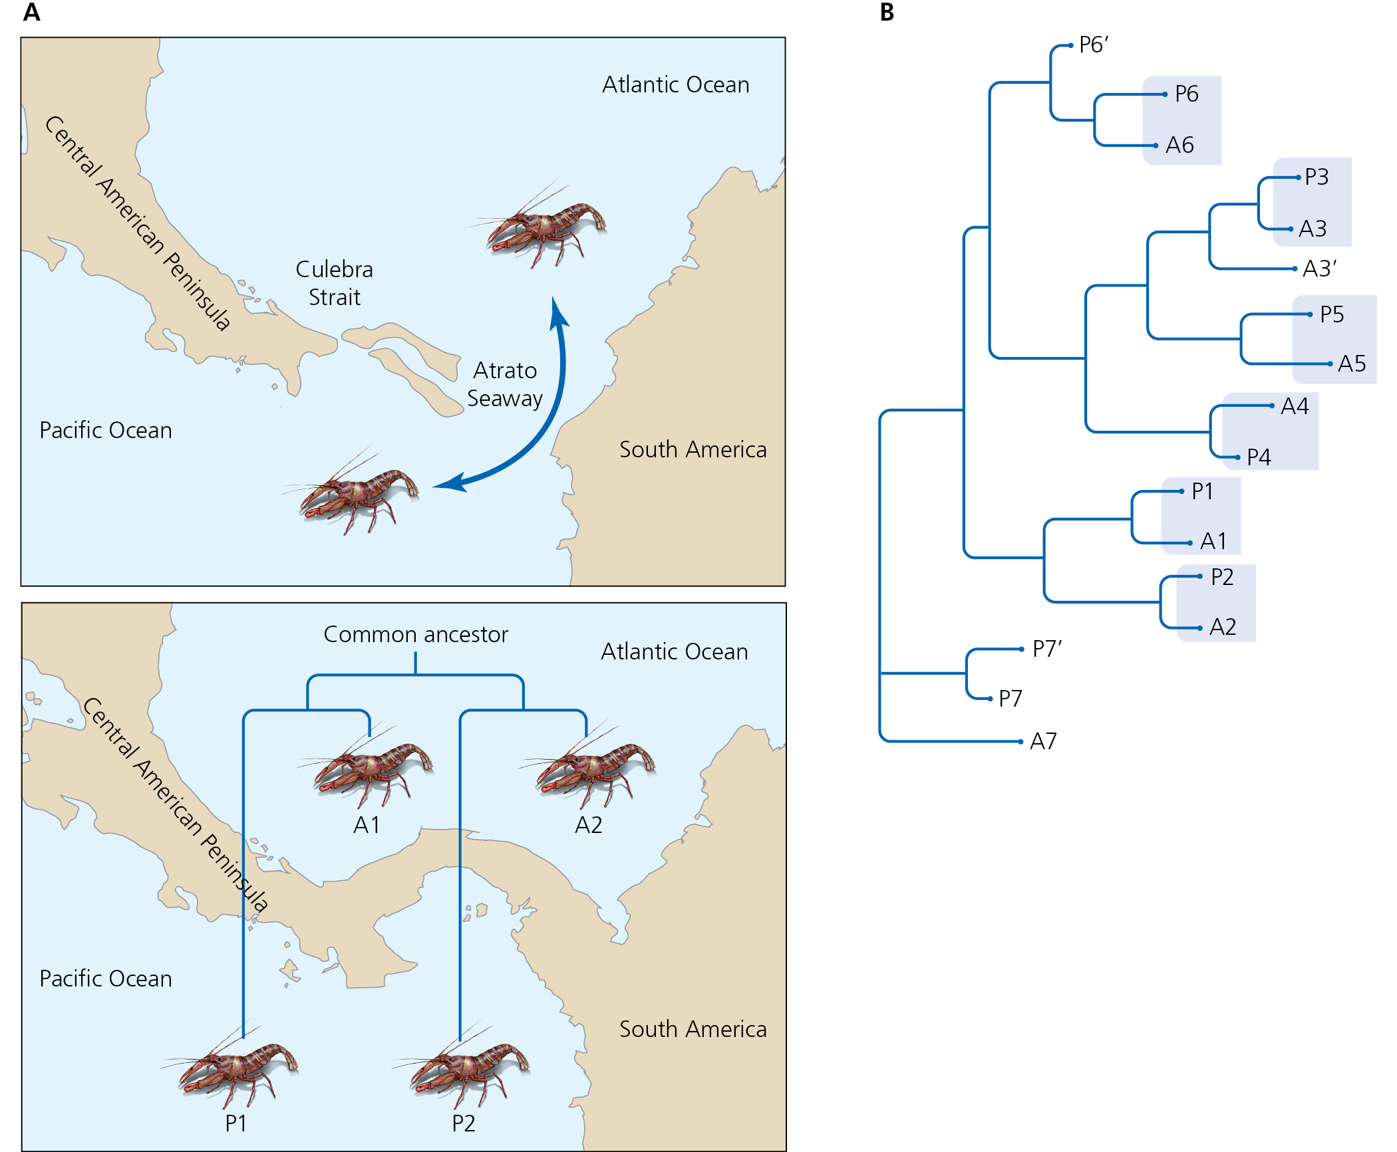
Phylogenetic signature of allopatric speciation

Slide 42
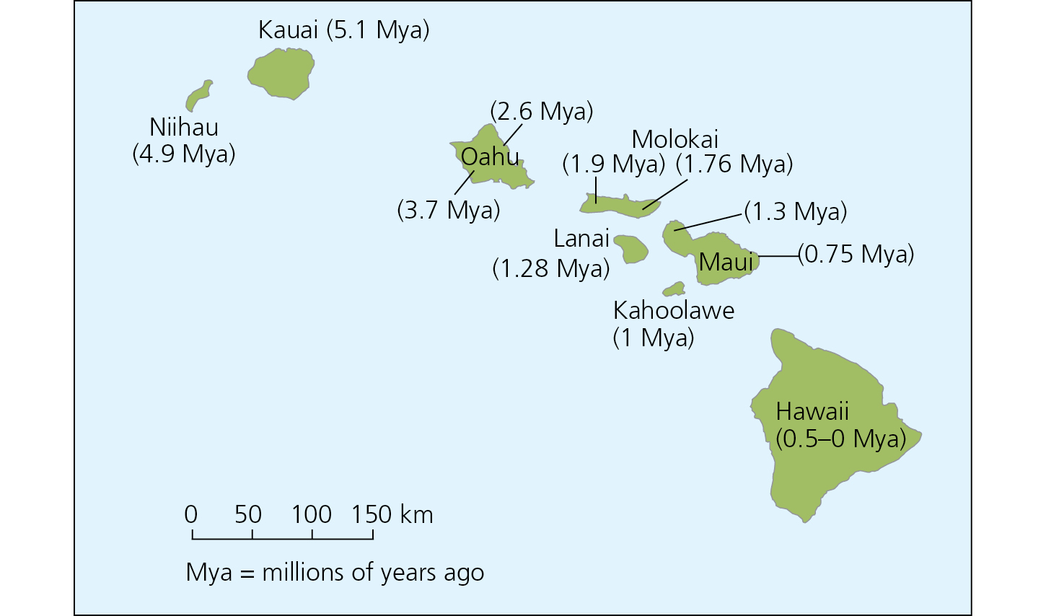
Islands provide opportunity for allopatric speciation

Slide 43
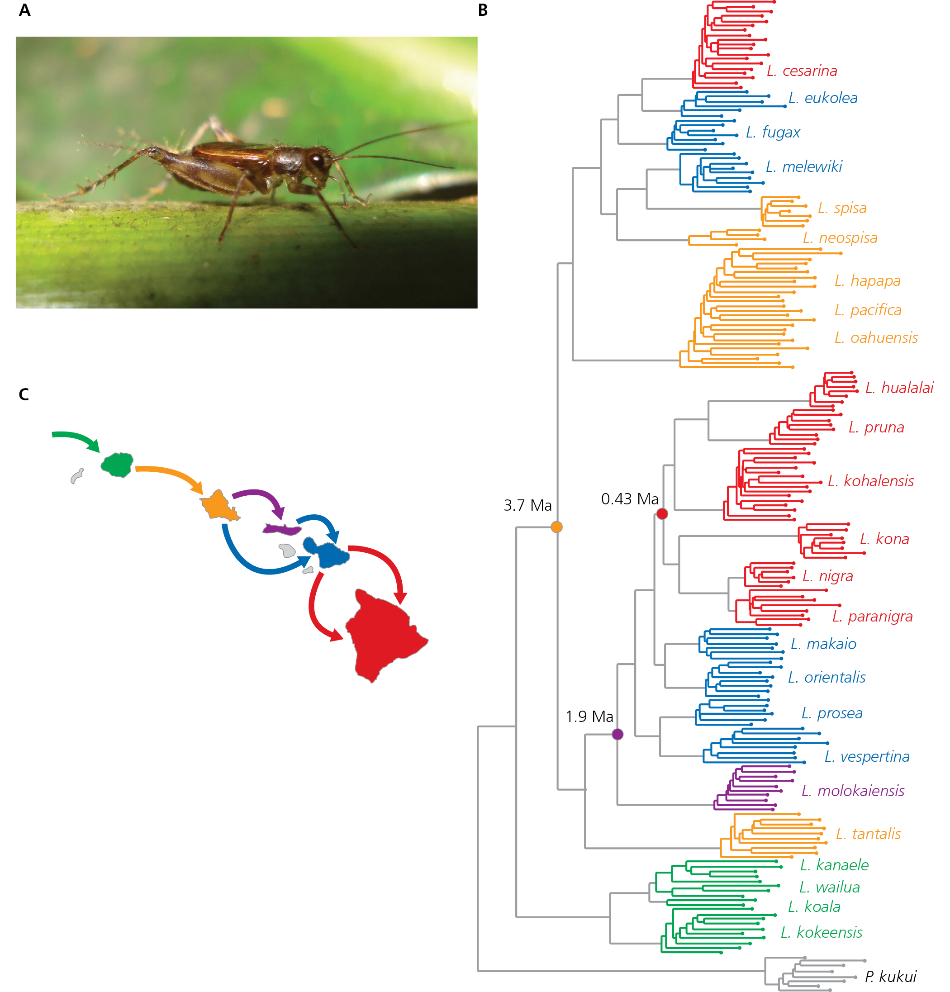
Colonization leads to speciation

Slide 44
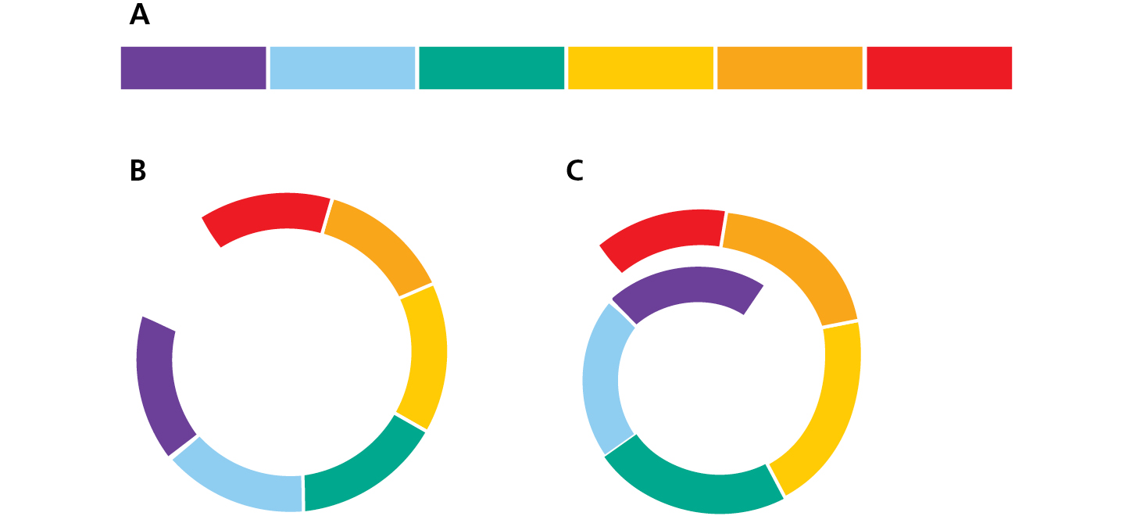
Ring species
Ring species: populations at ends can no longer interbreed

Slide 45
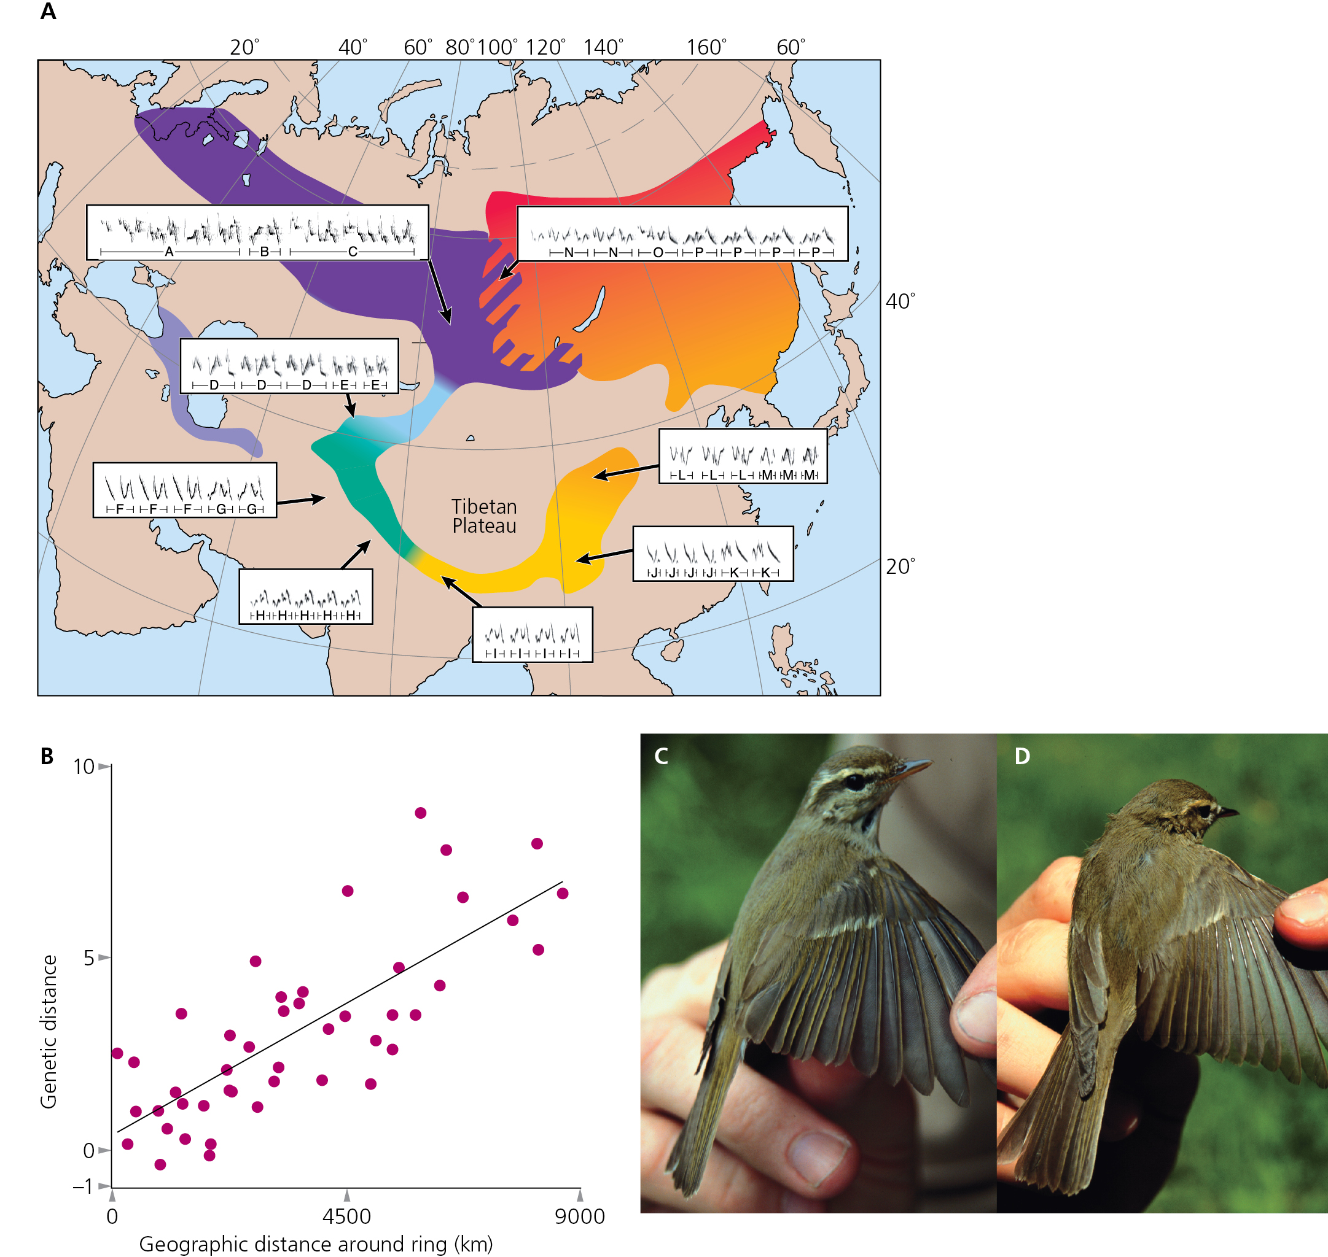
Ring species example

Slide 46
Peripatric Speciation
Peripatric speciation is a special version of the allopatric speciation mode and happens when one of the isolated populations has very few individuals.
(peri = near, patric = place) a small population isolated at the edge of a larger population

Slide 47
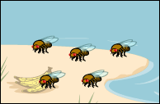
Double disaster: Not only are the island fruit flies geographically isolated from their mainland relatives, but only a few larvae have survived the harrowing journey to end up colonizing the island.

Slide 48
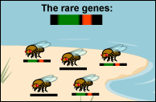
Rare genes survive: These few survivors just by chance carry some genes that are rare in the mainland population. One of these rare genes happens to cause a slight variation in the mating dance. Another causes a slight difference in the shape of male genitalia. This is an example of the founder effect.

Slide 49
In peripatric speciation, small population size would make full-blown speciation a more likely result of the geographic isolation because genetic drift acts more quickly in small populations. Genetic drift, and perhaps strong selective pressures, would cause rapid genetic change in the small population. This genetic change could lead to speciation.

Slide 50
The essential characteristic of this mode is that genetic drift plays a role in speciation. There are likely many cases where a population is split into two unequally-sized populations and they become separate species.
However, it is very difficult for us to tell after the fact what role genetic drift played in the divergence of the two populations—so gathering evidence to support or refute this mode is challenging.

Slide 51
Sympatric Speciation
Unlike the previous modes, sympatric speciation does not require large-scale geographic distance to reduce gene flow between parts of a population. How could a randomly mating population reduce gene flow and speciate?
(sym = same, patric = place)

Slide 52
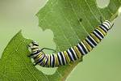
Merely exploiting a new niche may automatically reduce gene flow with individuals exploiting the other niche. This may occasionally happen when, for example, herbivorous insects try out a new host plant.

Slide 53
For example, 200 years ago, the ancestors of apple maggot flies laid their eggs only on hawthorns—but today, these flies lay eggs on hawthorns (which are native to America) and domestic apples (which were introduced to America by immigrants). Females generally choose to lay their eggs on the type of fruit they grew up in, and males tend to look for mates on the type of fruit they grew up in.

Slide 54
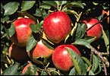
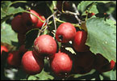
Apple maggot flies
apples
hawthorns

Slide 55
So hawthorn flies generally end up mating with other hawthorn flies and apple flies generally end up mating with other apple flies. This means that gene flow between parts of the population that mate on different types of fruit is reduced. This host shift from hawthorns to apples may be the first step toward sympatric speciation—in fewer than 200 years, some genetic differences between these two groups of flies have evolved.

Slide 56
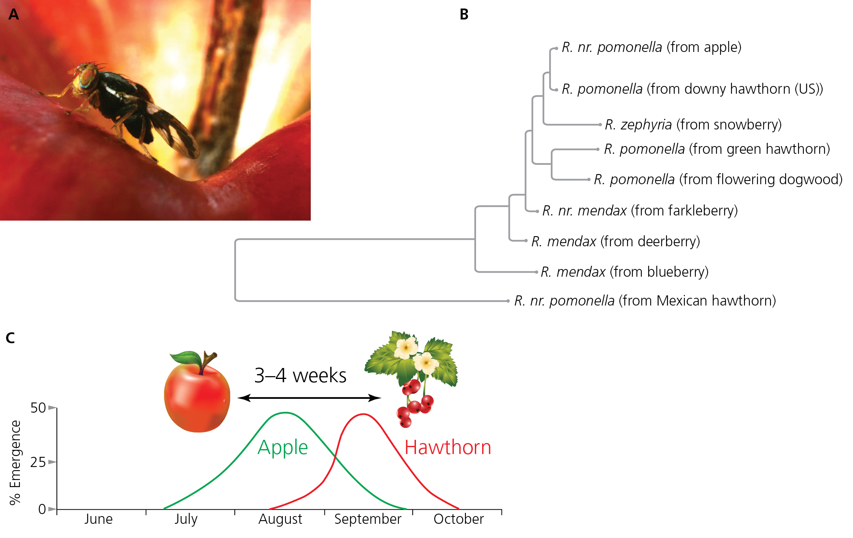
Sympatric speciation in Rhagoletis
Ecological speciation: evolution of reproductive barriers due to adaptation to divergent environments

Slide 57
Parapatric Speciation
In parapatric speciation there is no specific extrinsic barrier to gene flow. The population is continuous, but nonetheless, the population does not mate randomly. Individuals are more likely to mate with their geographic neighbors than with individuals in a different part of the population’s range. In this mode, divergence may happen because of reduced gene flow within the population and varying selection pressures across the population’s range.
(para = beside, patric = place) a continuously distributed population

Slide 58
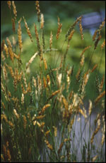
We may be observing the first steps of parapatric speciation in the grass species Anthoxanthum odoratum
Sweet vernal grass

Slide 59
Some of these plants live near mines where the soil has become contaminated with heavy metals. The plants around the mines have experienced natural selection for genotypes that are tolerant of heavy metals. Meanwhile, neighboring plants that don’t live in polluted soil have not undergone selection for this trait.

Slide 60
The two types of plants are close enough that tolerant and non-tolerant individuals could potentially fertilize each other—so they seem to meet the first requirement of parapatric speciation, that of a continuous population. However, the two types of plants have evolved different flowering times. This change could be the first step in cutting off gene flow entirely between the two groups.

Slide 61
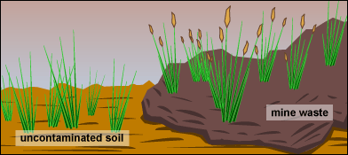
Although continuously distributed, different flowering times have begun to reduce gene flow between metal-tolerant plants and metal-intolerant plants.

Slide 62
Parapatric speciation begins with the evolution of a hybrid zone
The transition across which allele frequencies change may be broad or narrow.
A broad transition, extending across much of the total range, is called cline.
A narrow transition is called a hybrid zone or stepped cline.
The width of a hybrid zone depends on hybrid fitness and on gene flow.
The zone will be narrower with less migration (or lower rate of gene flow) and/or with lower fitness for heterozygotes.
The zone will be wider with more migration (higher rate of gene flow) or with higher fitness for heterozygotes.

Slide 63
Evidence for Speciation
In the summer of 1995, at least 15 iguanas survived Hurricane Marilyn on a raft of uprooted trees. They rode the high seas for a month before colonizing the Caribbean island, Anguilla. These few individuals were perhaps the first of their species, Iguana iguana, to reach the island. If there were other intrepid Iguana iguana colonizers of Anguilla, they died out before humans could record their presence.

Slide 64
Evolutionary biologists would love to know what happens next: will the colonizing iguanas die out, will they survive and change only slightly, or will they become reproductively isolated from other Iguana iguana and become a new species? We could be watching the first steps of an allopatric speciation event, but in such a short time we can’t be sure.

Slide 65
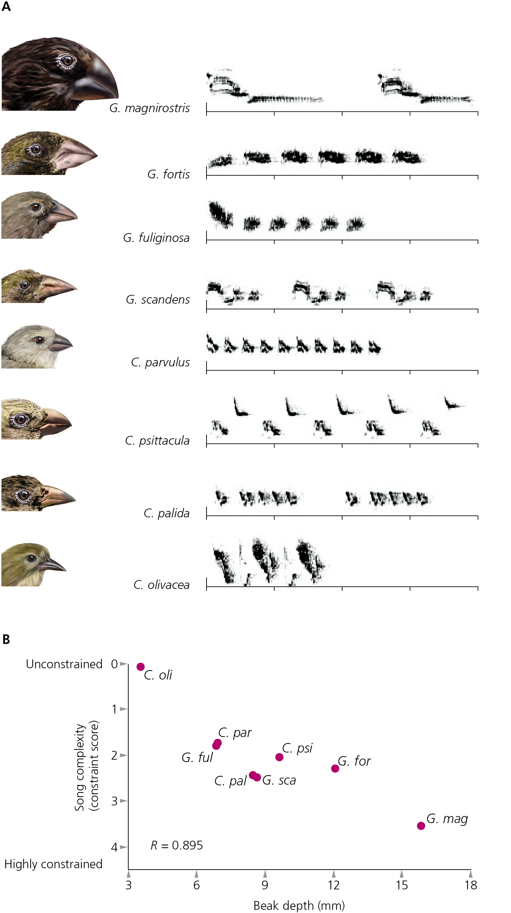
Ecological speciation in Darwin’s finches

Slide 66
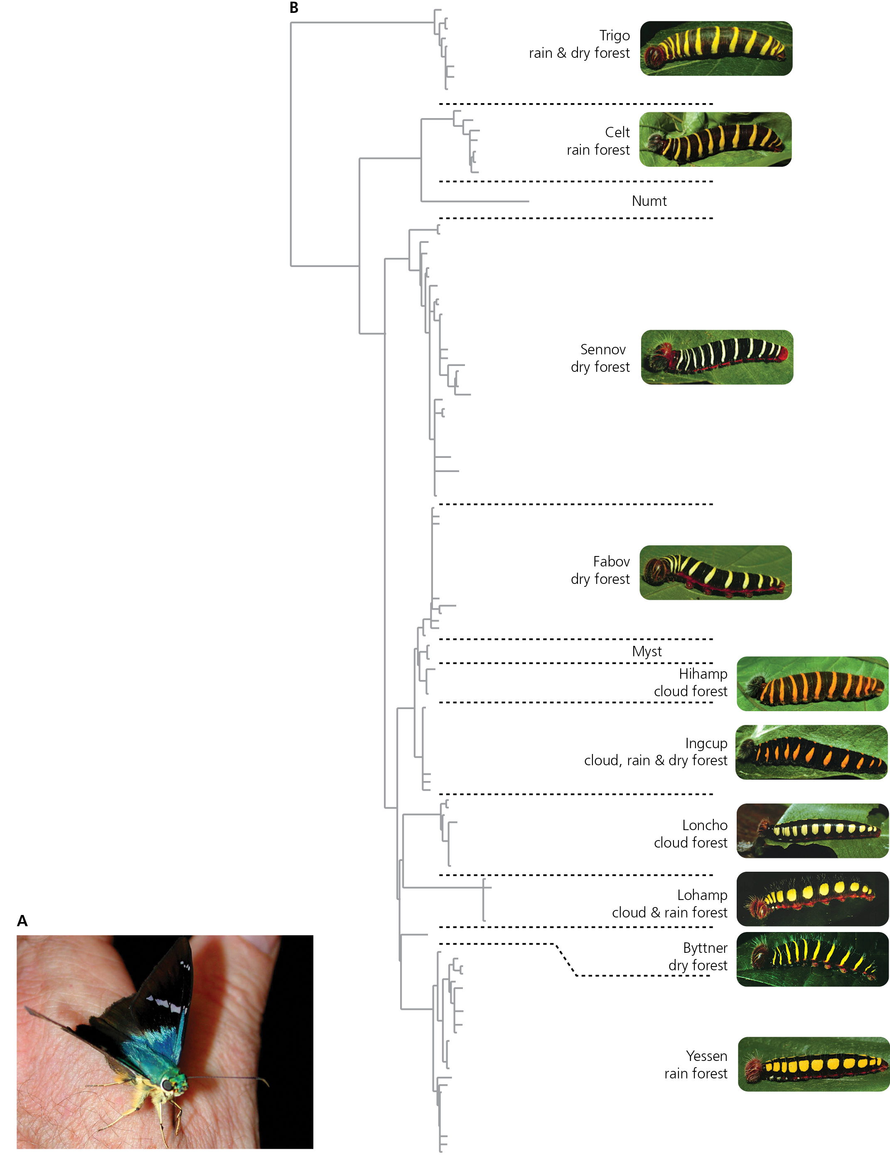
Cryptic diversity in skipper butterflies

Slide 67
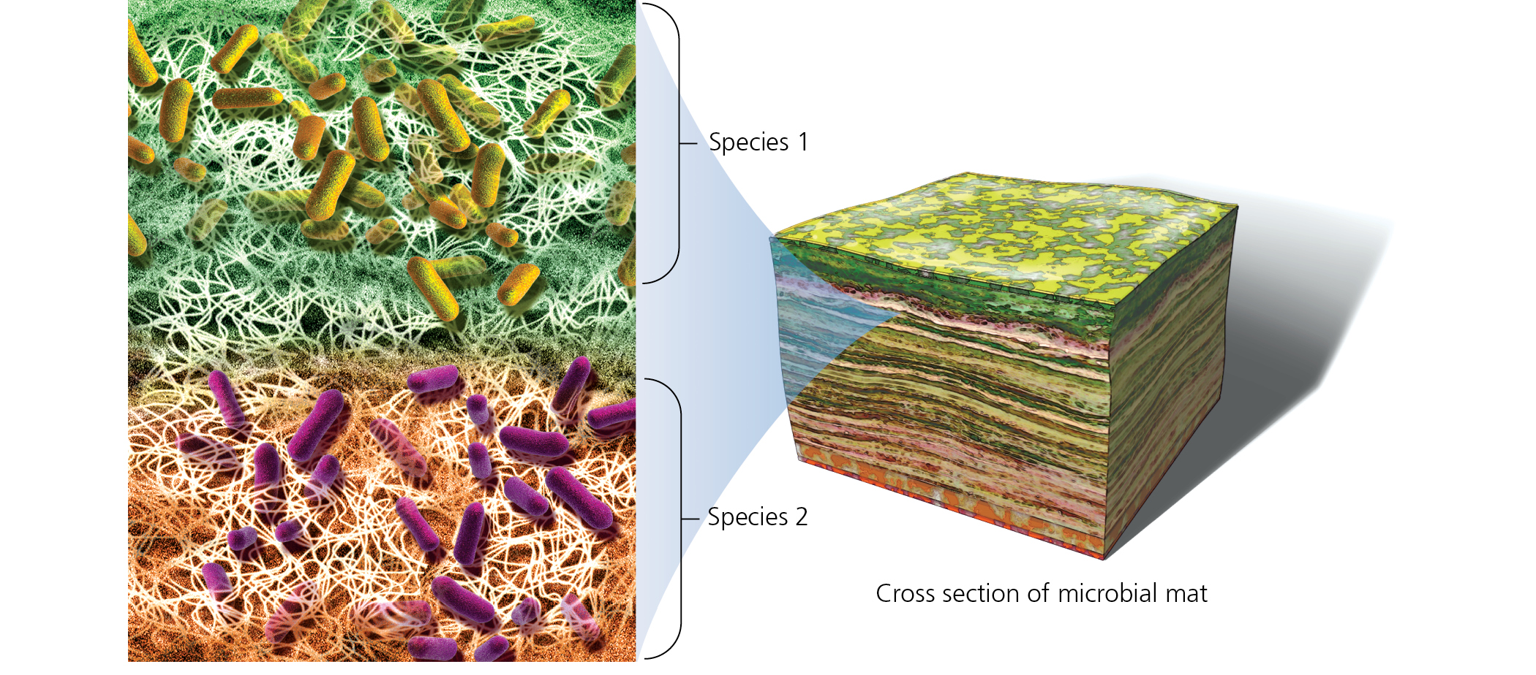
Bacterial species often defined by specific adaptations
Some scientists criticize this method

Slide 68
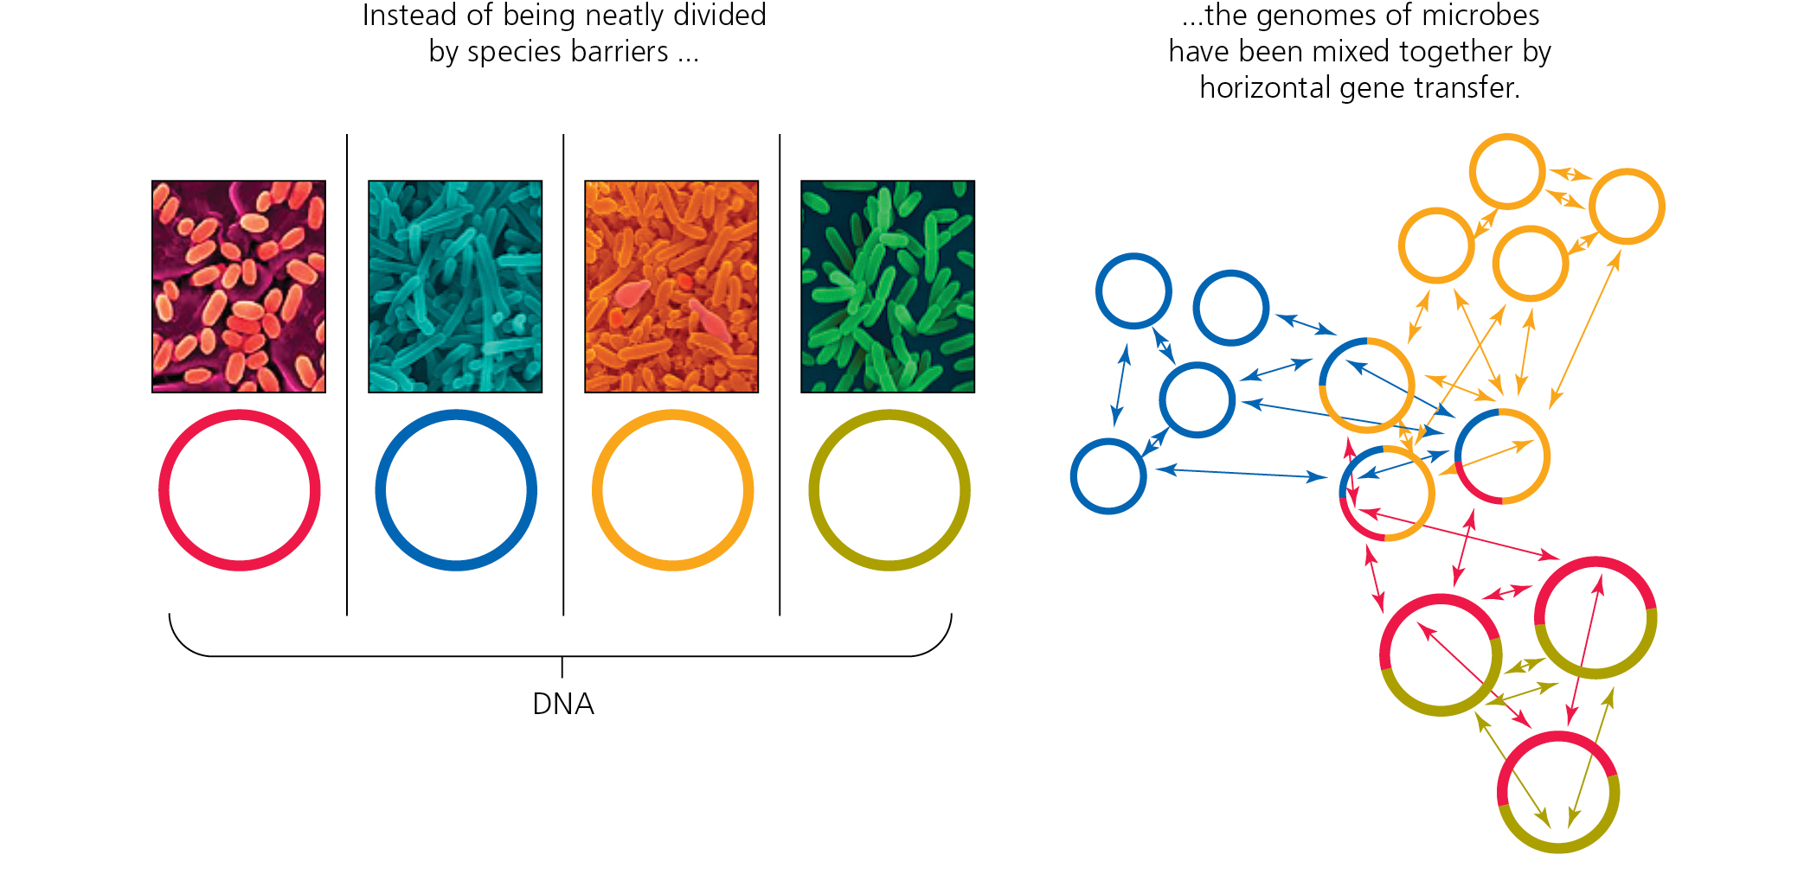
Horizontal gene transfer makes classification difficult

Slide 69
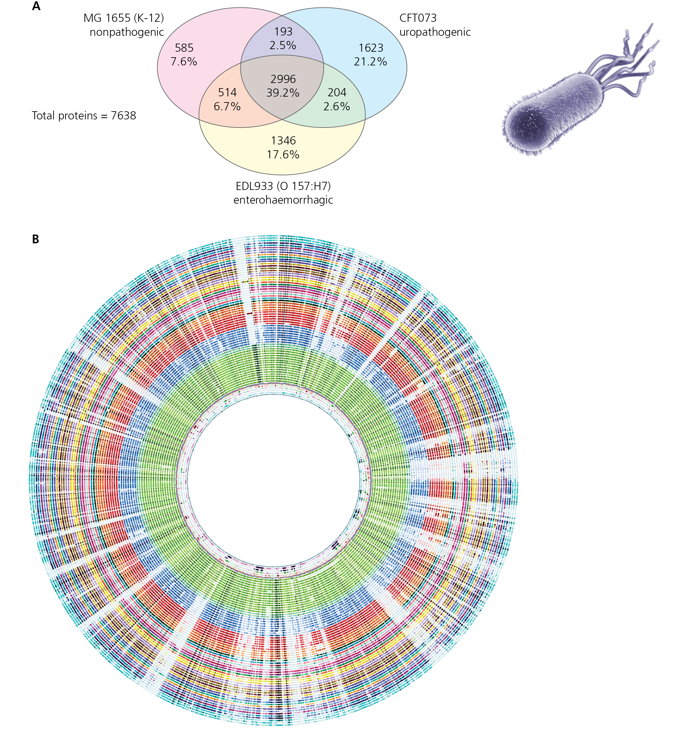
Horizontal gene transfer in E. coli
Core genome includes 993 genes
Pan-genome includes 15,741 genes

Slide 70
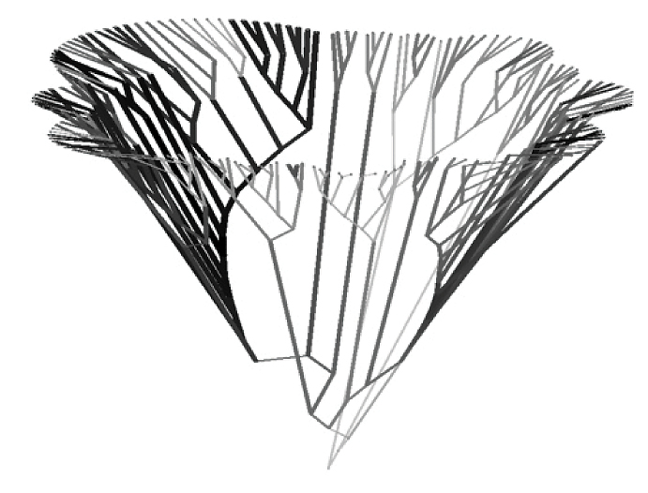
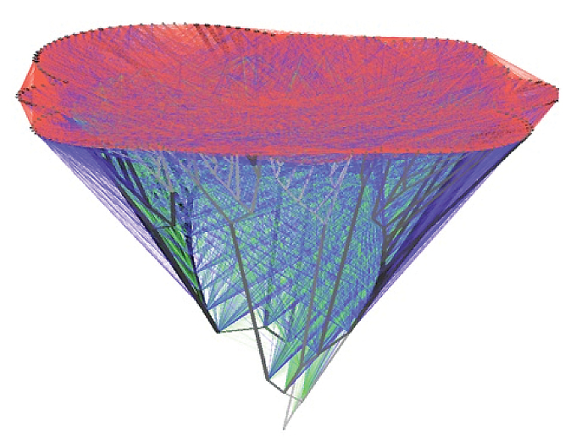
Horizontal gene transfer is common

Slide 71
Key Concepts
Ultimately, species concepts are human artifacts
Methods for recognizing species continue to improve
Remember, the definition is arbitrary..it is done for our convenience…the organisms couldn’t care!

