Slide 1
Microbiology
Chapter 7
Microbial Genetics

Slide 2
The Structure and Replication of Genomes
Genetics
Study of inheritance and inheritable traits as expressed in an organism’s genetic material
Genome
The entire genetic complement of an organism
Includes its genes and nucleotide sequences

Slide 3
The Structure and Replication of Genomes
The Structure of Prokaryotic Genomes
Prokaryotic chromosomes
Main portion of DNA, along with associated proteins and RNA
Prokaryotic cells are haploid (single chromosome copy)
Typical chromosome is a circular molecule of DNA in the nucleoid

Slide 4
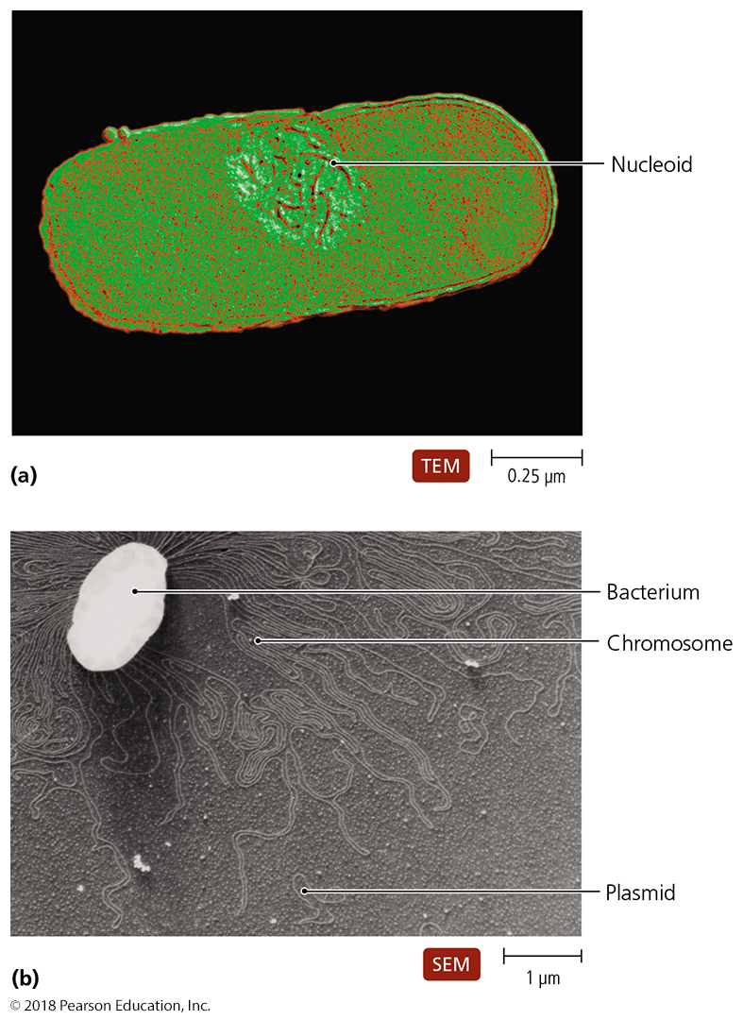
Figure 7.2 Bacterial genome.
Notes:
4

Slide 5
The Structure and Replication of Genomes
The Structure of Prokaryotic Genomes
Plasmids
Small molecules of DNA that replicate independently
Not essential for normal metabolism, growth, or reproduction
Can confer survival advantages
Many types of plasmids:
Fertility factors
Resistance factors
Bacteriocin factors
Virulence plasmids

Slide 6
The Structure and Replication of Genomes
The Structure of Eukaryotic Genomes
Nuclear chromosomes
Typically have more than one chromosome per cell
Chromosomes are linear and sequestered within nucleus
Eukaryotic cells are often diploid (two chromosome copies)

Slide 7
The Structure and Replication of Genomes
The Structure of Eukaryotic Genomes
Extranuclear chromosomes of eukaryotes
DNA molecules of mitochondria and chloroplasts
Resemble chromosomes of prokaryotes
Only code for about 5% of RNA and proteins
Some fungi, algae, and protozoa carry plasmids

Slide 8
Table 7.1 Characteristics of Microbial Genomes
Notes:
8

Slide 9
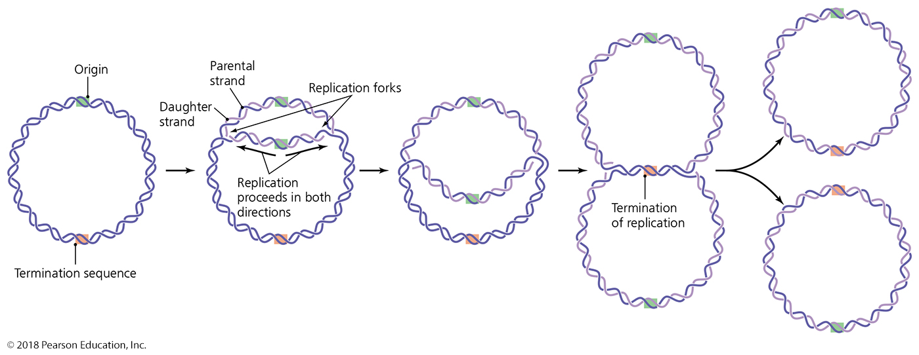
Figure 7.7 The bidirectionality of DNA replication in prokaryotes.
Notes:
9

Slide 10
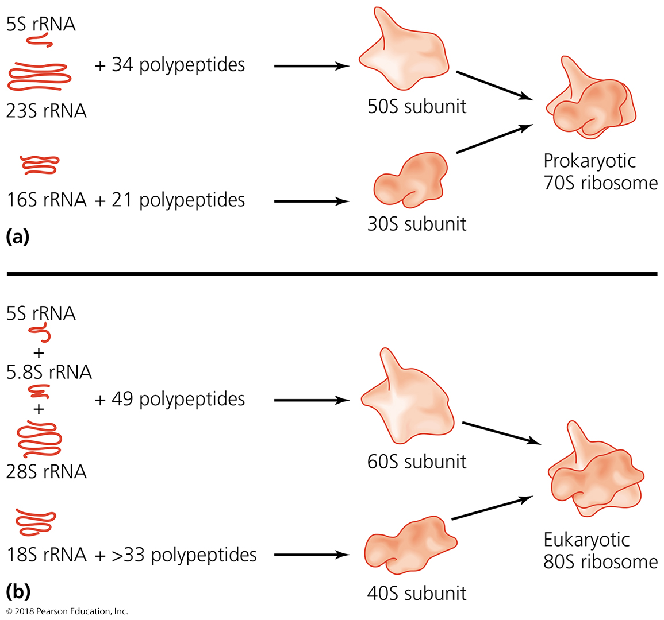
Figure 7.15 Ribosomal structures.
Notes:
10

Slide 11
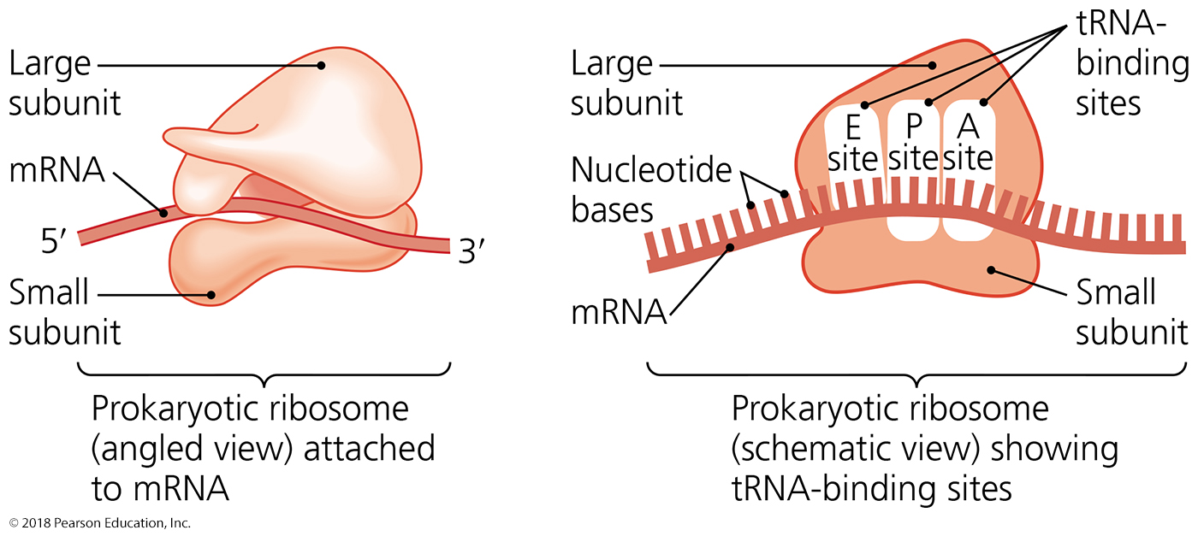
Figure 7.16 Assembled ribosome and its tRNA-binding sites.
Notes:
11

Slide 12
Mutations of Genes
Mutation
Change in the nucleotide base sequence of a genome
Rare event
Almost always deleterious
Rarely leads to a protein that improves ability of organism to survive

Slide 13
Mutations of Genes
Types of Mutations
Point mutations
One base pair is affected
Substitutions and frameshift mutations
Gross mutations
Include inversions, duplications, and transpositions

Slide 14
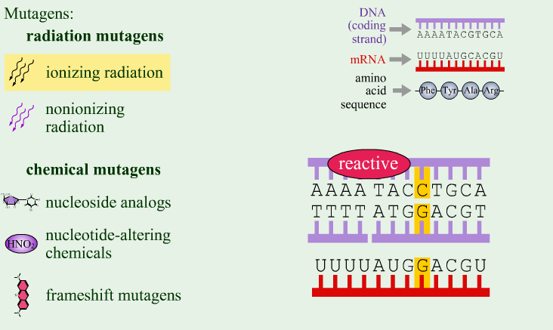
Mutagens
PLAY
Mutagens

Slide 15
Mutations of Genes
Mutagens
Radiation
Ionizing radiation
Nonionizing radiation
Chemical mutagens
Nucleotide analogs
Disrupt DNA and RNA replication
Nucleotide-altering chemicals
Result in base-pair substitutions and missense mutations

Slide 16
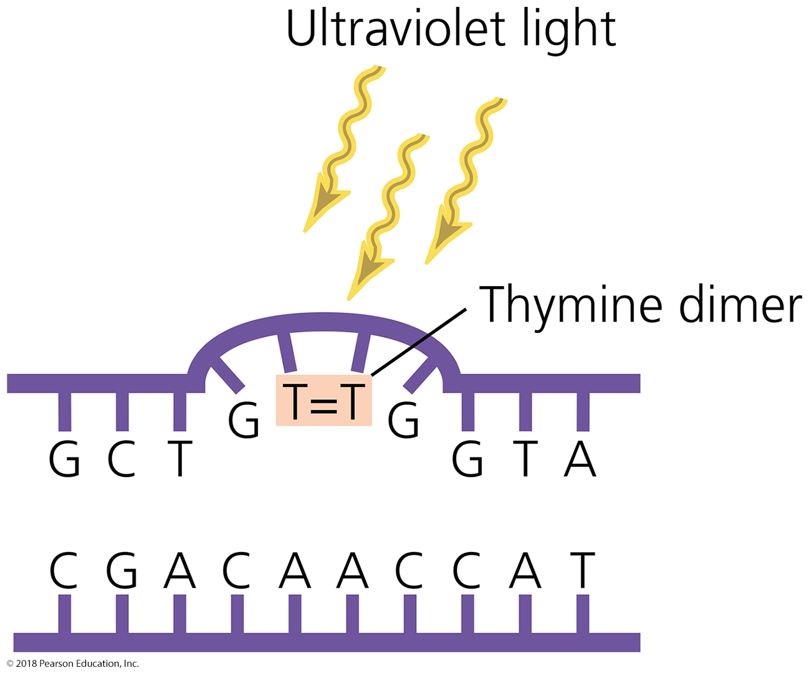
Figure 7.25 A pyrimidine (in this case, thymine) dimer.
Notes:
16

Slide 17
Mutations of Genes
Frequency of Mutation
Mutations are rare events.
Otherwise, organisms could not effectively reproduce.
Mutagens increase the mutation rate by a factor of 10 to 1000 times.

Slide 18
Genetic Recombination and Transfer
Exchange of nucleotide sequences often occurs between homologous sequences
Recombinants
Cells with DNA molecules that contain new nucleotide sequences

Slide 19
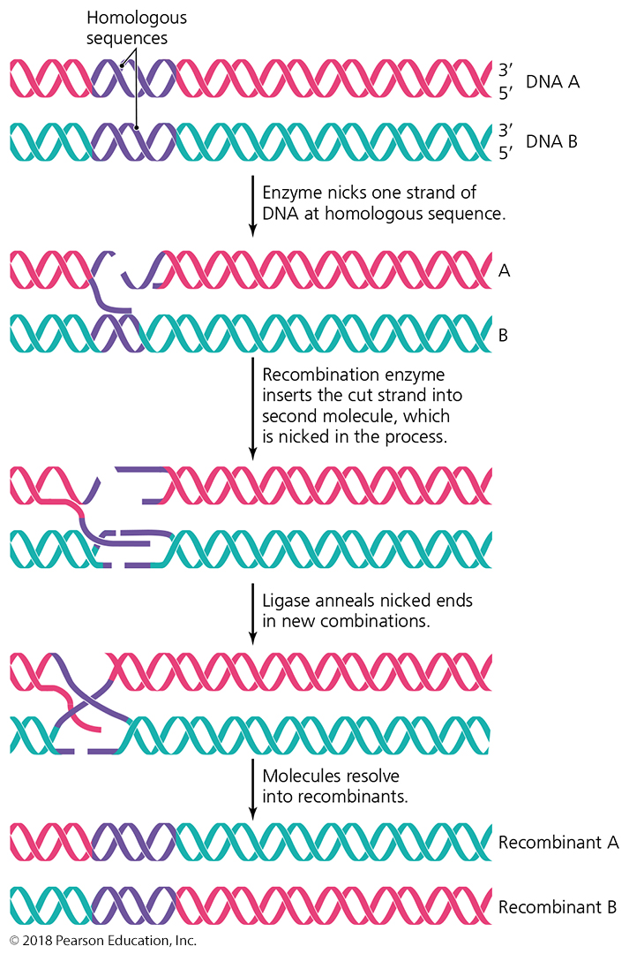
Figure 7.32 Genetic recombination.
Notes:
19

Slide 20
Genetic Recombination and Transfer
Horizontal Gene Transfer Among Prokaryotes
Horizontal gene transfer
Donor cell contributes part of genome to recipient cell
Three types:
Transformation
Transduction
Bacterial conjugation

Slide 21
Genetic Recombination and Transfer
Horizontal Gene Transfer Among Prokaryotes
Transformation
One of conclusive pieces of proof that DNA is genetic material
Cells that take up DNA are competent
Results from alterations in cell wall and cytoplasmic membrane that allow DNA to enter cell

Slide 22
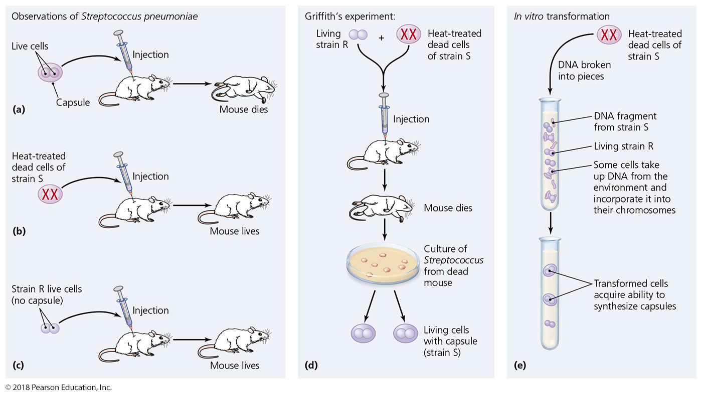
Figure 7.33 Transformation of Streptococcus pneumoniae.
Notes:
22

Slide 23
Genetic Recombination and Transfer
Horizontal Gene Transfer Among Prokaryotes
Transduction
Generalized transduction
Transducing phage carries random DNA segment from donor to recipient
Specialized transduction
Only certain donor DNA sequences are transferred

Slide 24
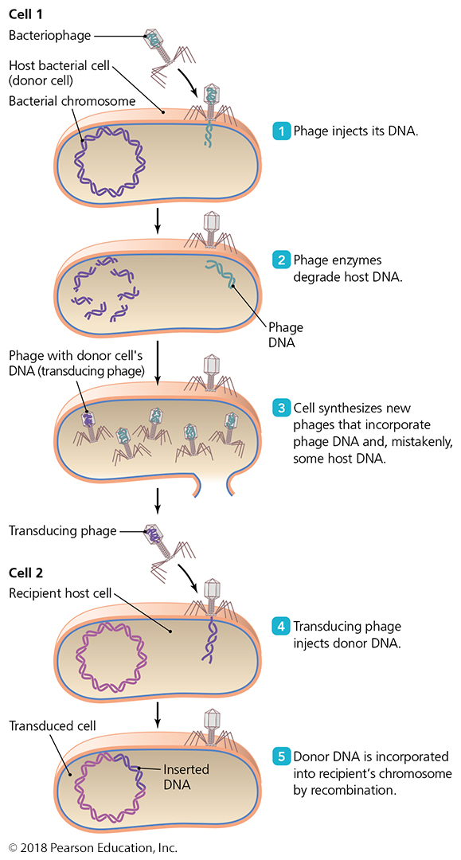
Figure 7.34 Transduction.
Notes:
24

Slide 25
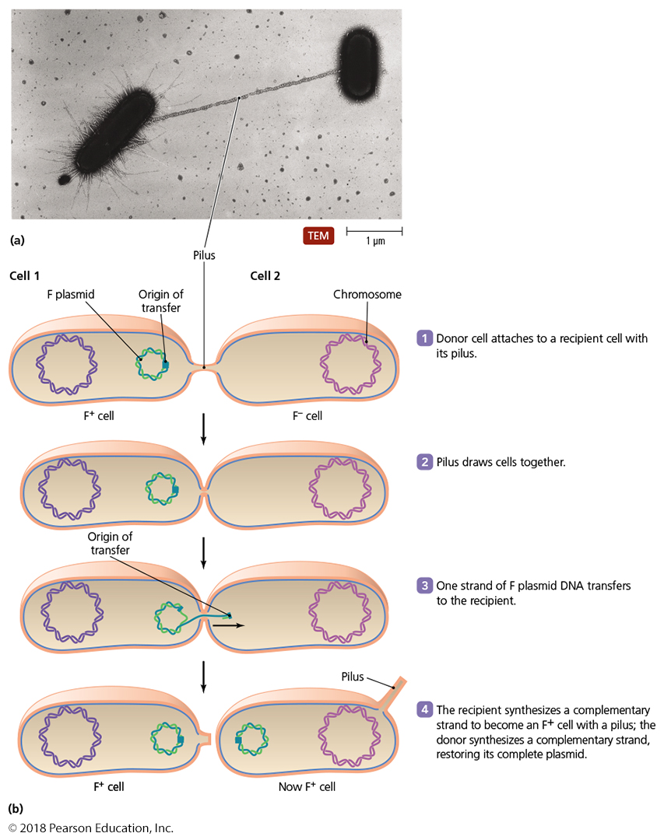
Figure 7.35 Bacterial conjugation.
Notes:
25

Slide 26
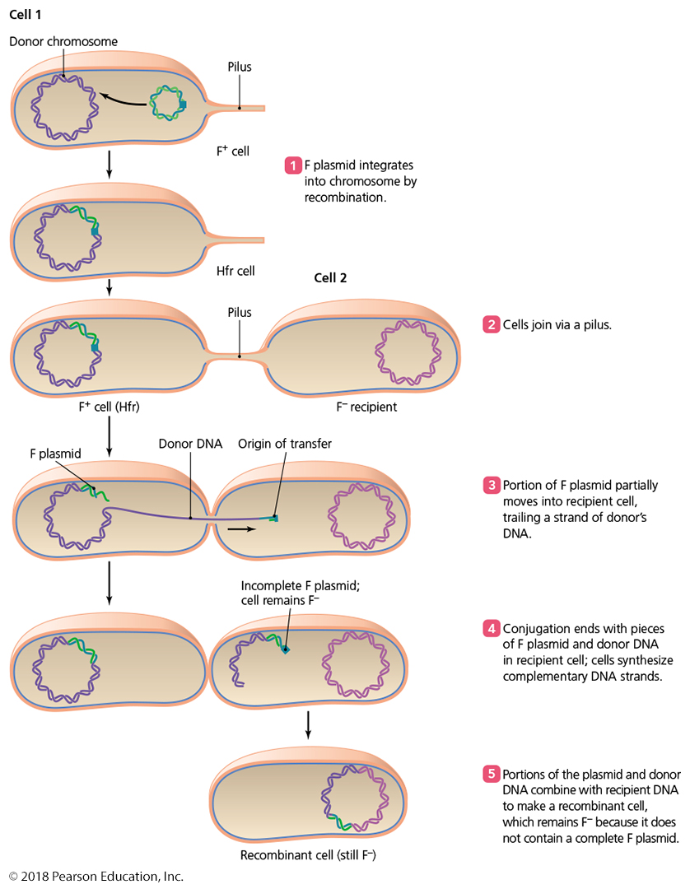
Figure 7.36 Conjugation involving an Hfr cell.
Notes:
26

Slide 27
Genetic Recombination and Transfer
Transposons and Transposition
Transposons
Segments of DNA that move from one location to another in the same or different molecule
Result is a kind of frameshift insertion (transpositions)
Transposons contain palindromic sequences at each end

Slide 28
Figure 7.37 Transposition.
Notes:
28

