Slide 1
The virus and the whale: how scientists study evolution

Slide 2
Biological evolution
Any change in the inherited traits of a population that occurs from one generation to the next

Slide 3
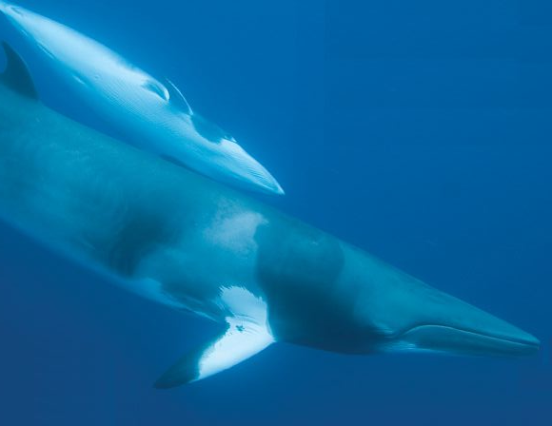
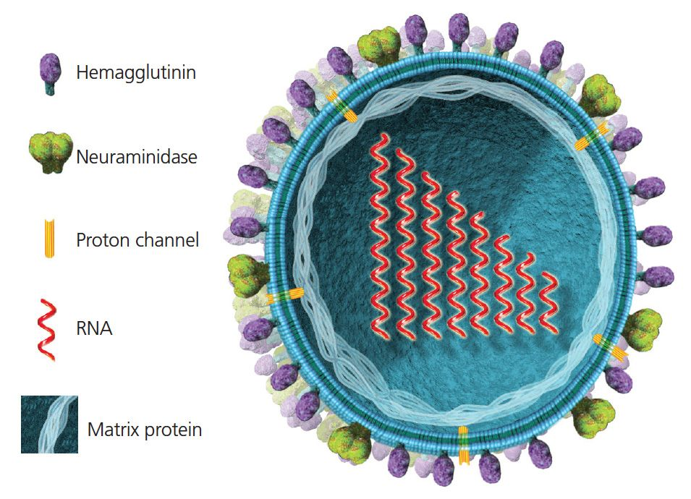
Evolution explains the diversity of life

Slide 4
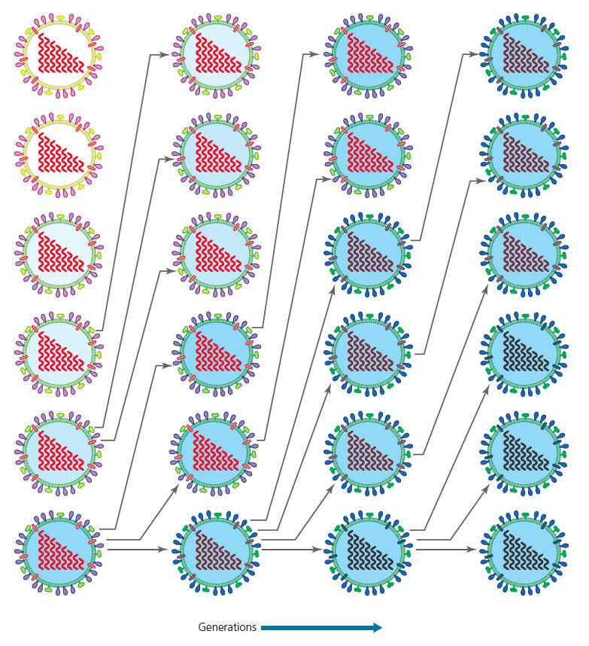
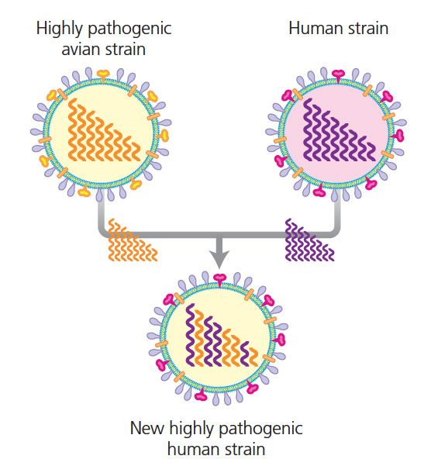
Understanding evolution has practical implications
How do pathogens become drug resistant?
What is the source of new pathogens?

Slide 5
Evolution case studies
Whales: mammals gone to sea
Viruses: the deadly escape artists

Slide 6
How do we know whales are mammals?
Whales share synapomorphies with mammals
Mammary glands
Three middle ear bones
Hair (in developing embryos)
Similarities with fish arose through convergent evolution

Slide 7
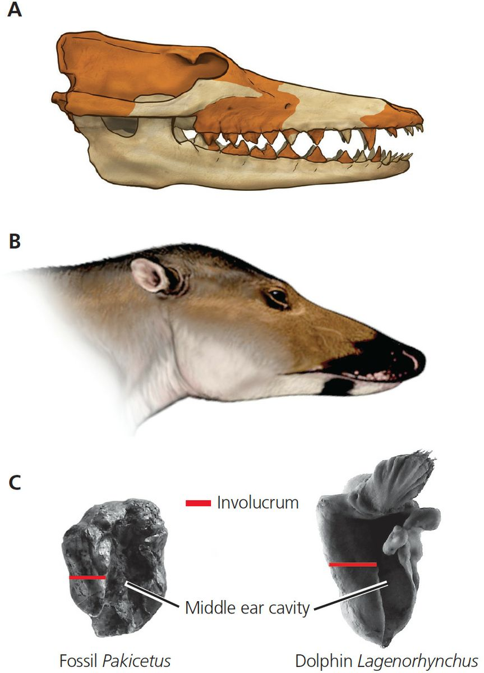
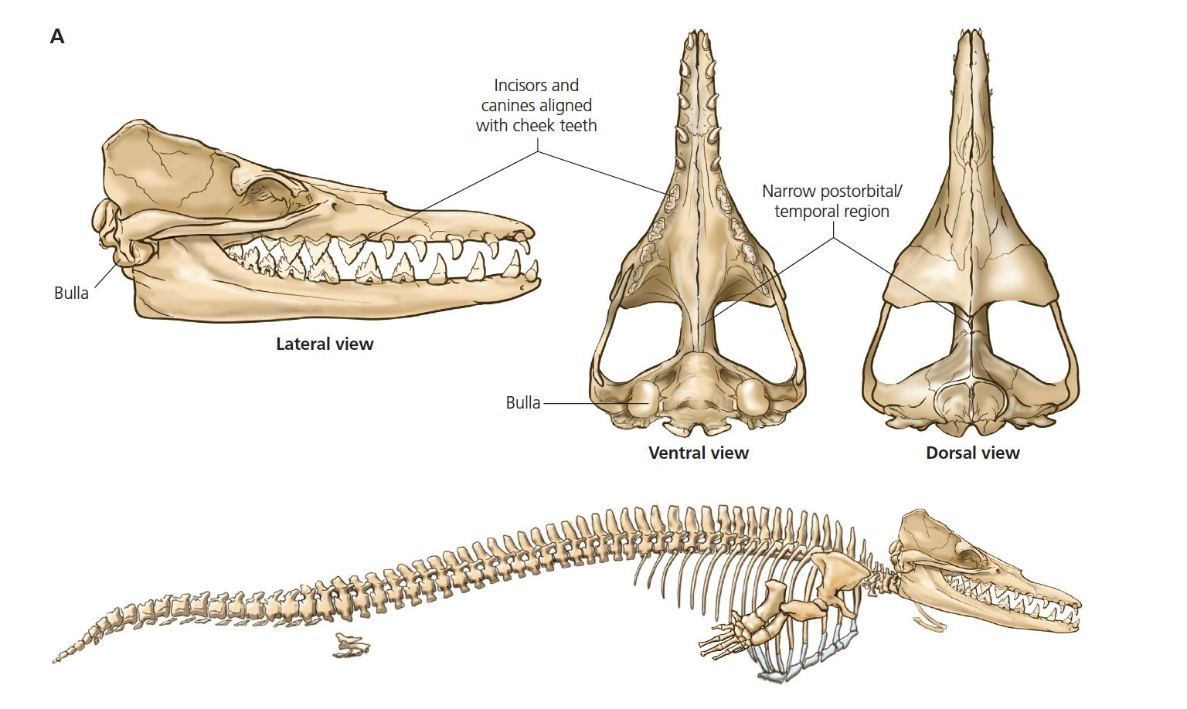
Fossil whales share synapomorphies with modern cetaceans

Slide 8
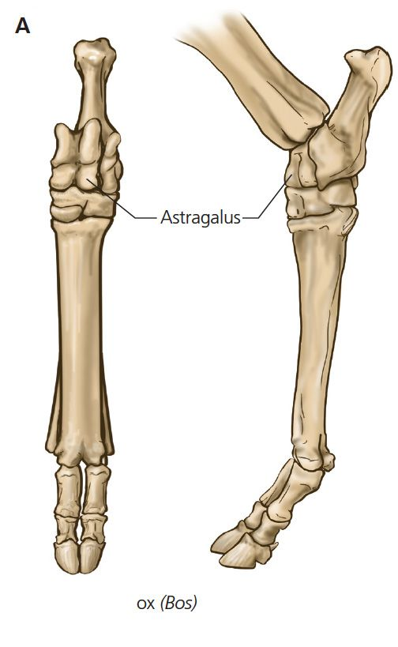
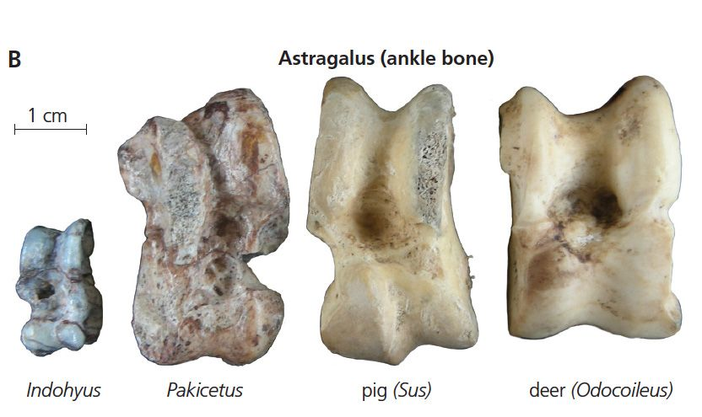
Fossils reveal links to land mammals
Shape of astragalus connects to artiodactyls

Slide 9
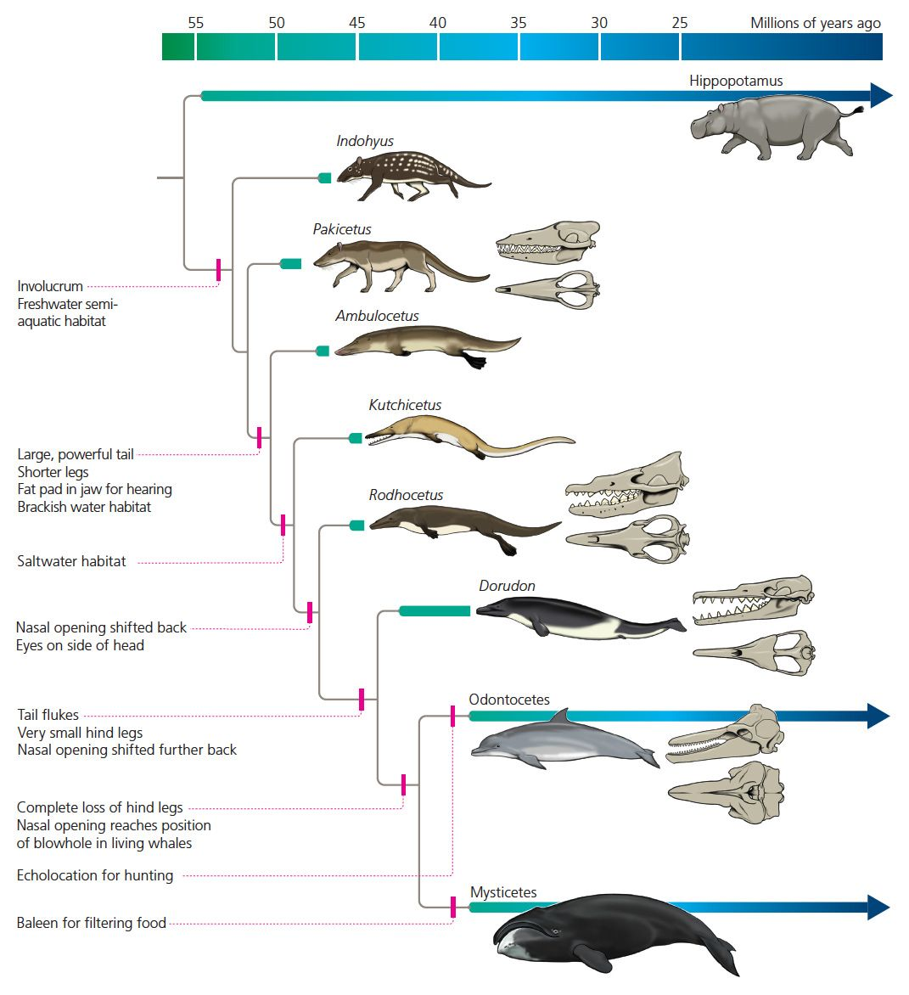
Fossil sequence documents transition from land to water

Slide 10
Documenting the transition from land to water
Isotopic analysis of fossil teeth
Fossil analysis of hindlimb loss

Slide 11
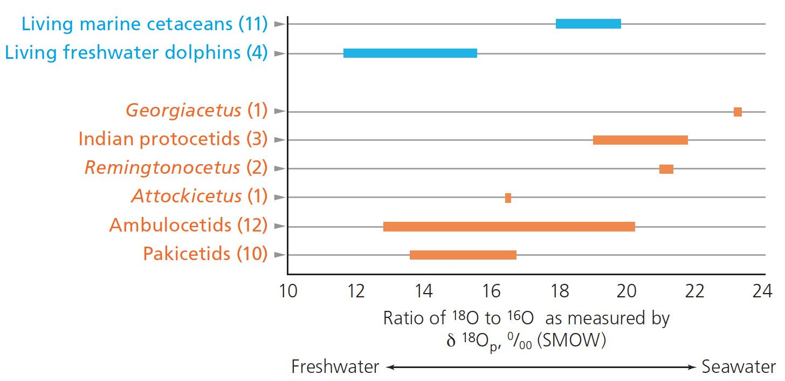
Isotopic analysis of fossil teeth
Terrestrial animals drink freshwater; marine animals drink saltwater
O¹⁸/O¹⁶ ratio higher in saltwater
Higher ratio in teeth of marine animals

Slide 12
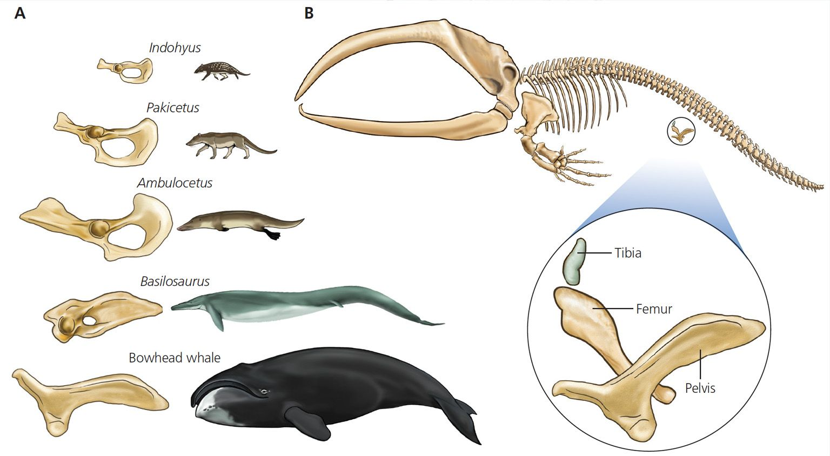
Fossils document hindlimb loss

Slide 13
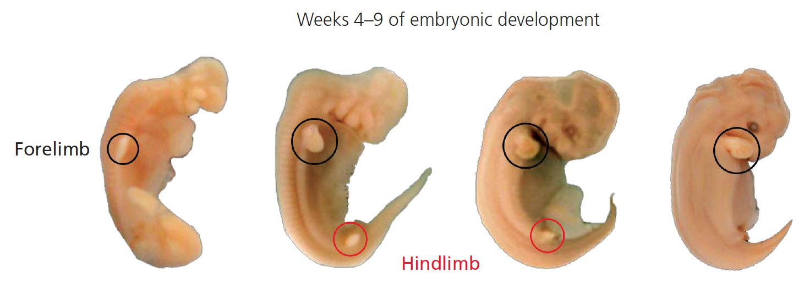
Changes in gene expression led to hindlimb loss
Hindlimbs begin to form but do not fully develop

Slide 14
Research gives more clues about whale evolution
Loss of teeth in baleen whales
Evolution of brain size and complexity
Whale diversity over evolutionary time

Slide 15
Baleen whales lost teeth
Ancestors of all modern whales had teeth
Also produced small patches of baleen
Baleen completely replaced teeth in Mysticetes
Genes for building teeth disabled

Slide 16
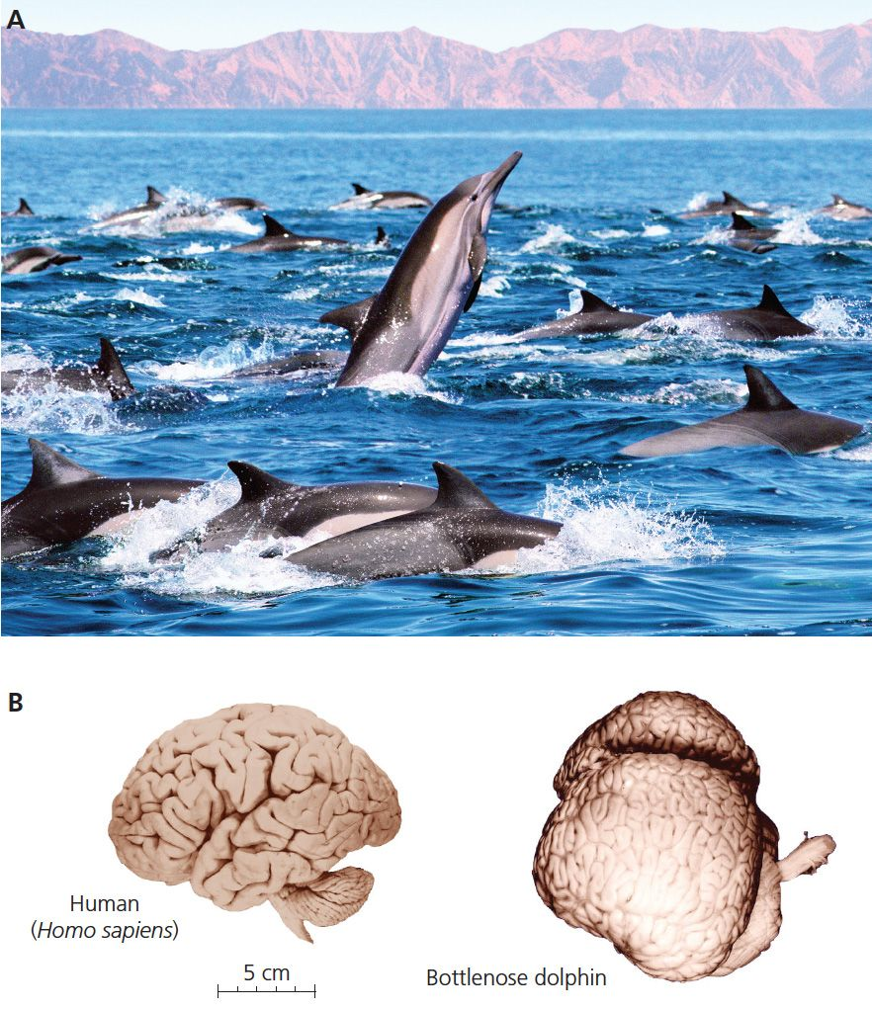
Brain size and complexity the result of natural selection
Sociality promoted the evolution of large brains
Form lasting alliances
Competition for mates
Complex communication

Slide 17
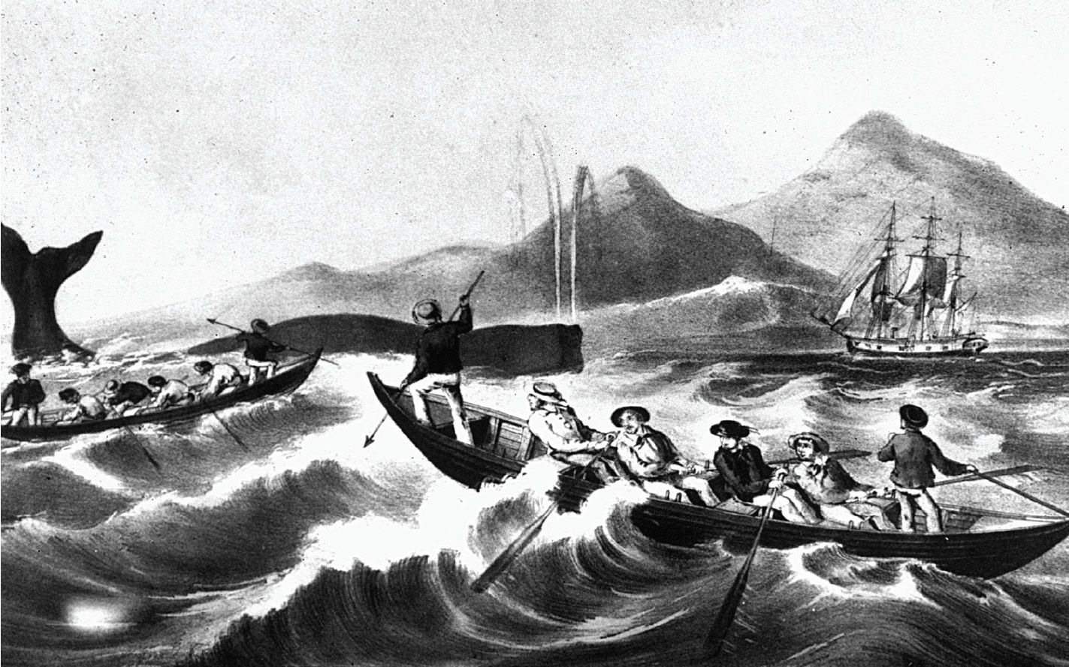
Small populations put some cetaceans at risk of extinction

Slide 18
Evolution case studies
Whales: mammals gone to sea
Viruses: the deadly escape artists

Slide 19
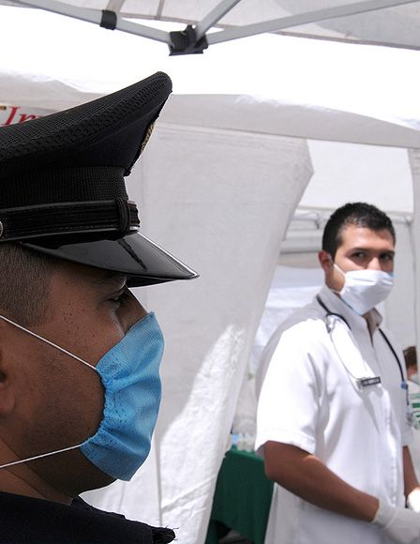
2009 H1N1 Flu Outbreak
Spread worldwide in a matter of weeks
First noticed in Mexico
16,000 deaths in U.S.
Evolutionary biologists helped solve the mystery of its appearance

Slide 20
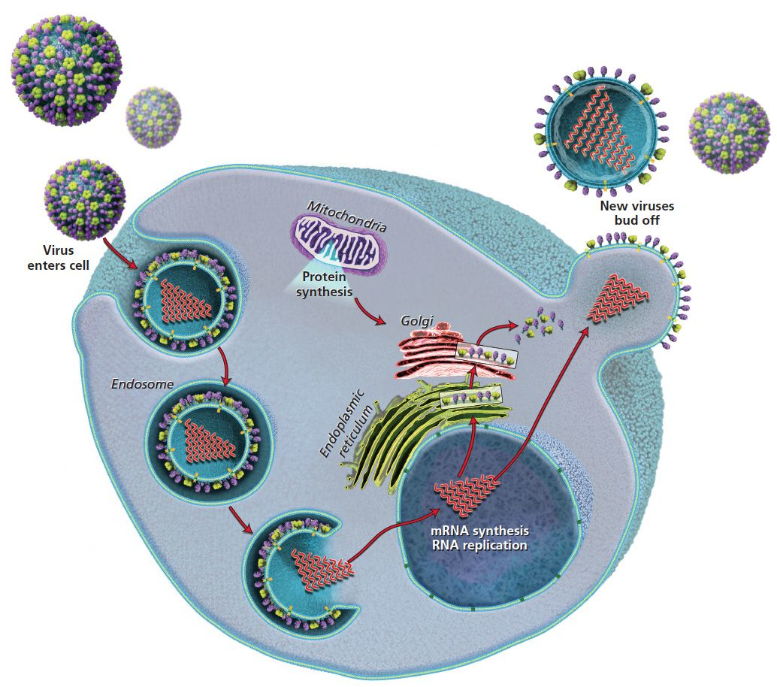
Flu life cycle

Slide 21
Vaccine design
Part of flu vaccine; primes immune system

Slide 22
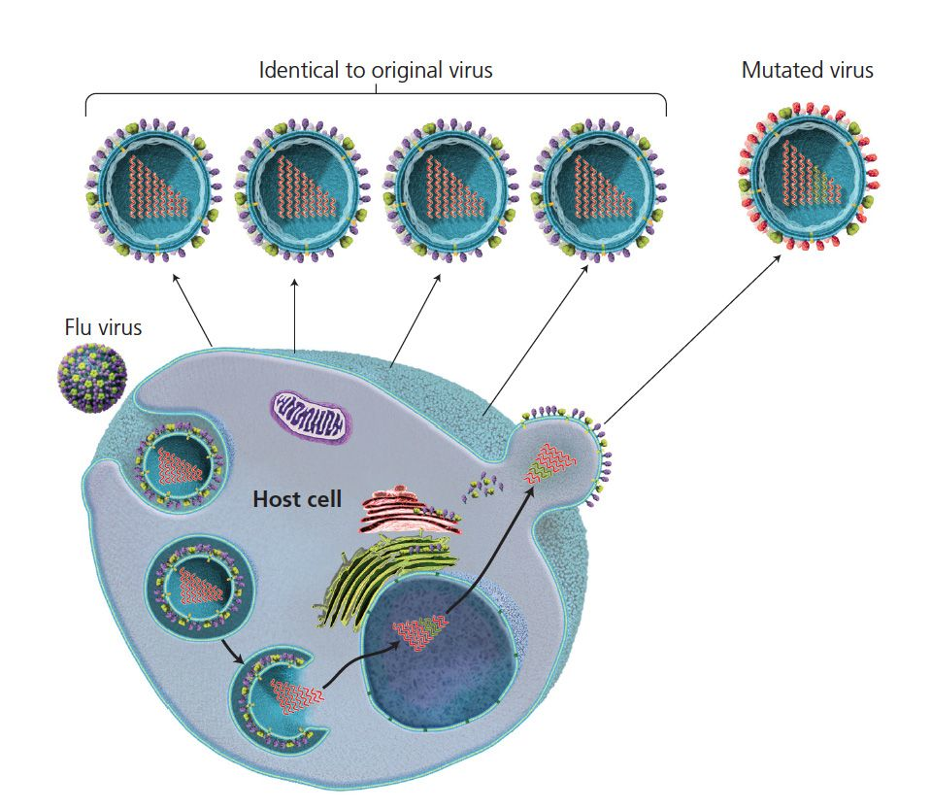
Why do new flu vaccines need to be made each year?
Mutations may be harmful or beneficial

Slide 23
Viral strains with beneficial mutations increase in frequency through natural selection
Viral strain no longer recognized by immune system
Requires new vaccine

Slide 24
Viral reassortment can lead to devastating consequences
Immune system cannot recognize distinct surface proteins
New strains can cause significant mortality
Spanish flu (1918)
Asian Flu (1957-58)
Hong Kong Flu (1968-69)

Slide 25
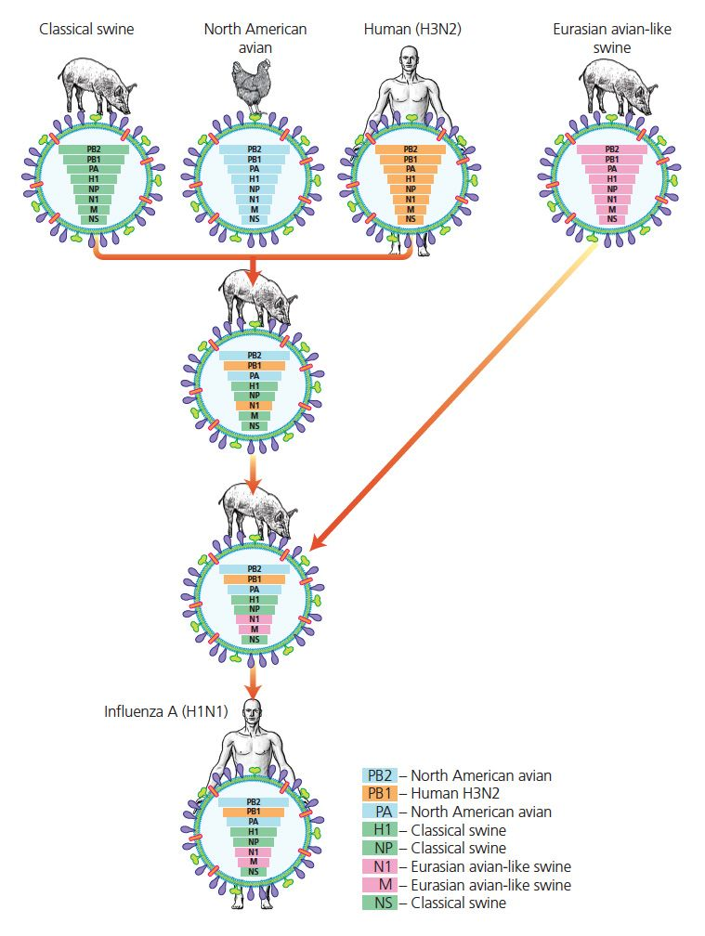
The 2009 outbreak was the result of reassortment

Slide 26
Common misconceptions about evolution

Slide 27
Evolution is “just” a theory
Scientific theories backed by multiple lines of evidence
Provide overarching explanation for major aspects of natural world
Other scientific theories
Gravity
Plate tectonics
Germ theory
Evolutionary theory overwhelmingly accepted by scientists

Slide 28
Evolutionary biologists understand everything about the history of life
Biologists continually discover new aspects of life
All evidence fits within context of evolution

Slide 29
Evolution explains the origin of life
Evolution deals with how life has changed after it originated
Other scientific fields address the origin of life

Slide 30
Evolutionary biologists search for missing links
Biologists expect the fossil record to be incomplete
Finding direct ancestors is unlikely
Available evidence strongly supports relationships between current and past species
Relationships shed light on how traits evolved

Slide 31
Evolution violates the second law of thermodynamics
Holds that disorder increases in closed systems
Earth is not a closed system
Sun provides constant input of energy

Slide 32
Evolution is natural selection
Natural selection is a mechanism of evolutionary change
Other mechanisms:
Genetic drift
Sexual selection

Slide 33
Evolution is entirely random
Evolution includes random and non-random components
Mutations are random
Natural selection is the non-random spread of particular mutations
Convergent evolution demonstrates that evolution is non-random
Phenotypes are predictable when environments are similar

Slide 34
Organisms evolve adaptations they “need”
Evolution cannot identify needs
Mutations do not occur because they would be adaptive in an environment
If beneficial mutations happen to occur they may increase in frequency through selection

Slide 35
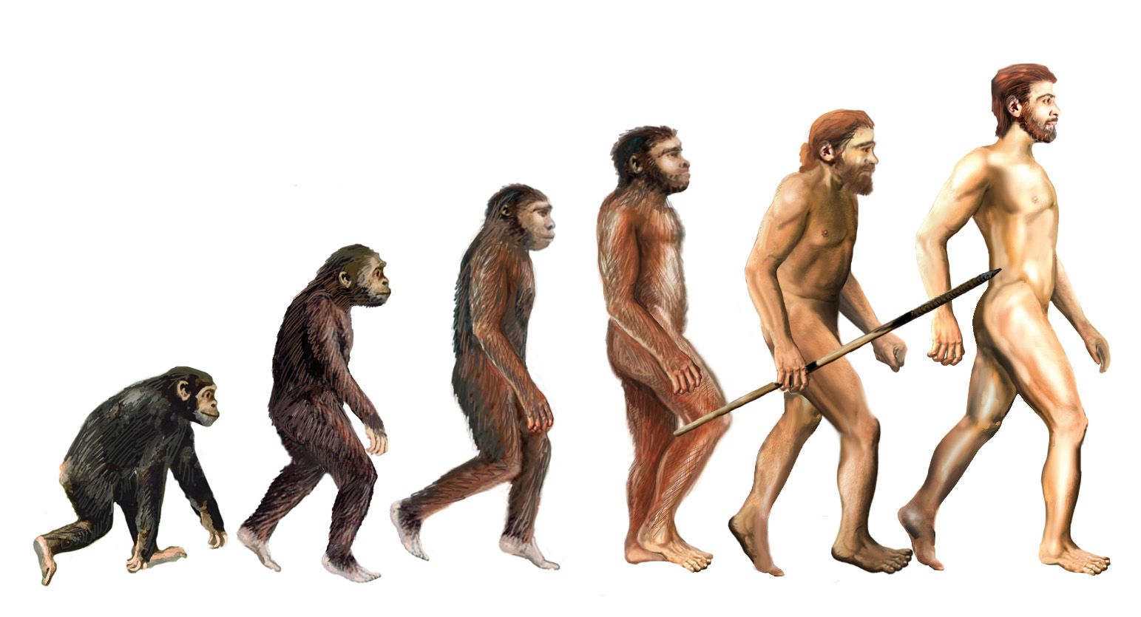
Evolution is a march of progress
Evolution is not ladder-like
New species result from branching events

Slide 36
Evolution always moves from simple to complex
Evolution can also move from complex to simple
e.g. mitochondria evolved from free-living bacteria

Slide 37
Evolution results from individuals adapting to environment
Evolution only works on inherited traits
Acquired changes are not passed to offspring
Populations evolve; individuals do not
Evolution results from changes in allele frequencies

Slide 38
Organisms are perfectly adapted to their environment
Natural selection can only work with available variation
Constrained by physics and development
Many traits involved in trade-offs
e.g. human brain size

Slide 39
Evolution happens for the good of the species
Evolution selects traits that are beneficial for individuals or their genes
Traits that are bad for individuals (or genes) will not be selected even if they are good for the species

Slide 40
Evolution promotes selfishness and cruelty
Natural selection favors traits that increase reproductive success
Different conditions select for different traits
Cooperative traits are beneficial under some conditions

Slide 41
Evolution seeks peaceful harmony in nature
Natural selection favors traits that increase reproductive success
Can result in exploitation

Slide 42
Life can be divided into higher and lower forms
All of life is adapted to the environment in numerous ways
Environments differ so adaptations differ
One adaptation is not “superior” to another adaptation

Slide 43
Evolution has produced a stable diversity of life
Extinction means diversity is not stable
99% of all species that ever existed are extinct

