Slide 1
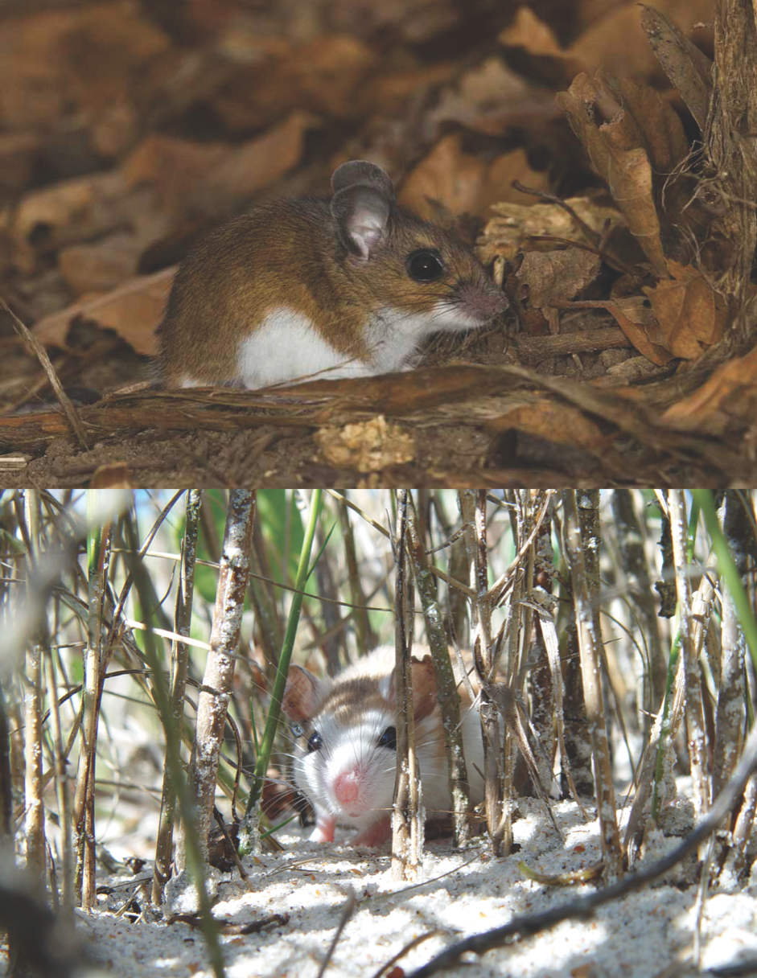
Chapter 7
Beyond alleles: quantitative genetics and the evolution of phenotypes

Slide 2
Continuous traits have a complex genetic basis
Polygenic trait: influenced by many genetic loci
  Interaction between alleles (epistasis)
  Interaction with environment (phenotypic plasticity)
Quantitative genetics: study of the genetic mechanisms of continuous phenotypic traits

Slide 3
Epistasis
Epistasis is a phenomenon in which the expression of one gene depends on the presence of one or more "'modifier genes'." A gene whose phenotype is expressed is called epistatic, while one whose phenotype is altered or suppressed is called hypostatic.

Slide 4
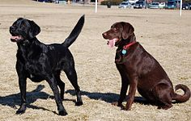
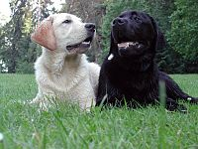
Epistasis
Labradors showing the two eumelanin color phenotypes: Black (BB,Bb) and Chocolate (bb).
Labradors with the recessive (ee) and dominant (EE, Ee) phenotypes for the expression of eumelanin pigment in the fur.

Slide 5
Phenotypic plasticity
Phenotypic plasticity is the ability of an organism to change its phenotype in response to changes in the environment.
Phenotypic plasticity encompasses all types of environmentally induced changes (e.g. morphological, physiological, behavioral) that may or may not be permanent throughout an individual’s lifespan.
It is NOT evolution.

Slide 6
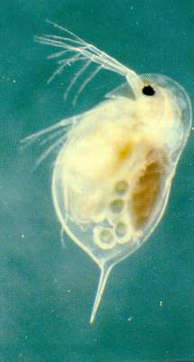
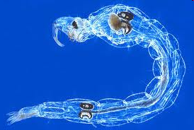
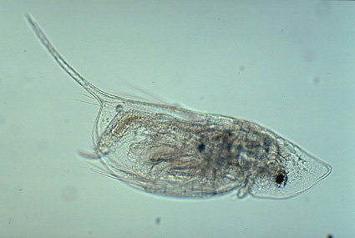
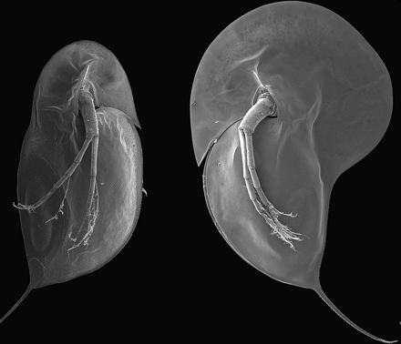
  Phenomenon in Daphnia, known today as cyclomorphosis
  When exposed to the presence of a predator they respond by altering the shape of their body to produce a “helmet” or “neck teeth”– effective in reducing predation pressure

Slide 7
So…
When components of variation are additive, genetic and environmental variance sum to total phenotypic variance
Heritability is the proportion of phenotypic variance due to genetic differences
Broad sense heritability includes:
  Additive effects
  Dominance effects
  Epistatic effects
  Maternal/Paternal environmental effects

Slide 8
Natural Selection
The process in nature by which, according to Darwin's theory of evolution, only the organisms best adapted to their environment tend to survive and transmit their genetic characteristics in increasing numbers to succeeding generations while those less adapted tend to be eliminated.

Slide 9
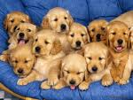
Natural selection is a mechanism that causes evolution. It occurs when some kinds of organisms in a population leave more offspring than other kinds of organisms; the result is that the kinds of organisms who leave more offspring will increase in frequency
over time.

Slide 10
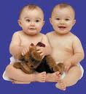
Natural selection can be understood as a logical argument in which a conclusion follows from a set of premises (or a result follows from a set of initial conditions). Natural selection will operate on anything that has the following properties:
  reproduction
  inheritance
  variation in fitness
  variation in individual
  characteristic

Slide 11
  reproduction
    New generation must exist
  inheritance
    “like must reproduce like”
  variation in fitness
    Some individuals are more likely to reproduce
    The fitness of an organism, in its simplest evolutionary sense, is how many successful offspring an individual has
  variation in individual characteristic
    There must be variation in phenotype (ergo genotype)

Slide 12
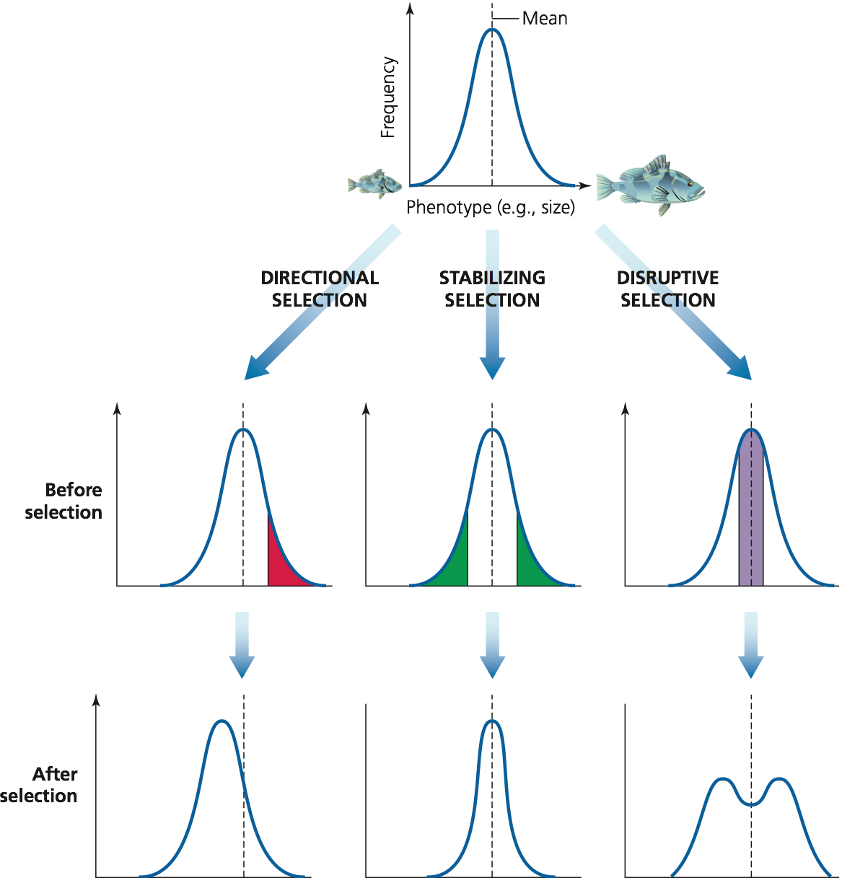
Modes of selection

Slide 13
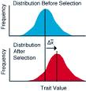
Directional Selection
Directional selection favors those individuals who have extreme variations in traits within a population.

Slide 14
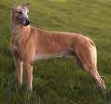
Directional Selection
A useful example can be found in the breeding of the greyhound dog. Early breeders were interested in dog with the greatest speed. They carefully selected from a group of hounds those who ran the fastest.

Slide 15
Directional Selection
From their offspring, the greyhound breeders again selected those dogs who ran the fastest. By continuing this selection for those dogs who ran faster than most of the hound dog population, they gradually produced a dog who could run up to 64km/h (40mph).
The greyhound was originally used to hunt the fastest of game, fox and deer. Their breed dates to Egypt in 3BCE.

Slide 16
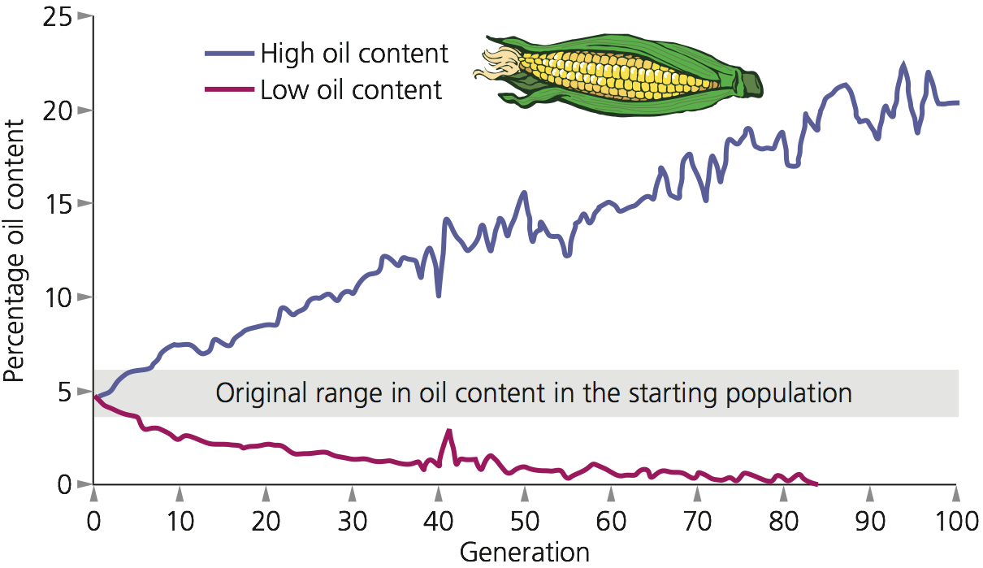
Cumulative effects of directional selection can be large

Slide 17
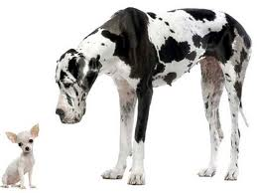
Or…

Slide 18

Stabilizing selection
Stabilizing selection favors the norm, the common, average traits in a population.
Look at the Siberian Husky, a dog bred for working in the snow.

Slide 19
Stabilizing selection
The Siberian Husky is a medium dog, males weighing 16-27kg (35-60lbs). These dogs have strong pectoral and leg muscles, allowing it to move through dense snow.
If the Siberian Husky had heavier muscles, it would sink deeper into the snow, so they would move slower or would sink and get stuck in the snow.

Slide 20
Stabilizing selection
Yet if the Siberian Husky had lighter muscles, it would not be strong enough to pull sleds and equipment, so the dog would have little value as a working dog.
So stabilizing selection has chosen a norm for the size of the Siberian Husky.

Slide 21
Disruptive selection
Disruptive (diversifying) selection, like directional selection, favors the extremes traits in a population. Disruptive selection differs in that sudden changes in the environment creates a sudden force favoring that extreme.

Slide 22

Disruptive selection
Think about the changes in the environment when that meteor crashed into Earth 65mya. A sudden decrease in light levels as the dust rose over large portions of the Earth. Extremely large tidal waves washing miles over the land. Increased seismic activity.

Slide 23
Disruptive selection
The sudden lost of food along the coast, possible plague due to the high initial death rate, dust filling the lungs of animals would have been the most stressful on larger animals.
Large animals need a large oxygen supply to supply energy to their muscles. They also need a large, constant supply of food.

Slide 24
Disruptive selection
The sudden drop of oxygen due to the dust, and the drop in fresh food, large animals would be stressed. If a plague started by the high death rate also hit these stressed animals, they would have been sorely pushed to survive. Evidence shows that they did not. So disruptive selection occurs quickly, selecting for those extreme traits that help organisms survive in the new environmental conditions.

Slide 25
Disruptive selection
So disruptive selection occurs quickly, selecting for those extreme traits that help organisms survive in the new environmental conditions.

Slide 26
Evolutionary response to selection
How much the population changes depends on:
  Selection differential (S)
  Heritability

Slide 27
Selection coefficient
the selection coefficient is a measure of the relative fitness of a phenotype. Usually denoted by the letter s, it compares the fitness of a phenotype to another favored phenotype, and is the proportional amount that the considered phenotype is less fit as measured by fertile progeny.
s = 0 then is selectively neutral compared to the favored phenotype, while s = 1 indicates complete lethality.

Slide 28
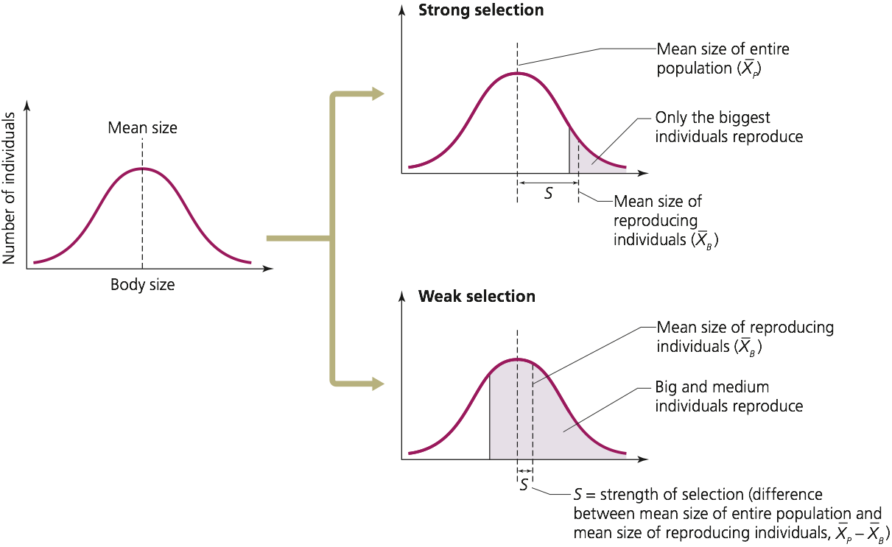
Selection differential measures the strength of selection

Slide 29
So..
Evolution and selection are not the same
  Selection can occur without evolution
The magnitude of change depends on:
  Strength of selection (selection differential)
  Heritability

Slide 30
Quantitative trait loci (QTLs)
Quantitative trait loci (QTLs) are stretches of DNA containing or linked to the genes that underlie a quantitative trait. Mapping regions of the genome that contain genes involved in specifying a quantitative trait is done using molecular tags, commonly SNPs.

Slide 31
Quantitative traits refer to phenotypes (characteristics) that vary in degree and can be attributed to polygenic effects, i.e., product of two or more genes, and their environment.

Slide 32
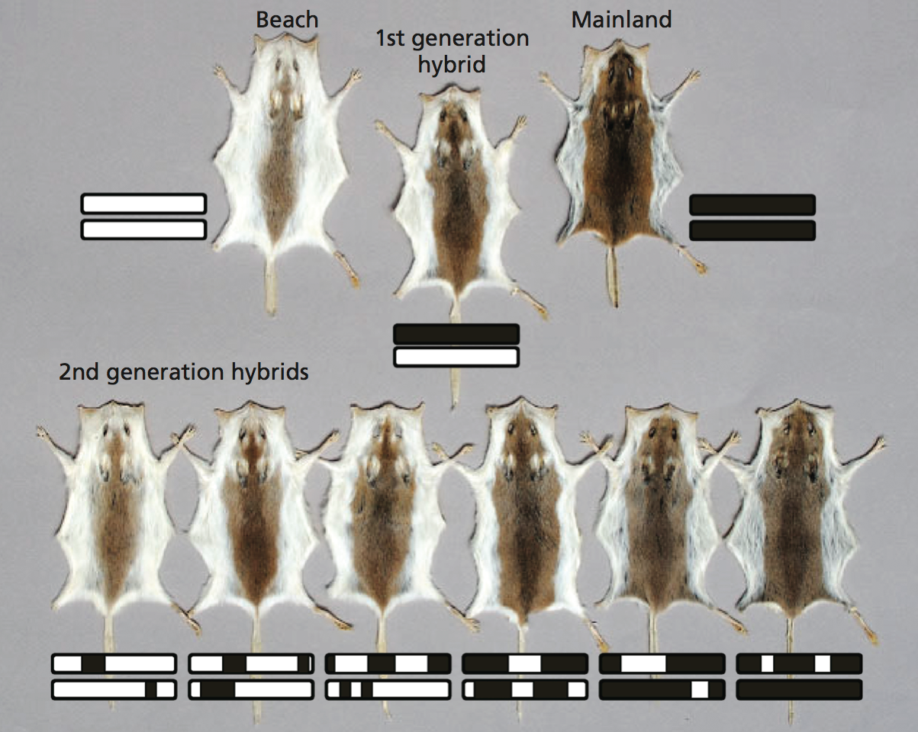
QTL analysis of coat color in mice

Slide 33
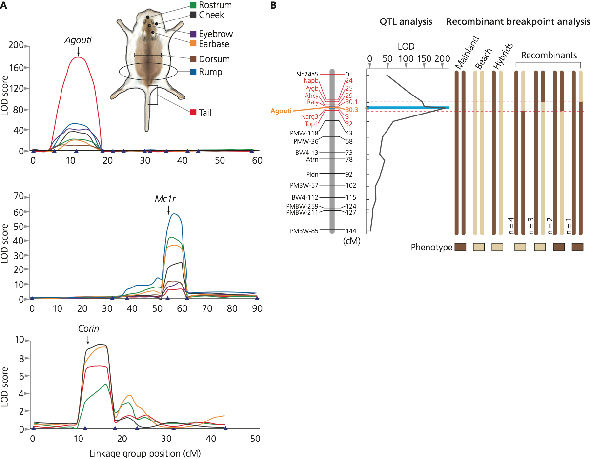
QTL analysis of coat color in mice

Slide 34
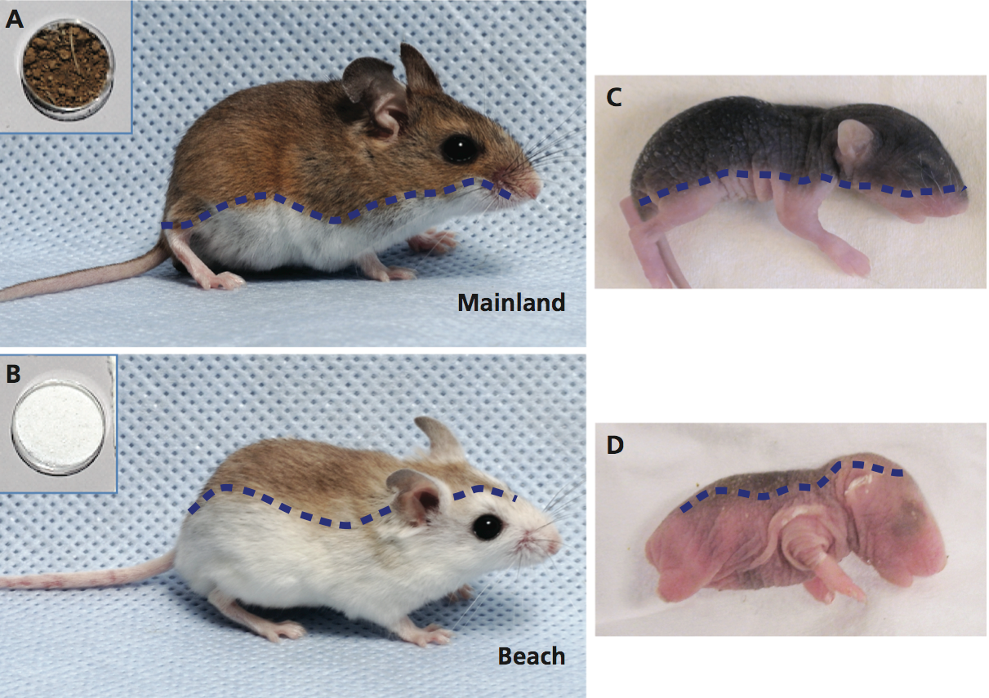
Expression of Agouti during development influences coat color

Slide 35
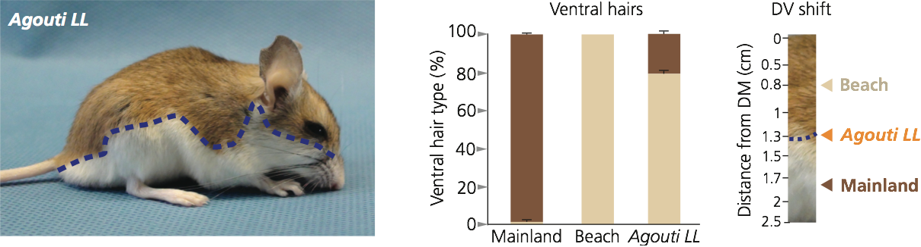
Genetic manipulation of dark mice makes them lighter

Slide 36
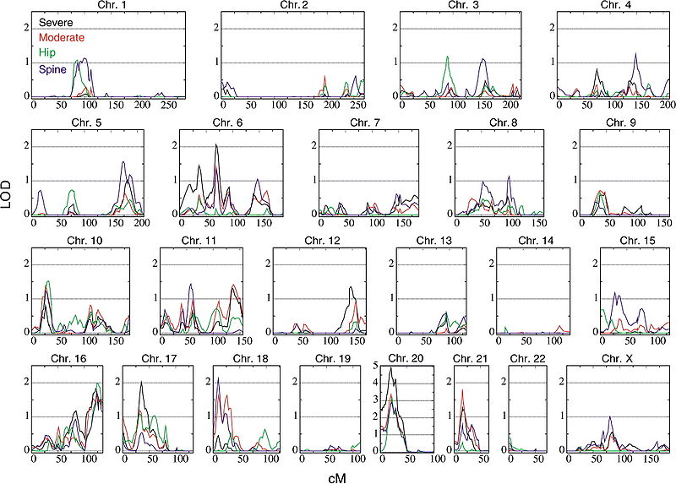
QTL analysis of osteoporosis

Slide 37
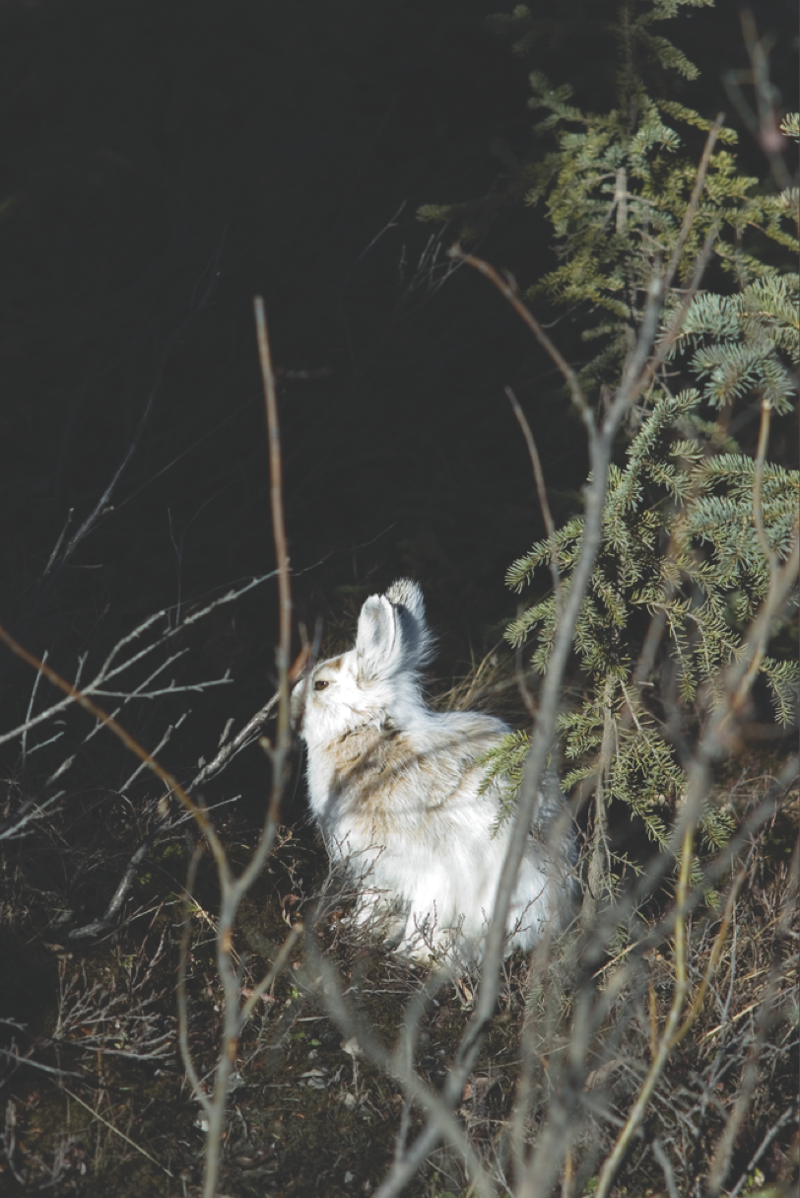
Rapid change can lead to mismatch between plastic traits and environment

