Slide 1
Human Evolution

Slide 2
Who are we?
Where did we come from?
What is the human genealogy?
These are basic questions that we all ask

Slide 3
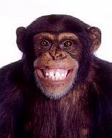
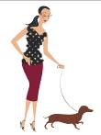
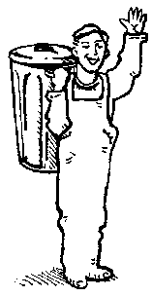
You Cuz
Dad Mum Aunt Uncle
Humans did not evolve from Apes
You are descended from your mother and father
You are related to your aunt and cousin

Slide 4
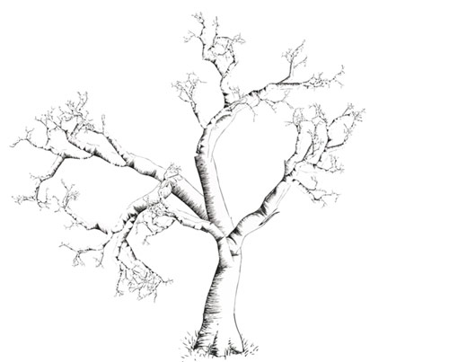
Common ancestor
Where we came from

Slide 5
Contemporary
animals
Where we are now

Slide 6
Contemporary
animals
Fossils
A lot of the pieces are missing!

Slide 7
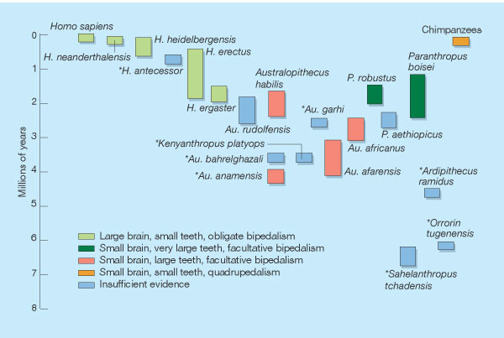
What is a Hominid?
Modern humans & our direct and indirect ancestors after our lineage split from the chimpanzee
Until recently, earliest hominids were dated between 3.5 and 2.4 mya & placed in the genus Australopithecus
In last few years, time range of Australopithecus pushed back to 4.2 mya, distribution expanded to include regions outside E. and S. Africa
New finds from 4.5-7 mya are thought to be hominids that predate Australopithecines, although their status is debated

Slide 8
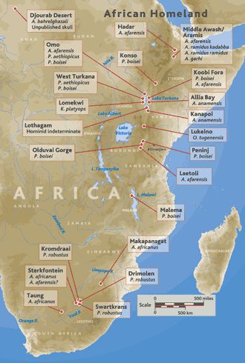
Hominid Sites
Earliest fossil hominid sites are in Africa
They now span the latest Miocene to the early Pleistocene from about 6-7 mya to about 1.6 mya
The major groups of sites are:
Ethiopia = Middle Awash valley & Hadar (Australopithecus afarensis)
Kenya = Lake Turkana
Tanzania = Olduvai Gorge
South Africa = various sites in limestone caverns centered around Sterkfontein

Slide 9
Hope of Life
A skull found in the African nation of Chad,
in 2002 and named Sahelanthropus tchadensis
but nicknamed Toumaï,
which means "hope of life" in the local Goran language,
has pushed back the origins of humans
to nearly 7 million years ago
Another discovery reported in 2006
provides strong evidence for
an ancestor-descendant relationship
between two early hominid lines,
one of which leads to our own human heritage

Slide 10
So where does this leave us, evolutionarily speaking?
At a very exciting time as we seek to unravel the history of our species
Our understanding of our genealogy
is presently in flux, and each new fossil hominid find sheds more light on our ancestry

Slide 11
Apparently human evolution is just like that of other groups
We have followed an uncertain evolutionary path
As new species evolved,
they filled ecologic niches
and either gave rise to descendants
better adapted to the changing environment
or became extinct
Our own evolutionary history has many dead-end side branches

Slide 12
What Are Primates?
Primates are difficult to characterize as an order
they lack the strong specializations found in most other mammalian orders
We can, however, point to several trends in their evolution that help define primates and are related to their arboreal, or tree-dwelling, ancestry

Slide 13
Trends in Primates
These include changes in the skeleton
and mode of locomotion
an increase in brain size
a shift toward smaller, fewer and less specialized teeth,
and the evolution of stereoscopic vision
and a grasping hand with opposable thumb
Not all these trends took place in every primate group nor did they evolve at the same rate in each group

Slide 14
Why did bipedalism become the primary adaptation of hominids?
Carrying behavior
Reduction of overall heat stress - facilitates heat loss through convection by exposing body to air currents, only humans have sweat glands that produce moisture to cool body
Most energy efficient way to travel long distances
Allows for better vision in open environments & defensive action against predators by freeing hands to throw objects

Slide 15
Classification of primates
The primate order is divided into two suborders:
Prosimians, or lower primates
include the lemurs, lorises, tarsiers, and tree shrews,
Anthropoids, or higher primates,
include monkeys, apes, and humans

Slide 17
Order Primates:
Suborder Prosimii: (lower primates) Lemurs, lorises, tarsiers, tree shrews
Suborder Anthropoidea: (Higher primates) Monkeys, apes, humans
Superfamily Cercopithecoidea: Macaque, baboon, proboscis monkey (Old World monkeys)
Superfamily Ceboidea: Howler, spider, and squirrel monkeys (New World monkeys)
Superfamily Hominoidea: Apes, humans
Family Pongidae: Chimpanzees, orangutans, gorillas
Family Hylobatidae: Gibbons, siamangs
Family Hominidae: Humans

Slide 18
Prosimians
Prosimians are generally small,
ranging from species the size of a mouse up to those as large as a house cat
They are arboreal, have five digits
on each hand and foot with either claws or nails,
are typically omnivorous
They have large, forwardly directed eyes
specialized for night vision, hence most are nocturnal

Slide 19
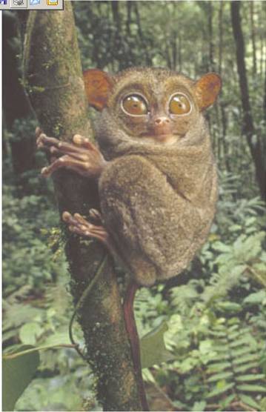
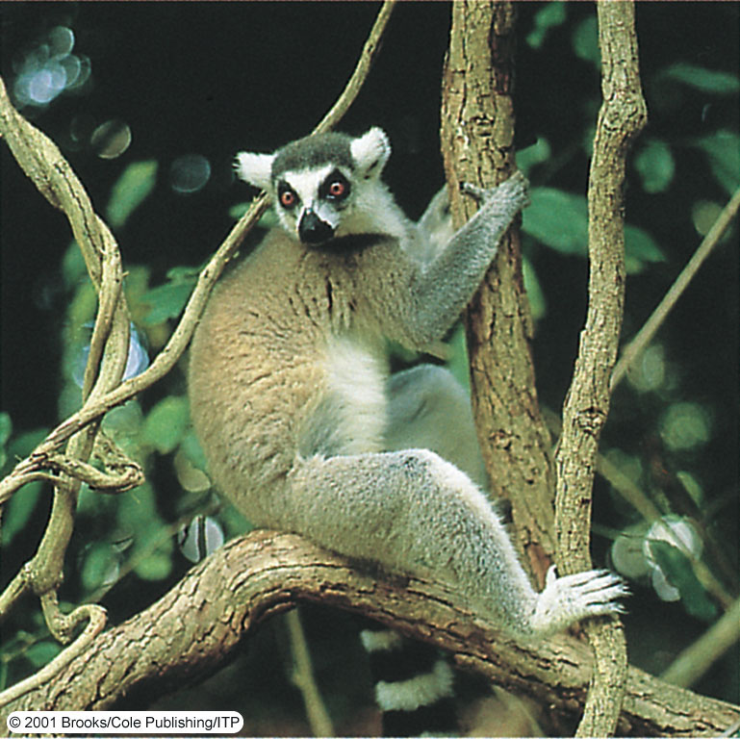
Prosimians
Ring-tailed lemur
Tarsier

Slide 20
Eocene Prosimian
Notharctus,
a primitive Eocene prosimian

Slide 21
Decline due to weather change
As the continents moved northward during the Cenozoic
the climate changed from warm tropical to cooler mid-latitude conditions,
the prosimian population decreased in both abundance and diversity
By the Oligocene, hardly any prosimians were left in the northern continents
as the once widespread Eocene populations migrated south to the warmer latitudes
of Africa, Asia, and Southeast Asia
Presently, prosimians are found only in the tropical regions
of Asia, India, Africa, and Madagascar

Slide 22
As their name implies
pro means "before," and simian means "ape”,
prosimians are the oldest primate lineage, and their fossil record extends back to the Paleocene
During the Eocene prosimians were
abundant, diversified, and widespread in North America, Europe, and Asia

Slide 23
Anthropoids
Anthropoids evolved from a prosimian lineage
sometime during the Late Eocene
and by the Oligocene they were well established
Anthropoids are divided into three superfamilies

Slide 24
Old World Monkey
Suborder: Anthropoidea
Superfamily : Cercopithecoidea

Slide 25
Old World Monkey
Old World monkeys
are characterized by close-set, downward-directed nostrils
like those of apes and humans
grasping hands, and a nonprehensile tail
They include
the macaque, baboon, and proboscis monkey

Slide 26
Present-day Old World monkeys
are distributed in the tropical regions of Africa and Asia
are thought to have evolved from a primitive anthropoid ancestor,
such as Aegyptopithecus, sometime during the Oligocene

Slide 27
Skull of Aegyptopithecus zeuxis

Slide 28
New World Monkey
Suborder: Anthropoidea
Superfamily Ceboidea:

Slide 29
New World Monkeys
are found only in Central and South America
They probably evolved from African monkeys
that migrated across the widening Atlantic sometime during the Early Oligocene, and they have continued evolving in isolation to this present day

Slide 30
New World monkeys
No evidence exists of any prosimian
or other primitive primates in Central or South America
nor of any contact with Old World monkeys after the initial immigration from Africa
New World monkeys are characterized
by a prehensile tail, flattish face
widely separated nostrils
include the howler, spider, and squirrel monkeys

Slide 31
Great Apes
Suborder: Anthropoidea
Superfamily : Hominoidea

Slide 32
Hominoidea
consist of three families:
the great apes
family Pongidae
which includes chimpanzees, orangutans, and gorillas
the lesser apes
family Hylobatidae
which are gibbons and siamangs;
and the hominids
family Hominidae
which are humans and their extinct ancestors

Slide 33
Hominoids
The hominoid lineage diverged from Old World monkeys
sometime before the Miocene, but exactly when is still being debated
It is generally accepted, however, that hominoids evolved in Africa,
probably from the ancestral group that included Aegyptopithecus

Slide 34
Apes adapted
As the climate changed, the primate populations also changed
Prosimians and monkeys became rare,
whereas hominoids diversified in the newly forming environments
and became abundant
Ape populations became reproductively isolated
from each other within the various forests,
leading to adaptive radiation
and increased diversity among the hominoids

Slide 35
Hominoids
During the Miocene,
Africa collided with Eurasia, producing additional changes in the climate,
provided opportunities for migration of animals between the two landmasses

Slide 36
Hominoids
Two apelike groups evolved during the Miocene
ultimately gave rise to present-day hominoids
Although scientists still disagree on the early evolutionary relationships among the hominoids
fossil evidence and molecular DNA similarities between modern hominoid families is providing a clearer picture of the evolutionary pathways and relationships among the hominoids

Slide 37
Early History of Anthropoids
Much of our knowledge about the early evolutionary history of anthropoids
comes from fossils found in the Fayum district,
a small desert area southwest of Cairo, Egypt
During the Late Eocene and Oligocene,
this region of Africa was a lush, tropical rain forest
supported a diverse and abundant fauna and flora
Within this forest lived many different
arboreal anthropoids as well as various prosimians

Slide 38
Thousands of Fossil Specimens
Several thousand fossil specimens have been recovered from rocks of this region
representing more than 20 species of primates
One of the earliest anthropoids, Aegyptopithecus,
a possible ancestor of the Old World monkeys
a small, fruit-eating, arboreal primate, about 5 kg
It had monkey characteristics and ape features
and is the closest link we currently have to Old World primates

Slide 39
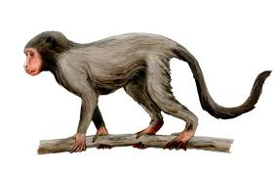
Aegyptopithecus

Slide 40
The hominids (family Hominidae)
The primate family that includes present-day humans and their extinct ancestors
Have a fossil record extending back to almost 7 million years
Several features distinguish them from other hominoids
Hominids are bipedal;
that is, they have an upright posture,
which is indicated by several modifications in their skeleton

Slide 41
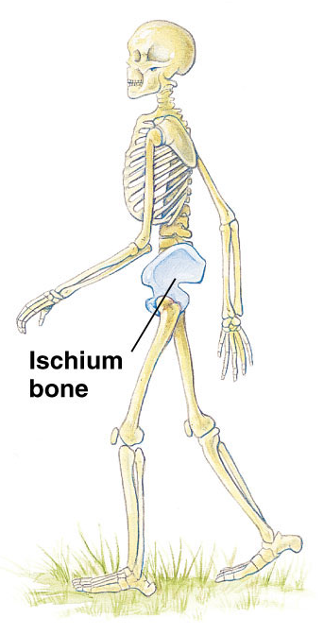
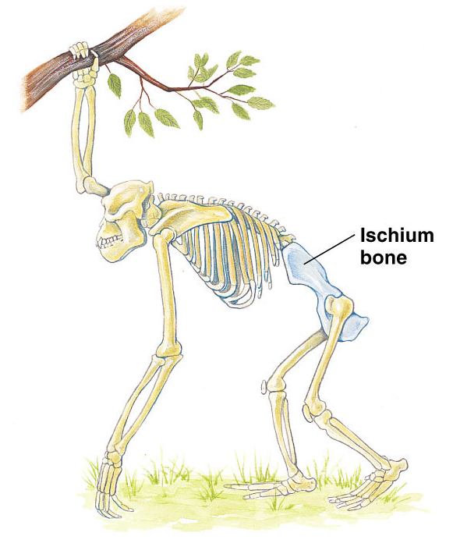
Comparison between quadrupedal and bipedal locomotion
Gorillas: the ischium bone is long and the entire pelvis is tilted toward the horizontal
Humans: the ischium bone is much shorter and the pelvis is vertical

Slide 42
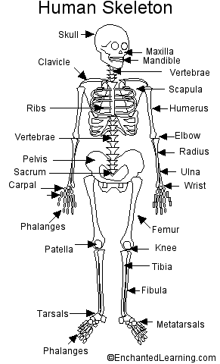
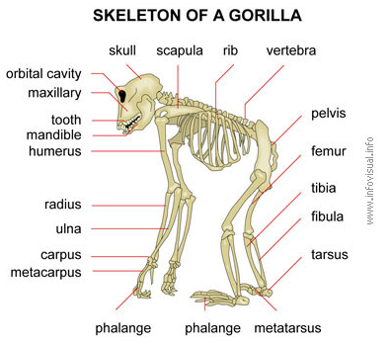
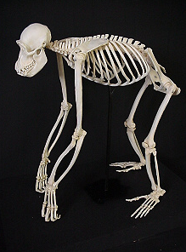
Topic 14 – Human Evolution
II. Hominid Evolution
C. Upright posture evolved before large brains

Slide 43
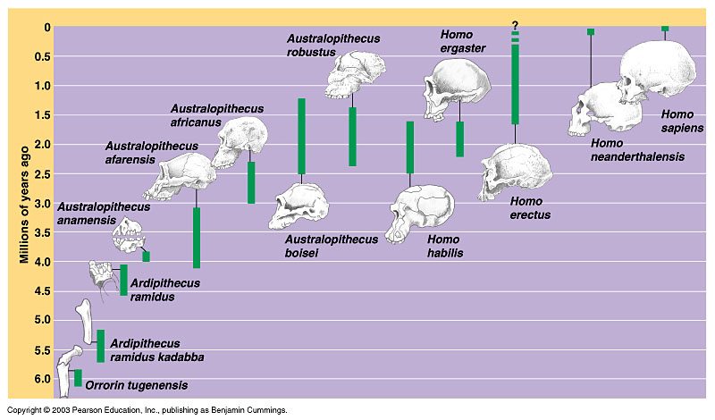
Topic 14 – Human Evolution
II. Hominid Evolution
C. Upright posture evolved before large brains
Opening in skull reveals upright posture

Slide 44
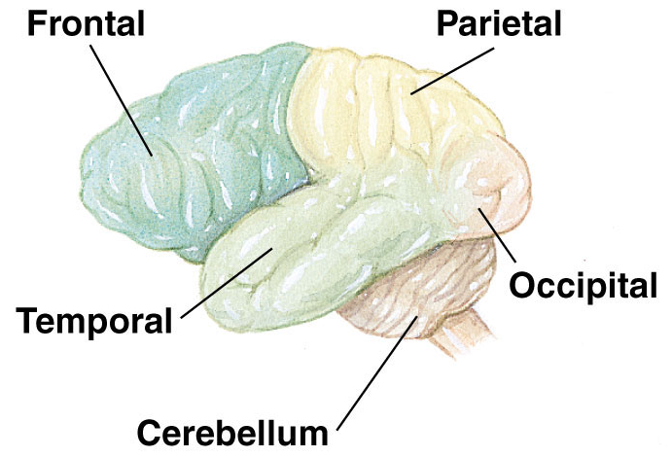
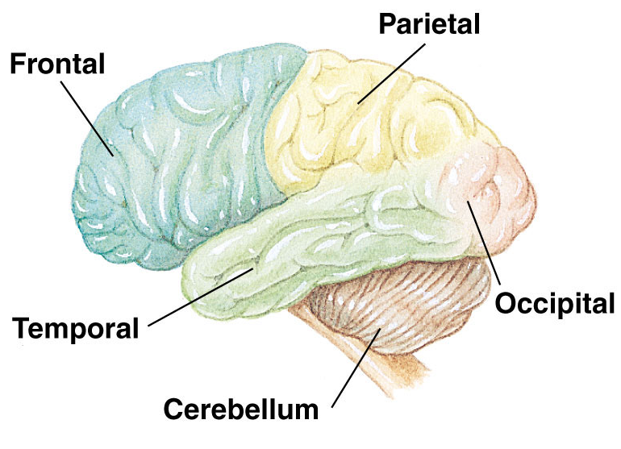
Brain Size and organization
New World Monkey
Great Ape
Present day human

Slide 45
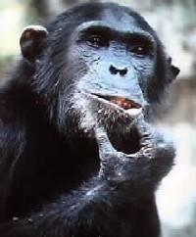
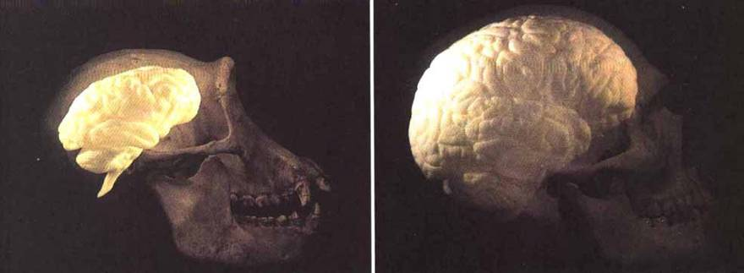
Brain size

Slide 47
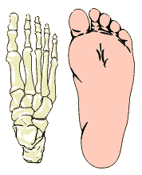
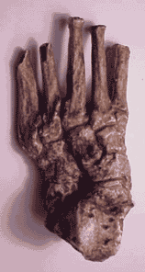
Topic 14 – Human Evolution
Position of inner toe reveals upright posture
II. Hominid Evolution
Upright posture evolved before large brains
Convergent big toe

Slide 48
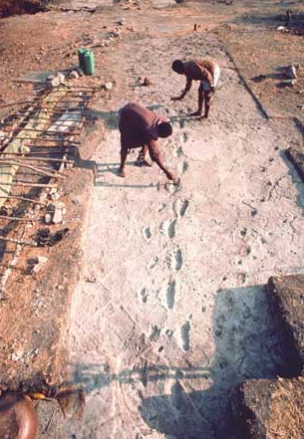
Topic 14 – Human Evolution
II. Hominid Evolution
Upright posture evolved before large brains
Convergent big toe
-Tanzania
-ca. 3.5 Ma
-damp volcanic ash

Slide 49
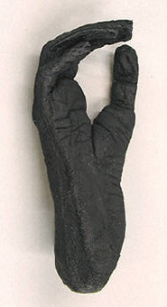
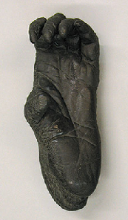
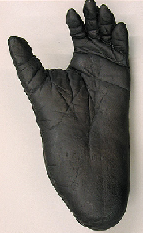
Topic 14 – Human Evolution
II. Hominid Evolution
Upright posture evolved before large brains
Convergent big toe
Position of inner toe reveals upright posture
Hylobatidae Pongo Gorilla Pan Homo

Slide 50
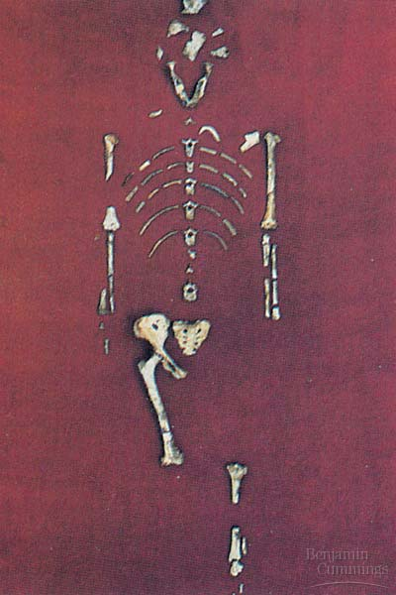
Topic 14 – Human Evolution
II. Hominid Evolution
Upright posture evolved before large brains
Pelvis, spine curvature, knee joint all reveal bipedalism
Lucy (Australopithecus afarensis)
http://www.teachersdomain.org/resources/tdc02/sci/life/evo/findinglucy/index.html

Slide 51
Other distinguishing features
Other features that distinguish hominids from other hominoids include
a reduced face
reduced canine teeth
omnivorous feeding
increased manual dexterity
use of sophisticated tools

Slide 52
Hominid Evolution

Slide 53
No Clear Consensus
At present, no clear consensus exists on the evolutionary history of the hominid lineage
This is partly because
of the incomplete fossil record of hominids, as well as new discoveries,
because some species are known only from partial specimens or fragments of bone
Because of this, scientists even disagree on the total number of hominid species

Slide 54
Some Current Theories
A complete discussion of all the proposed hominid species and the various competing schemes of hominid evolution is beyond the scope of this course
However, we will discuss the generally accepted taxa and present some of the current theories of hominid evolution

Slide 55
Commonly accepted species of hominids

Slide 56
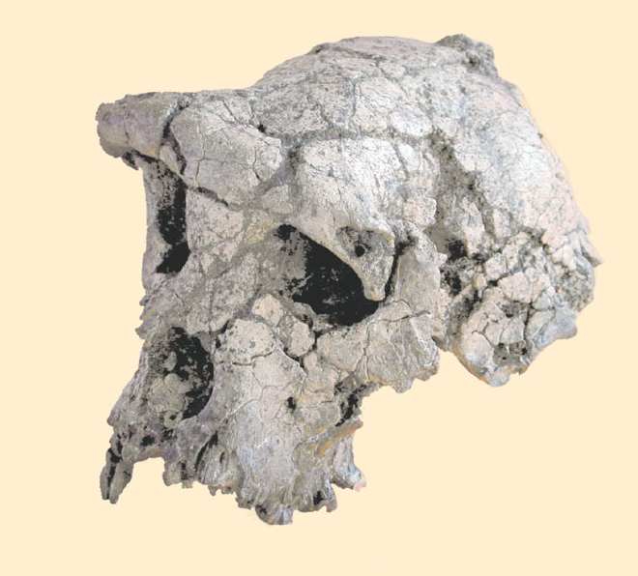
Oldest known hominid
Discovered in northern Chad's Djurab Desert in July, 2002
the nearly 7-million-year-old skull and dental remains of Sahelanthropus tchadensis “Toumai”
makes it the oldest known hominid yet unearthed and very close to the time
when humans diverged from our closest-living relative, the chimpanzee

Slide 57
When Humans and Chimpanzees Diverged
Currently, most paleoanthropologists accept that the human-chimpanzee stock separated from gorillas about 8 million years ago and humans separated from chimpanzees about 5 million years ago

Slide 58
Besides being the oldest hominid, Sahelanthropus tchadensis shows a mosaic of primitive and advanced features that has excited and puzzled paleoanthropologists
The small brain case and most of the teeth (except the canines) are chimplike
However, the nose, which is fairly flat, and the prominent brow ridges are features only seen, until now, in the human genus Homo
Sahelanthropus tchadensis may have been bipedal in its walking habits, but until bones from its legs and feet are found, that supposition remains conjecture

Slide 59
The controversy
Sahelanthropus may represent a common ancestor of humans and chimpanzees; no consensus has been reached yet by the scientific community. The original placement of this species as a human ancestor but not a chimpanzee ancestor would complicate the picture of human phylogeny.
In particular, if Toumaï is a direct human ancestor, then its facial features bring into doubt the status of Australopithecus because its thickened brow ridges were reported to be similar to those of some later fossil hominids (notably Homo erectus), whereas this morphology differs from that observed in all australopithecines, most fossil hominids and extant humans.

Slide 60
Another possibility is that Toumaï is related to both humans and chimpanzees, but is the ancestor of neither. The discoverers of Orrorin tugenensis, suggested that the features of S. tchadensis are consistent with a female proto-gorilla.
Even if this claim is upheld, then the find would lose none of its significance, for at present, few chimpanzee or gorilla ancestors have been found anywhere in Africa.
If S. tchadensis is an ancestral relative of the chimpanzees (or gorillas), then it represents the first known member of their lineage. Furthermore, S. tchadensis does indicate that the last common ancestor of humans and chimpanzees is unlikely to resemble chimpanzees very much, as had been previously supposed by some paleontologists

Slide 61
A further possibility, highlighted by research published in 2012, is that the human/chimpanzee split is earlier than previously thought, with a possible range of 7 to 13 million years ago (with the more recent end of this range being favored by most researchers), based on slower than previously thought changes between generations in human DNA.

Slide 62
Next oldest hominid
The next oldest hominid is Orrorin tugenensis, whose fossils have been dated at 6 million years, in Kenya
consist of bits of jaw, isolated teeth, finger, arm, and partial upper leg bones
At this time, debate continues as to exactly where Orrorin tugenensis fits in the hominid lineage

Slide 64
If Orrorin proves to be a direct human ancestor, then australopithecines such as Australopithecus afarensis ("Lucy") may be considered a side branch of the hominid family tree
Orrorin is both earlier, by almost 3 million years, and more similar to modern humans than is A. afarensis. The main similarity is that the Orrorin femur is morphologically closer to that of H. sapiens than is Lucy's; there is, however, some debate over this point

Slide 65
“Ardi”
Sometime between 5.8 and 5.2 million years ago another hominid was present in eastern Africa
Ardipithecus ramidus kadabba is older than its 4.4 million year old relative Ardipithecus ramidus ramidus
Ardipithecus ramidus kadabba is very similar in most features to Ardipithecus ramidus ramidus but in certain features of its teeth is more apelike than its younger relative

Slide 66
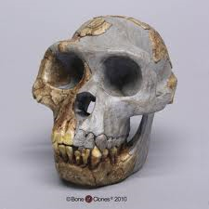
“Ardi”

Slide 68
Habitual bipedal walkers
Although many paleoanthropologists think both Orrorin tugenensis and Ardipithecus ramidus kadabba were habitual bipedal walkers and thus on a direct evolutionary line to humans, others are not as impressed with the fossil evidence and are reserving judgment
Until more fossil evidence is found and analyzed, any single scheme of hominid evolution presented here would be premature

Slide 69
Australopithecines
Australopithecine is a collective term for all members of the genus Australopithecus
Currently, five species are recognized:
A. anamensis
A. afarensis
A. africanus
A. robustus
A. boisei

Slide 71
Evolutionary scheme
Many paleontologists accept the evolutionary scheme in which A. anamensis, the oldest known australopithecine, is ancestral to A. afarensis, who in turn is ancestral to A. africanus and the genus Homo, as well as the side branch of australopithecines represented by A. robustus and A. boisei

Slide 72
Australopithecus anamensis
The oldest known australopithecine is Australopithecus anamensis
discovered at Kanapoi, a site near Lake Turkana, Kenya,
A. anamensis, a 4.2-million-year-old bipedal species
has many features in common with its younger relative, A. afarensis,
is more primitive in other characteristics, such as its teeth and skull
A. anamensis is estimated to have been between 1.3 and 1.5 m tall and weighed between 33 and 50 kg

Slide 73
New fossil discovery
A discovery in 2006 of fossils of A. anamensis, from the Middle Awash area in northeastern Ethiopia has shed new light on the transition between Ardipithecus and Australopithecus.
The discovery of Ardipithecus in the same region of Africa and same times as the earliest Australopithecus provides strong evidence that Ardipithecus evolved into Australopithecus and links these two genera in the evolutionary lineage leading to humans.

Slide 74
Australopithecus afarensis
Australopithecus afarensis
lived 3.9–3.0 million years ago,
was fully bipedal
exhibited great variability in size and weight
Members of this species ranged from just over 1 m to about 1.5 m tall and weighed between 29 and 45 kg

Slide 75
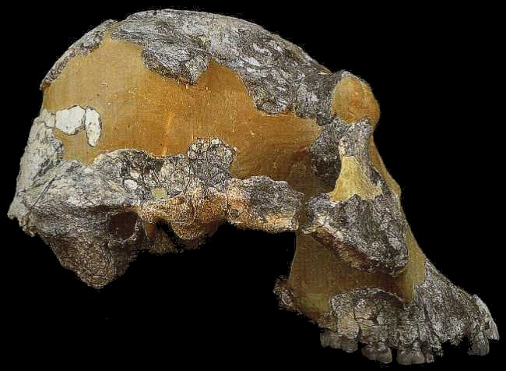
AustralopitheAustralopithecus afarensiscus afarensis

Slide 77
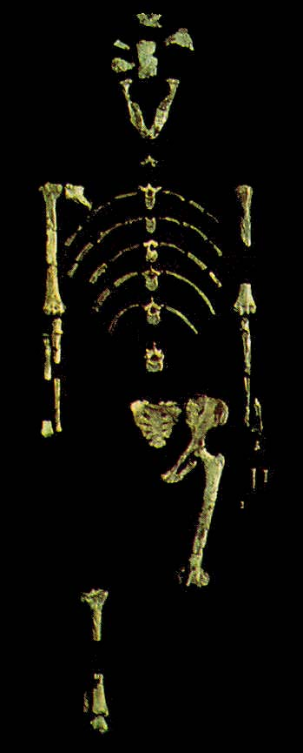
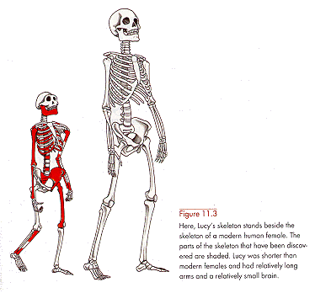
A. afarensis Skeleton - Lucy

Slide 78
Lucy
Reconstruction illustrates how adaptations in Lucy’s hip, leg and foot allowed a fully bipedal means of locomotion

Slide 79
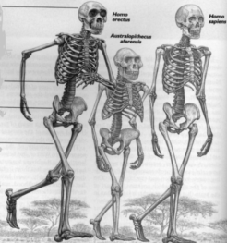
Homo erectus
Homo sapiens
Australopithecus afarensis

Slide 80
Hominid footprints
Preserved in volcanic ash at Laetoli, Tanzania
Discovered in 1978 by Mary Leakey, these footprints proved hominids were bipedal walkers at least 3.5 million years ago
The footprints of two adults and possibly those of a child are clearly visible in this photograph
Most scientists think the footprints were made by Australopithecus afarensis whose fossils are found at Laetoli

Slide 81
Australopithecus africanus
A. afarensis was succeeded by Australopithecus africanus, which lived 3.0–2.3 million years ago
The differences between the two species are relatively minor
They were both about the same size and weight, but A. africanus had a flatter face and somewhat larger brain

Slide 82
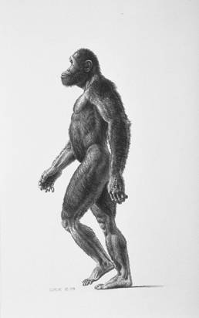
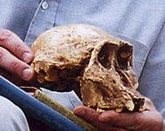
Australopithecus africanus
Southern Ape of Africa

Slide 83
A. afarensis
A. afarensis had a brain size of 380–450 cubic centimeters (cc)
larger than the 300–400 cc of a chimpanzee
much smaller than that of present-day humans (1350 cc average)
The skull of A. afarensis retained many apelike features
massive brow ridges
forward-jutting jaw, but its teeth were intermediate between those of apes and humans
The heavily enameled molars
probably an adaptation to chewing fruits, seeds, and roots
It appears the limbs of A. africanus may not have been as well adapted for bipedalism as those of A. afarensis

Slide 84
A reconstruction of the skull of Australopithecus africanus
This skull, known as that of the Taung Child, was discovered by Raymond Dart in South Africa in 1924 and marks the beginning of modern paleoanthropology

Slide 85
Robust species
Both A. afarensis and A. africanus differ markedly from the so-called robust species
A. boisei (2.6–1.0 million years ago)
A. robustus (2.0–1.2 million years ago)
A. boisei was 1.2–1.4 m tall and weighed between 34 and 49 kg
It had a powerful upper body, a distinctive bony crest on the top of its skull, a flat face, and the largest molars of any hominids

Slide 86
A. robustus
A. robustus, in contrast, was somewhat smaller (1.1–1.3 m tall) and lighter (32–40 kg)
It had a flat face, and the crown of its skull had an elevated bony crest that provided additional area for the attachment of strong jaw muscles
Its broad flat molars indicated A. robustus was a vegetarian
Most scientists accept the idea that the robust australopithecines form a separate lineage from the other australopithecines that went extinct 1 million years ago

Slide 87
Australopithecus robustus
This species had a massive jaw, powerful chewing muscles, and large broad flat chewing teeth apparently used for grinding up coarse plant food

Slide 88
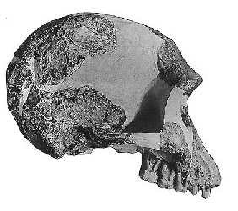
Topic 14 – Human Evolution
II. Hominid Evolution
D. Larger brains (tools) and reduced sexual dimorphism define the genus Homo
Often found with primitive stone tools
(e.g. Olduvai Gorge, Tanzania;
Lake Turkana, Kenya)
ca. 1.8 Ma

Slide 89
Why larger brains??
Larger brains have plausibly been connected with the evolution of a distinct human sexual psychology, favoring pair-bonding over promiscuity. Among both species of chimpanzees, females have exclusive charge of infants. Because of promiscuous sexual practices, paternity is generally not trackable. Australopithecines have similar brains and bodies and we have as yet no reason to think they didn't follow similar practices.

Slide 90
A selection for larger brains -- for whatever reason -- would run up against the problem of a baby's larger head needing to pass through the bones surrounding the birth canal. The solution in place today is that human babies are born very prematurely compared to the offspring of our closest relatives. The still soft head of a new-born infant is deformed into a tube as it is squeezed through the birth canal.

Slide 91
The price humans pay for this is a requirement of increased maternal care; for instance, for many months the baby is completely incapable of any form of locomotion, or even of clinging to the mother.
Larger brains would have favored extending the period in which infants are primarily devoted to learning new skills. These factors are likely to have created a significant benefit for children who received care not only from their mothers but also from their fathers and possibly their grandmothers (in the latter case creating a selective pressure for menopause).

Slide 92
In the case of fathers, natural selection would have favored males who were able to invest in their own rather than in others' offspring, thus creating selective pressures some way for males to track paternity.
Pair-bonding is the likely solution -- one that necessitated novel psychological adaptations, possibly along with physiological ones such as continued sexual receptivity in females

Slide 94
The Human Lineage
Homo habilis
The earliest member of our own genus Homo is Homo habilis,
lived 2.5-1.6 million years ago
Its remains were first found at Olduvai Gorge, Tanzania,
but it is also known from Kenya, Ethiopia, and South Africa
H. habilis evolved from the A. afarensis and A. africanus lineage and coexisted with A. africanus for about 200,000 years

Slide 95
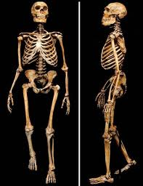

Slide 96
Homo habilis
H. habilis had a larger brain (700 cc average) than its australopithecine ancestors, but smaller teeth
It was about 1.2-1.3 m tall and only weighed 32-37 kg

Slide 97
Homo erectus
In contrast to the australopithecines and H. habilis, which are unknown outside Africa, Homo erectus was a widely distributed species, having migrated from Africa during the Pleistocene
Specimens have been found not only in Africa but also in Europe, India, China ("Peking Man"), and Indonesia ("Java Man")
H. erectus evolved in Africa 1.8 million years ago and by 1 million years ago, moved into southeastern and eastern Asia, where it survived until about 100,000 years ago

Slide 98
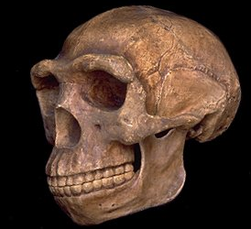
Topic 14 – Human Evolution
II. Hominid Evolution
D. Larger brains (tools), reduced sexual dimorphism, & the genus Homo
-1.8-1.5 Ma
-First Homo to leave Africa
-First hunter / gatherers, rather than mere prey
-Fire (ca. 500,000 – 300,000 ybp)?
‘Peking man’ (H. erectus)

Slide 99
Homo erectus
Although H. erectus developed regional variations in form, the species differed from modern humans in several ways
Its brain size of 800-1300 cc, though much larger than that of H. habilis, was still less than the average for Homo sapiens (1350 cc)
H. erectus's skull was thick-walled, its face was massive, it had prominent brow ridges, and its teeth were slightly larger than those of present-day humans
H. erectus was comparable to size to modern humans, standing between 1.6 and 1.8 m tall and weighing between 53 and 63 kg

Slide 100
Tool Maker
The archaeological record indicates that H. erectus was a tool maker
Furthermore, some sites show evidence that its members used fire and lived in caves, an advantage for those living in more northerly climates

Slide 102
Homo sapiens evolved from H. erectus
Our species, H. sapiens most certainly evolved from H. erectus

Slide 103
Topic 14 – Human Evolution
II. Hominid Evolution
E. Origins of the “wise-man”, Homo sapiens
Homo sapiens
Defined by larger brain, forehead, and reduced brow ridge.

Slide 104
Neanderthals
Perhaps the most famous of all fossil humans are the Neanderthals,
inhabited Europe and the Near East from about 200,000 to 30,000 years ago
Some paleoanthropologists regard the Neanderthals
as a variety or subspecies of our own species (Homo sapiens neanderthalensis),
whereas others regard them as a separate species (Homo neanderthalensis)

Slide 106
Neanderthals
their name comes
from the first specimens found in 1856 in the Neander Valley near Düsseldorf
The most notable difference between Neanderthals and present-day humans is in the skull
Neanderthal skulls were long and low with heavy brow ridges, a projecting mouth, and a weak, receding chin
Their brain was slightly larger on average than our own, and somewhat differently shaped

Slide 107
Archaeological evidence indicates Neanderthals lived in caves and participated in ritual burials such as occurred approximately 60,000 years ago at Shanidar Cave, Iraq
The remains of Neanderthals are found chiefly in caves and hutlike rock shelters, which also contain a variety of specialized stone tools and weapons
Archaeological evidence indicates that Neanderthals commonly took care of their injured and buried their dead, frequently with such grave items as tools, food, and perhaps even flowers

Slide 108
Cold Adapted
The Neanderthal body was more massive and heavily muscled than oursrather short lower limbsmuch like those of other cold-adapted people of today
Given the specimens from more than 100 sites, we now know Neanderthals were not much different from us, only more robust
Europe's Neanderthals were the first humans to move into truly cold climates, enduring miserably long winters and short summers as they pushed north into tundra country

Slide 109
Cro-Magnons
About 30,000 years ago,
humans closely resembling modern Europeans moved into the region inhabited by the Neanderthals and completely replaced them
Cro-Magnons, the name given to the successors of the Neanderthals in France, lived from about 35,000 to 10,000 years ago; during this period the development of art and technology far exceeded anything the world had seen before

Slide 110
Cro-Magnons
Highly skilled nomadic hunters, Cro-Magnons followed the herds in their seasonal migrations
They used a variety of specialized tools in their hunts, including perhaps the bow and arrow
They sought refuge in caves and rock shelters and formed living groups of various sizes
Cro-Magnons were also cave painters
Using paints made from manganese and iron oxides, Cro-Magnon people painted hundreds of scenes on the ceilings and walls of caves in France and Spain, where many of them are still preserved today

Slide 111
Painting of a horse from the cave of Niaux, France

Slide 112
Replacement model
Debate still surrounds the transition from H. erectus to our own species, Homo sapiens
Paleoanthropologists are split into two camps
On the one side are those who support
the "out of Africa" view
According to this camp, early modern humans evolved from a single woman in Africa, whose offspring then migrated from Africa, perhaps as recently as 100,000 years ago and populated Europe and Asia, driving the earlier hominid populations to extinction

Slide 114
The "multiregional" view
On the other side are those supporting the "multiregional" view
According to this hypothesis, early modern humans did not have an isolated origin in Africa, but rather established separate populations throughout Eurasia (H. erectus > H. neanderthalenis > H. sapiens
Occasional contact and interbreeding between these populations enabled our species to maintain its overall cohesiveness, while still preserving the regional differences in people we see today

Slide 115
Beginning in the 1980's, Rebecca Cann, at the University of California, argued that the geographic region in which modern people have lived the longest should have the greatest amount of genetic diversity today.
Through comparisons of mitochondrial DNA sequences from living people throughout the world, she concluded that Africa has the greatest genetic diversity and, therefore, must be the homeland of all modern humans.

Slide 116
Assuming a specific, constant rate of mutation, she further concluded that the common ancestor of modern people was a woman living about 200,000 years ago in Africa.
This supposed predecessor was dubbed "mitochondrial Eve“
More recent genetic research at the University of Chicago and Yale University lends support to the replacement model.
It has shown that variations in the DNA of the Y chromosome and chromosome 12 also have the greatest diversity among Africans today.

Slide 117
Critics of the genetic argument for the replacement model also point out that the rate of mutation used for the "molecular clock" is not necessarily constant, which makes the 200,000 year date for "mitochondrial Eve" unreliable.
The rate of inheritable mutations for a species or a population can vary due to a number of factors including generation time, the efficiency of DNA repair within cells, ambient temperature, and varying amounts of natural environmental mutagens.

Slide 118
Further criticism of the genetic argument for the replacement model has come from geneticists at Oxford University.
They found that the human beta-globin gene is widely distributed in Asia but not in Africa. Since this gene is thought to have originated more than 200,000 years ago, it undercuts the claim that an African population of modern Homo sapiens replaced East Asian archaic humans less than 60,000 years ago.

Slide 119
The "multiregional" view
Fossil evidence also is used to support the regional continuity model. Its advocates claim that there has been a continuity of some anatomical traits from archaic humans to modern humans in Europe and Asia.
In other words, the Asian and European physical characteristics have antiquity in these regions going back over 100,000 years.
They point to the fact that many Europeans have relatively heavy brow ridges and a high angle of their noses reminiscent of Neanderthals. (Europeans have mixed with Neanderthals-most Europeans are between 2.6-3.2% Neanderthal)

Slide 120
Similarly, it is claimed that some Chinese facial characteristics can be seen in an Asian archaic human fossil from Jinniushan dating to 200,000 years ago.
Like Homo erectus, East Asians today commonly have shovel-shaped incisors while Africans and Europeans rarely do.
This supports the contention of direct genetic links between Asian Homo erectus and modern Asians.

Slide 121
New Assimilation Model
It is apparent that both the complete replacement and the regional continuity models have difficulty accounting for all of the fossil and genetic data.
It takes a middle ground and incorporates both of the old models.
This theory proposes that the first modern humans did evolve in Africa, but when they migrated into other regions they did not simply replace existing human populations.
Rather, they interbred to a limited degree with late archaic humans resulting in hybrid populations.

Slide 122
In Europe, for instance, the first modern humans appear in the archaeological record rather suddenly around 45-40,000 years ago.
The abruptness of the appearance of these Cro-Magnon people could be explained by their migrating into the region from Africa via an eastern Mediterranean coastal route.
They apparently shared Europe with Neandertals for another 12,000 years or more. During this long time period, it is argued that interbreeding occurred and that the partially hybridized predominantly Cro-Magnon population ultimately became modern Europeans.

Slide 123
In 2003, a discovery was made in a Romanian cave named Peştera cu Oase that supports this hypothesis. It was a partial skeleton of a 15-16 year old male Homo sapiens who lived about 30,000 years ago or a bit earlier. He had a mix of old and new anatomical features.
The skull had characteristics of both modern and archaic humans.
A computer-based analysis of 10 different human DNA sequences indicates that there has been interbreeding between people living in Asia, Europe, and Africa for at least 600,000 years.

Slide 124
This is consistent with the hypothesis that humans expanded again and again out of Africa and that these emigrants interbred with existing populations in Asia and Europe.
It is also possible that migrations were not only in one direction--people could have migrated into Africa as well. If interbreeding occurred, it may have been a rare event. This is supported by the fact that most skeletons of Neanderthals and Cro-Magnon people do not show hybrid characteristics.

Slide 125
Denisovans
Three years ago the genetic analysis of a little finger bone from Denisova cave in the Altai Mountains in northern Asia led to a complete genome sequence of a new line of the human family tree-the Denisovans. Since then, genetic evidence pointing to their hybridisation with modern human populations has been detected, but only in Indigenous populations in Australia, New Guinea and surrounding areas. In contrast, Denisovan DNA appears to be absent or at very low levels in current populations on mainland Asia, even though this is where the fossil was found.

Slide 126
With the appearance of Cro-Magnons, human evolution has become almost entirely cultural rather than biological
Humans have spread throughout the world by devising means to deal with a broad range of environmental conditions
Since the evolution of the Neanderthals about 200,000 years ago, humans have gone from a stone culture to a technology that has allowed us to visit other planets with space probes and land astronauts on the Moon

Slide 127
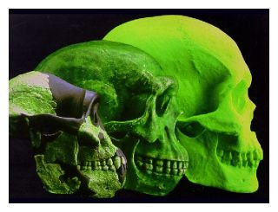
Are we still evolving?
Microevolution: change in gene frequency - YES
Macro evolution : formation of species - NO

Slide 128
Are we genetically different from our Homo sapiens ancestors who lived 10-20,000 years ago? The answer is almost certainly yes. In fact, it is very likely that the rate of evolution for our species has continuously accelerated since the end of the last ice age, roughly 10,000 years ago.
This is mostly due to the fact that our human population has explosively grown and moved into new kinds of environments, including cities, where we have been subject to new natural selection pressures.

Slide 129
For instance, our larger and denser populations have made it far easier for contagious diseases, such as tuberculosis, small pox, the plague, and influenza to rapidly spread through communities and wreak havoc. This has exerted strong selection for individuals who were fortunate to have immune systems that allowed them to survive.

Slide 130
There also has been a marked change in diet for most people since the end of the last ice age. It is now less varied and predominantly vegetarian around the globe with a heavy dependence on foods made from cereal grains. It is likely that the human species has been able to adapt to these and other new environmental pressures because it has acquired a steadily greater genetic diversity.

Slide 131
A larger population naturally has more mutations adding variation to its gene pool simply because there are more people. This happens even if the mutation rate per person remains the same. However, the mutation rate may have actually increased because we have been exposed to new kinds of man-made environmental pollution that can cause additional mutations.

Slide 132
It is not clear what all of the consequences of the environmental and behavioral changes for humans have been. However, it does appear that the average human body size has become somewhat shorter over the last 10,000 years, and we have acquired widespread immunity to the more severe effects of some diseases such as measles and influenza.

Slide 133
The Future
It remains to be seen
how we will use this technology in the future
and whether we will continue as a species,
evolve into another species,
or become extinct as many groups have before us

