Slide 1
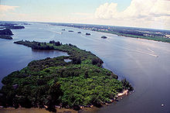
Indian River Lagoon Ecology

Slide 2
What is a lagoon?
Lagoons are shallow coastal bodies of water separated from the ocean by a series of barrier islands which lie parallel to the shoreline. Inlets, either natural or man-made, cut through barrier islands and permit tidal currents to transport water into and out of the lagoons.

Slide 3
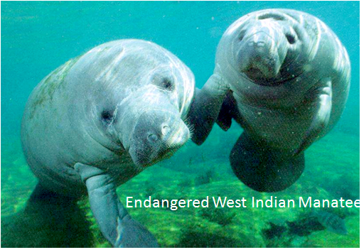
What is a lagoon?
Lagoons are classified into 3 main types:
-leaky lagoons
-choked lagoons
-restricted lagoons

Slide 4
What is a lagoon?
Leaky lagoons have wide tidal channels, fast currents and unimpaired exchange of water with the ocean.
Choked lagoons occur along high energy coastlines and have one or more long narrow channels which restrict water exchange with the ocean. Circulation within this type of lagoon is dominated by wind patterns.

Slide 5
What is a lagoon?
Restricted lagoons have multiple channels, well defined exchange with the ocean, and tend to show a net seaward transport of water. Wind patterns in restricted lagoons can also cause surface currents to develop, thus helping to transport large volumes of water downwind. The Indian River Lagoon is a restricted type lagoon.

Slide 6
What is a lagoon?
Along the length of this narrow water corridor, a diverse variety of natural habitats are linked to form a complex coastal ecosystem.
The Indian River Lagoon exchanges seawater with the ocean between two natural inlets (Ponce de Leon and Jupiter), three man-made inlets (Sebastian, Fort Pierce, St. Lucie) and a lock system at Port Canaveral, which limits water exchange between the Atlantic Ocean and the Banana River Lagoon.

Slide 7
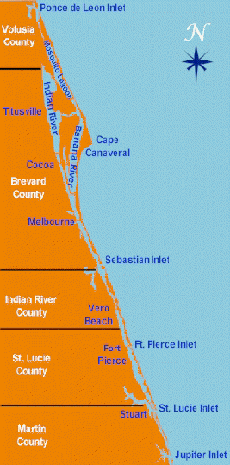
The Indian River Lagoon
is a grouping of three
lagoons:
Mosquito Lagoon,
Banana River and the
Indian River.

Slide 8
What is a lagoon?
This limited exchange with the ocean is the reason these estuaries (places where salt and fresh water mix) are referred to as lagoons - shallow bodies of seawater generally isolated from the ocean by a series of barrier islands.

Slide 9
IRL
The Lagoon is 156 miles long and extends from Ponce De Leon Inlet in Volusia County to Jupiter Inlet in Palm Beach County.
The Lagoon varies in width from 1/2 to 5 miles and averages just 3 feet (0.91 m) in depth.

Slide 10
IRL
The IRL is a complex mosaic of a variety of ecosystems ranging from terrestrial to freshwater, brackish and marine. These systems interact with one another to create an environmental complex having incredible habitat diversity.

Slide 11
IRL
Because the IRL straddles the transition zone between colder temperate and warmer sub-tropical biological provinces, tropical and temperate species coexist and thrive. This unique feature of the IRL accounts for much of its high biological diversity and helps distinguish the IRL from other estuarine systems.

Slide 12
IRL
It serves as a spawning and nursery ground for many different species of oceanic and lagoon fish and shellfish. The lagoon has one of the most diverse bird populations anywhere in America.

Slide 13
IRL
Nearly 1/3 of the nation’s manatee population lives here or migrates through the Lagoon seasonally. In addition, its ocean beaches provide one of the densest sea turtle nesting areas found in the Western Hemisphere.

Slide 14
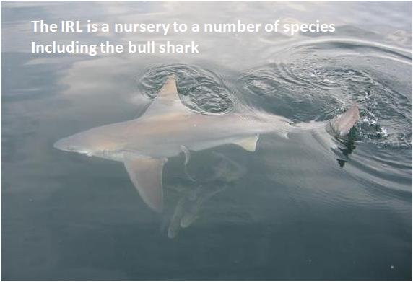
IRL
The IR Lagoon is home to more plant and animal species than any other estuary in North America, with more than 2,200 different species of animals and 2,100 species of plants.

Slide 15
IRL
The IRL is shallow, and as such, is strongly influenced by precipitation and evaporation. Heavy rains, storm water runoff, freshwater releases, and periods of drought all contribute to fluctuations in water temperature and salinity.

Slide 16
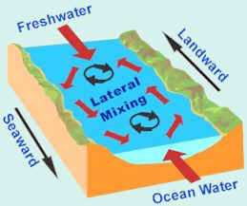
IRL
In terms of salinity, the IRL is a well mixed estuary because it is also heavily influenced by wind patterns and to some extent by the tides.
The southern Lagoon has more ocean inlets so tides play a larger role in that area.

Slide 17
IRL
Wind not only has the effect of vertically mixing the water column, it also influences surface currents that increase mixing. This results in a vertical profile of the water column where virtually no change in salinity is observed from the surface to the bottom.
In contrast, salinity does decrease horizontally with distance from the ocean.

Slide 18
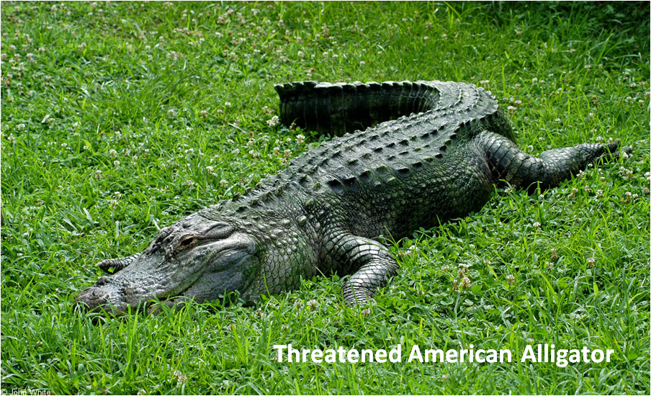
IRL
Because tidal effects decrease as distance from an inlet increases, wind is also the primary mechanism of volume transport in the interior of the IRL.

Slide 19
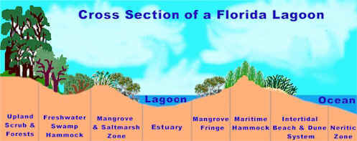
HABITATS
Because of the estuarine nature and the barrier islands and sandy soil, the IRL has a variety of habitats.

Slide 20
IRL DIVERSITY
Covered by saltwater at high tide and exposed to air during low tide, many of the areas of the lagoon present a hostile environment to plants.
However, mangrove trees thrive and provide roosting areas for birds and a nursery for crabs, fish, and other creatures.

Slide 21
Mangroves
Mangrove trees also filter sediments, nutrients and other pollutants from runoff before it reaches the lagoon.

Slide 22
Mangroves
The three types of mangroves found in Florida include the Red Mangrove (Rhizophora mangle), the Black Mangrove, (Avicennia germinans) and White Mangrove, (Laguncularia racemosa).
The three are only distantly related. Each belongs to a different family.

Slide 23
Red Mangrove
The red mangrove is the most noticeable of the three Florida mangrove trees. It grows in the deepest water and its arching prop roots support the tree above the water as if it were walking on stilts.
Wart-like lenticels on these prop roots provide openings where oxygen can be taken in and pumped through the system to the underground roots growing in the anaerobic mud.

Slide 24
Red Mangrove
Since red mangroves grow close together, their roots form an impenetrable tangled network which slows down the movement of water underneath the trees. This causes a deposition of sediment and traps an enormous collection of debris. This build up of sediment and debris under the right conditions can create a thick layer of organic peat.

Slide 25
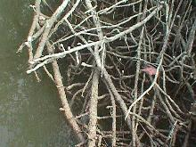
Red Mangrove

Slide 26
Red Mangrove
The leathery evergreen leaves of the red mangrove form a dense canopy which are highly efficient in converting sunlight to organic molecules. Sprinkled in among the leaves are yellow and white flowers.
The red mangroves have an unusual reproductive adaptation enabling the seedling to survive in the watery environment. The seed germinates from the fruit while it is still attached to the parent tree. Many fruits with finger-like seedlings, often twelve or more inches in length, can be seen hanging in clusters

Slide 27
Red Mangrove
. When mature, the seedlings break free from the fruit and fall into the water. Some may stick in the soft mud around the base of the parent tree and begin to grow. Many more float around with the tide. After floating in the water for a short period of time, the pointed end absorbs water and begins to sink. When the seedling becomes grounded in the mud. roots are quickly produced from the pointed end and the seedling begins to put out leaves.

Slide 28
Red Mangrove

Slide 29
Black Mangrove
The black or honey mangrove usually forms a zone behind that of the red mangrove. This tree takes its name from its dark scaly bark. Black mangroves usually grow in soils that are exposed to the air at low tide but covered by high tide. Where they seldom experience frost, black mangroves can develop into large trees over 50 feet tall.

Slide 30
Black Mangrove
Their 2 to 4 inch long leaves are dark green above with silvery, hairy undersides. In these leaves there are special glands that excrete salt extracted from the water taken in by the roots. The salt often forms a white crust-like coating on their upper surface.

Slide 31
Black Mangrove
Black mangroves have small white flowers which produce abundant nectar used by bees. They have no prop roots, but their root system produces many slender upright aerating roots known as pneumatophores. They cover the muddy soil around the base of the tree and supply the root system with oxygen

Slide 32
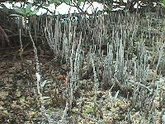
Black Mangrove

Slide 33
Black Mangrove
Black mangrove seeds are the size and shape of very large lima beans. They germinate as soon as they fall into the water. The seedlings are smaller than the red mangrove seedlings so they are washed farther up into the forest by tides. Here they become entangled in mats of detritus trapped by the mangrove roots and begin to grow.

Slide 34
White Mangrove
White mangroves grow in sandy soils at the upper edge of the intertidal zone. Their round pale green leaves are notched at the tip and have a pair of salt excreting glands on either side of their petioles. The white mangroves have small peg roots which help anchor them in the sandy soil

Slide 35
White Mangrove
The small green seeds of the white mangroves begin to develop after they fall into the water. Over time they turn brown and wrinkled. Due to their small size, the white mangrove seeds are carried high In the swamp by the tide. When the seeds are finally deposited in the strand line, they germinate. The seedlings quickly put down roots and produce a pair of notched tip leaves.

Slide 36
White Mangrove

Slide 37
Ecological Value of Mangroves
Every part of the mangrove forest, from the roots to the top most branches, which may reach as high as 60 feet, provide shelter or food for a multitude of creatures .These organisms range from tiny sand flies to large tarpon offshore.

Slide 38
Ecological Value of Mangroves
One of the birds that finds its home In the tree tops of the mangroves is the brown pelican. The pelicans share their "rookeries" with egrets, herons. wood storks, ospreys, and cormorants.

Slide 39
Ecological Value of Mangroves
A host of other creatures make use of the mangroves to forage. Raccoons favor the coon oysters that live on the prop root of the red mangrove. Spiders weave many webs to catch unsuspecting insects. Snakes slither up the tree trunks after birds' eggs and nestlings, and cormorants dine chiefly on the fish in the nearby waters.

Slide 40
Ecological Value of Mangroves
Fiddler crabs and their larger relatives the land crabs move out during the low tide to perform a large service. They aerate the soil as they probe the sediment for food, thereby increasing the supply of oxygen to the trees that attract the creatures.

Slide 41
Ecological Value of Mangroves
However, when the tide comes in covering the roots and pneumatophores of the mangrove forest, it becomes part of a marine nursery. The mangrove forest provides a place where young fish, as well as other organisms such as blue crabs, are protected from predators and competing species which are unable to enter the lower salinity water.

Slide 42
Ecological Value of Mangroves
Oysters, barnacles, and sponges along with the ribbed mussels are found in great quantities in the mangrove root zone.

Slide 43
Seagrass
Seagrasses are flowering vascular plants that inhabit shallow areas of oceans, estuaries, and lagoons worldwide. They are the only flowering plants that live their entire lives totally in seawater. Seagrass beds are one of the most important habitats of the Indian River Lagoon.

Slide 44
Seagrass
Although seagrasses are flowering plants and produce seeds through sexual reproduction, the major mode of reproduction is asexual, through extension of underground parts. Thus, seagrass beds are composed of one to many clones, each of which can be quite extensive.

Slide 45
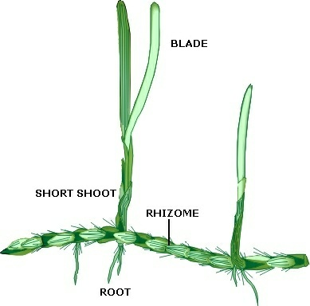
Seagrass
Major parts of a typical seagrass include the blade, which is the main photosynthetic organ, and the short shoot, which is analogous to a land plant stem.

Slide 46
Seagrass
The rhizomes are mostly underground organs that function in anchoring the plant to the substrate, in the movement of nutrients and waste products throughout the clone, and in extension and asexual reproduction of the clone. The roots function as anchoring devices and also absorb nutrients and excrete waste products

Slide 47
Seagrass meadows
In the Lagoon, these seagrasses form “meadows”, which are spawning areas where the grass grow up to three feet tall.
They provide habitat for many organisms and form the basis of the food web

Slide 48
Seagrass
Six species of seagrass are found in the Indian River Lagoon. The
most common are turtle, shoal and manatee grasses.
Seagrass beds are excellent habitat for many fish, crustaceans and shellfish, and are critical nursery areas for young marine animals.
Bay scallops, blue crabs and spotted sea trout are examples of species that depend on seagrass beds.
Seagrasses are also a major part of the diets of manatees and sea
turtles and are substrate for epiphytic (attached) algae, a critical component of the marine food web.

Slide 49
Seagrass
Within the Indian River Lagoon, seagrass is a primary indicator of overall estuarine health. The extent and health of the seagrass community is dependent on good water quality and is a good indicator of water quality trends in the IRL.

Slide 50
Seagrass
Interpretation of aerial photographs taken in 1943 of the IRL found approximately 62,000 acres of seagrass in the IRL. This figure has served as a benchmark for seagrass restoration in the IRL.

Slide 51
Seagrass
Seagrass surveys done in 1992 found approximately 58,000 acres of seagrass with substantial losses of seagrass acreage (up to 80 percent) in most urbanized segments.

Slide 52
Impacts to Seagrasses
Over the past 20 years, losses of seagrasses along the lagoon have been severe, with some areas losing up to 95 percent of their coverage. Other areas, however, have remained stable and productive.

Slide 53
Impacts to Seagrasses
Reduced light transmittance through the water column has been one of the major factors implicated in losses of seagrass coverage. Seagrass loss due to light attenuation usually starts at the outer (deeper) edge of the beds, where the light reaching the plants is only marginal, and progresses towards the shallower regions as conditions deteriorate. content

Slide 54
Impacts to Seagrasses
Several factors are important in reducing light penetrating to a given depth of the water column:
Absorption by other floating vegetation.
Suspended and dissolved substances.
Color due to dissolved organic materials.
Eutrophication (excessive organic production and nutrient

Slide 55
Spoil Islands
Over 200 Spoil islands were created in the 1950s when the Inter coastal was dredged.
The excess dirt was just piled up and created these islands.
Although the dredging did significant damage to seagrass beds, over time the islands are now home to mangrove trees.

Slide 56
Location of spoil islands off Sebastian

Slide 57
OYSTER REEFS
Oyster reefs in Florida are found in near shore areas and estuaries of both coasts, but grow especially vigorously near estuarine river mouths where waters are brackish and less than 10 meters deep.

Slide 58
OYSTER REEFS
Within the Indian River Lagoon, oyster reefs may be found in the vicinity of spoil islands and impounded areas. In addition to being commercially valuable, oyster reefs serve a number of important ecological roles in coastal systems: providing important habitat for a large number of species; improving water quality; stabilizing bottom areas, and influencing water circulation patterns within estuaries.

Slide 59
SALT MARSHES
By the 1970s, 75 percent of lagoon salt marshes were lost. Dikes built to separate 40,400 acres from the lagoon to control mosquito breeding eliminated juvenile fish nursery grounds.

Slide 60
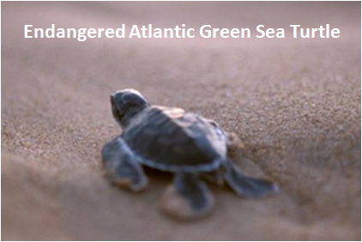
A Lagoon in Peril
One of the more prevalent ecological problems to the Indian River Lagoon is storm water runoff.
Unlike natural runoff that occurred before human development, storm water runoff comes from our roadways, parks, golf courses and other sources.

Slide 61
A Lagoon in Peril
Every summer storm sends millions of gallons of runoff into the lagoons sending petroleum products from roadways and nitrates/phosphates and other chemicals from yards and manicured landscaping.
Wastewater and storm water discharges deposit freshwater and pollutants promoting algal growth and seagrass destruction.

Slide 62
A Lagoon in Peril
In 1985, 45 domestic Wastewater Treatment Plants discharged more than 39 million gallons per day of treated wastewater to the IRL. These plants discharged more than 1.7 million pounds of total nitrogen, 400,000 pounds of total phosphorous and 1.5 million pounds of total suspended solids to the IRL each year.

Slide 63
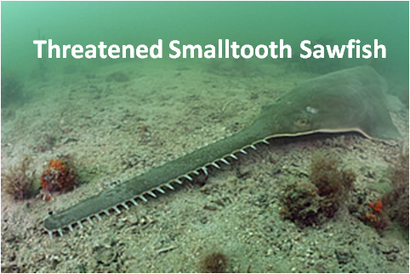
A Lagoon in Peril
While raw sewage has been greatly eliminated from the lagoon, treated sewage and waste are evasive and killing tens of thousands of acres of sea grass each decade.

Slide 64
A Lagoon in Peril
St. Johns River marshes and Lake Okeechobee discharges were drained into the lagoon. Excessive freshwater degrades shellfish habitat and carries soils and pollutants (primarily nitrogen and phosphorus) into the lagoon, fostering algal growth and killing sea grasses.

Slide 65
Progress
The Surface Water Improvement and Management (SWIM) Act of 1987 (Chapter 373.453 373.459, Florida Statutes) was established to aid in the restoration of priority water bodies throughout Florida.

Slide 66
SWIM
The program is designed to develop and execute a combination of research and practical implementation projects to protect or restore the environmental resources of the St. Lucie Estuary and Indian River Lagoon. The program has three goals:

Slide 67
SWIM
Attain and maintain water and sediment of sufficient quality to support a healthy, seagrass-based estuarine ecosystem
Attain and maintain a functioning seagrass ecosystem which supports endangered and threatened species, fisheries and wildlife
Achieve heightened public awareness and coordinated interagency management

Slide 68
IRL NEP
The Indian River Lagoon National Estuary Program (IRL NEP), is one of 28 NEPs across the country, and was established in 1990. The IRL NEP is comprised of the Advisory Board, the Citizens Committee, and the Technical Committee.

Slide 69
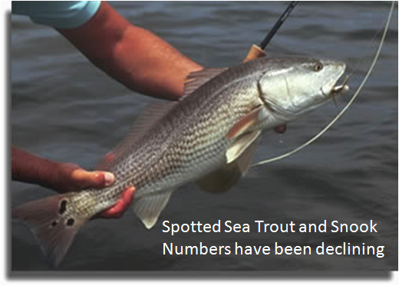
IRL NEP
The Advisory Board manages the IRL NEP including development and implementation of the Comprehensive Conservation and Management Plan (CCMP). The St. Johns River Water Management District administers the IRL NEP with four full-time IRL NEP employees.

Slide 70
IRL NEP
The NEP model is a non-regulatory approach to coastal watershed restoration with 4 goals:
1) A watershed/ecosystem focus that moves beyond political jurisdictions,
2) Integration of good science with sound decision-making,
3) Collaborative problem- solving
4) Public involvement

Slide 71
Progress
Today, there has been a greater than 90% reduction in nutrients and suspended solids discharged from domestic treatment plants to the IRL since 1985. This reduction in pollutant loadings has been reflected in lower nutrient and chlorophyll a concentrations in the IRL as well as an increase in sea grass beds.

